Slide 1
Do Now
Turn in the two assignments from yesterday stapled together if you did not finish them yesterday
Pick up the sheet from the front table. This is your Do Now. Finish this quickly so we can get into World War II

Slide 2
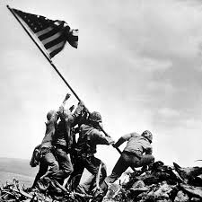
World War II
1939-1945

Slide 3
Major Causes of WWII
Militarism
Italian fascism
Nationalism
Treaty of Versailles: German resentment
Depression: Worldwide
American isolationism
Nazism and Hitler
Communism (& anti-sentiments)
Expansionism (Japan)

Slide 4
Allied and Axis Powers
Allied powers
Axis powers
U.S.
Britain
France
USSR
Australia, Belgium, Brazil, Canada, China, Denmark, Greece, Netherlands, New Zealand, Norway, Poland, South Africa, Yugoslavia
Germany
Italy
Japan
Hungary, Romania, Bulgaria

Slide 5
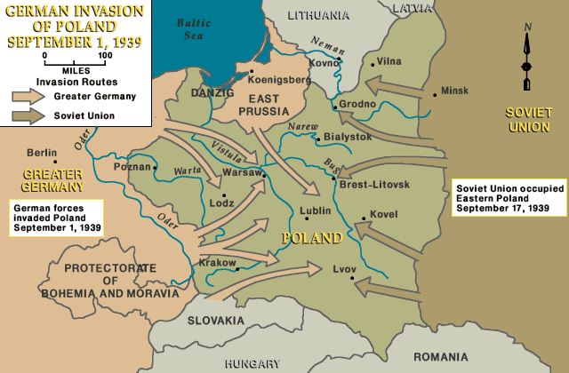
Germans Invade Poland
September 1, 1939 – Germany invades neighboring Poland with 1.5 million troops
September 3, 1939 – Britain and France declare war on Germany
September 29, 1939 – Nazis and Soviets divide up Poland
Hitler and the Germans used a military attack called blitzkrieg, or “lightning war,” to quickly move through Poland
Blitzkrieg: armored divisions smashed through enemy lines and isolated segments of the enemy, which were encircled and captured by motorized German infantry while the panzer tanks rushed forward to repeat the pattern

Slide 6
World War II in Europe

Slide 7
World War II in Asia

Slide 8
Axis Powers

Slide 9
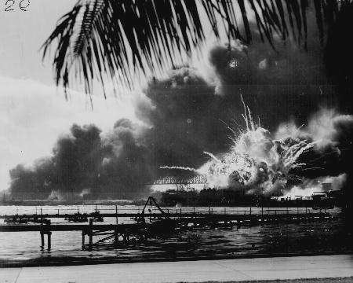
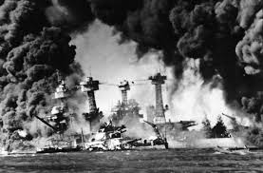
Pearl Harbor
December 7, 1941 – Japan bombs the United States in a surprise air raid in Pearl Harbor off the coast of Hawaii killing more than 2,500 Americans
December 8, 1941 – U.S. and Britain declare war on Japan
December 11, 1941 – Hitler declares war on the U.S.

Slide 10
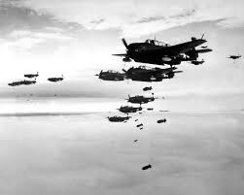
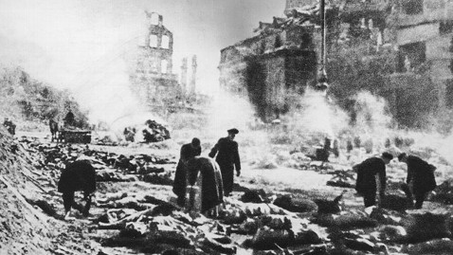
Bombings
Between 1939 and 1945 the Allies dropped 3.4 million tons of bombs, an average of about 27,700 tons of bombs each month

Slide 11
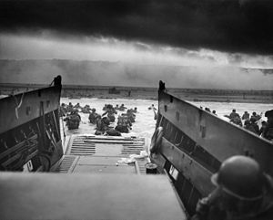
D-Day
On June 6, 1944 the Allies executed the largest sea invasion in history of Normandy to take back France from the Germans
The Allied powers lost an incredible amount of soldiers (over 10,000) compared to only 1,000 Axis soldiers
However, this was the turning point for the Allied powers who then gained back their land and forced the Germans out of France
https://youtu.be/flh8DNmqMSA
https://youtu.be/fdViodeace8
https://youtu.be/jtEOOgg5CP4

Slide 12
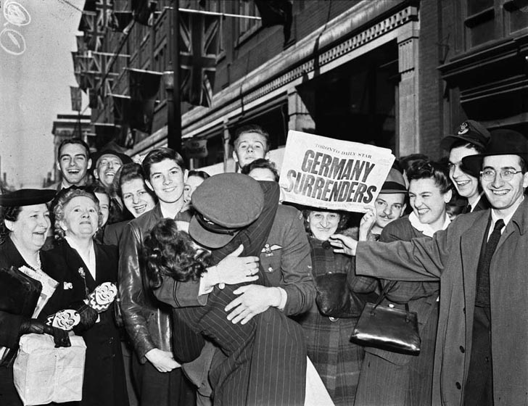
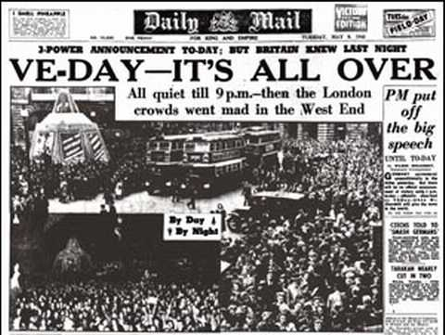
V-E Day – Victory in Europe
April 21, 1945 – The Allied Powers reach Berlin, Germany (the capital)
April 28, 1945 – Mussolini is captured and hanged by the Allies
April 30, 1945 – Sensing defeat, Hitler commits suicide
May 7, 1945 – Germany surrenders to the Allies and the war ends on the Western Front

Slide 13
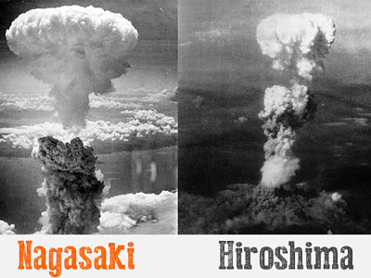
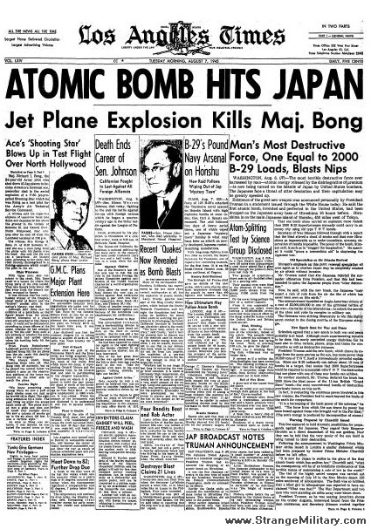
V-J Day – Victory in Japan
July 16, 1945 – First U.S. atomic bomb test
August 6, 1945 – First atomic bomb dropped, on Hiroshima, Japan.
August 9, 1945 – Second atomic bomb dropped, on Nagasaki, Japan.
August 14, 1945 – Japan surrenders

Slide 14
Was the Atomic Bomb the Right Decision?
Between 60,000 and 80,000 people were killed instantly. The heat from the bomb was so intense that some people simply vanished in the explosion. Many more died of the long-term effects of radiation sickness. The final death toll was calculated at 135,000.

Slide 15
The Deadliest War in History
Battle Deaths | 15,000,000
Battle Wounded | 25,000,000
Civilian Deaths | 45,000,000
http://www.nationalww2museum.org/learn/education/for-students/ww2-history/ww2-by-the-numbers/world-wide-deaths.html

