Slide 1
Warm Up
Pick up an article as you enter (“Muslims Will Outnumber Christians This Century, Pew Says”)
Answer the following questions in your warm up book after you read the article:
What’s the main idea of the article?
Where are most Christians located? Muslims?
Why do the authors say Muslims will outnumber Christians by the year 2070?
Give me an example of a piece of evidence they use to support their claim of why Muslims will outnumber Christians in 2070.
What effect will/could this change have on the world?

Slide 2
Warm Up
We only have until 9:30 today because of the assembly, so we need to get started quickly
We are going to take some notes so take out your binders

Slide 3
World Religions

Slide 5
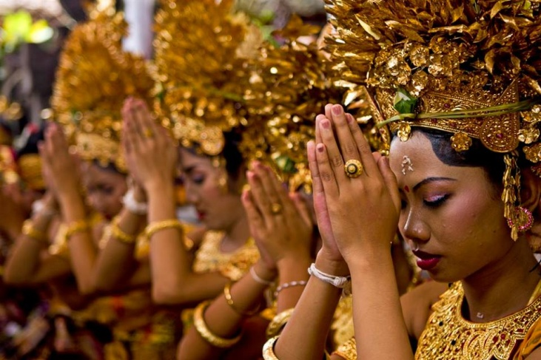
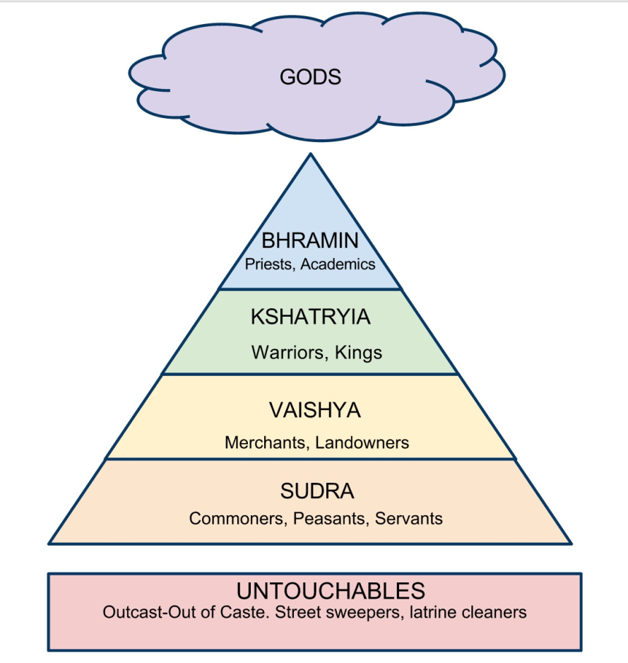
Hinduism
Polytheistic
Began in Ancient India
Some gods are Brahma, Vishnu, and Shiva
Believe in Karma, Dharma, and
Reincarnation
Caste System: rigid class structure based
on Hinduism

Slide 6
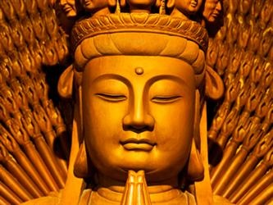
Buddhism
Polytheistic
Founded by Siddhartha Gautama (Buddha) in India
Dalai Lama is the spiritual leader of Buddhists
Believes in Kharma, Dharma, and Reincarnation
Four Noble Truths
Life is full of pain and suffering
Human desire causes this suffering
By putting an end to desire, humans can end suffering
Humans can end desire by following the Eightfold Path

Slide 7
Shintoism
Philosophy, not a religion
Originated in Japan
Kami: spirits that inhabit everything in the world; mountains, rivers, plants, and animals

Slide 8
Judaism
First monotheistic religion
Founder: Abraham
Developed in the Middle East and around current-day Israel
Holy Texts: Torah and Talmud
Ten Commandments
Served as the basis for Christianity and Islam

Slide 9
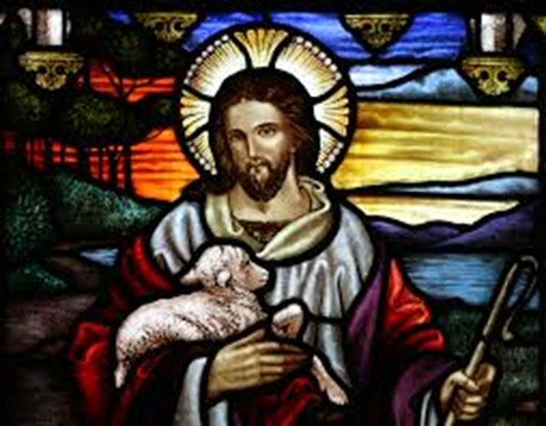
Christianity
2nd monotheistic religion
Founder: Jesus
Developed around current-day Israel in the Middle East
Holy Text: The Bible
Believes Jesus is the messiah, son of God

Slide 10
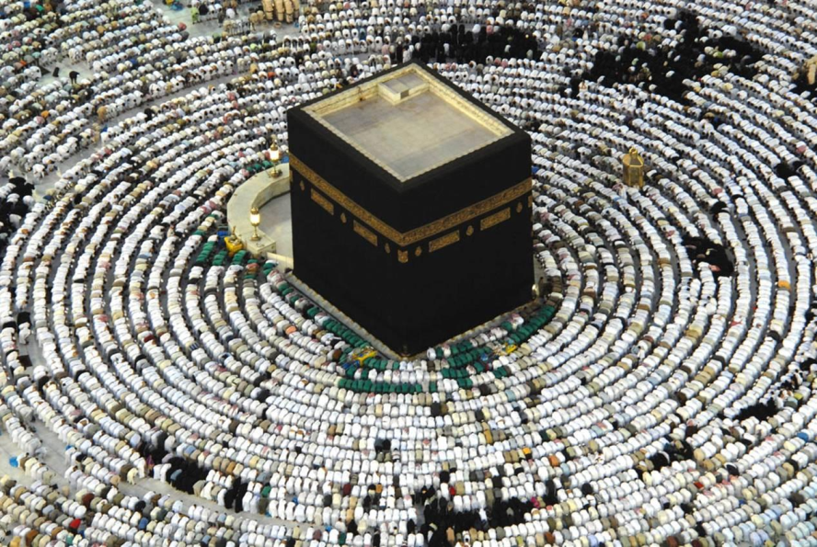
Islam
3rd monotheism (Allah)
Followers are called Muslims
Founder: Mohammed in the Middle East
Holy Text: Qur’an
Hijra: Mohammed’s journey from Mecca to Medina
Teachings and Beliefs: Mohammed is the prophet of Allah. Five Pillars of Islam → rules in order to lead an ethical life
Confession of Faith
Prayer
Charity
Fasting
Pilgrimage

Slide 11
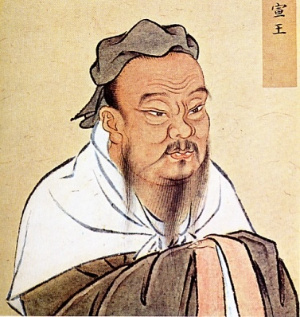
Confucianism
Philosophy, not a religion
Founder: Kung Fu Zi, later became known as Confucius
Developed in China
Key Text: The Analects
Teachings and Beliefs: There is a natural order to society which is explained by the Five Relationships and to keep order, individuals must know and do what is expected of them.
Ruler to ruled
Father to son
Older brother to younger brother
Husband to wife
Friend to friend

Slide 12
World Religion DBQ
Step 1: Read the documents and answer the questions that follow
Step 2: By the star, list the religion that the document is describing
Step 3: Read the essential question at the end
Step 4: Decide which three religions you are going to cover in your answer and which documents you will use as evidence
Step 5: Write your answer to the essential question
Step 6: Edit your response, looking for the following:
Did you answer all parts of the question?
Did you provide evidence for each answer and cite that evidence?
Grammar, spelling, punctuation, capitalization

