Slide 1
Absolutism

Slide 2
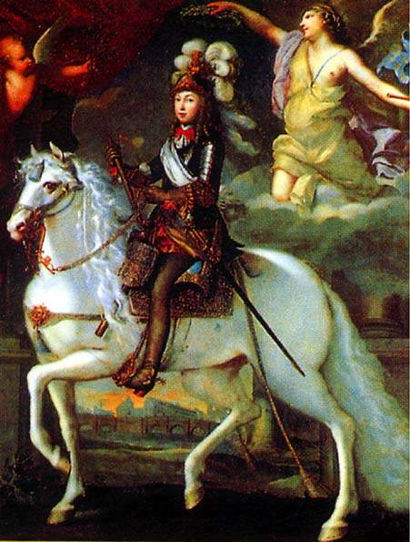
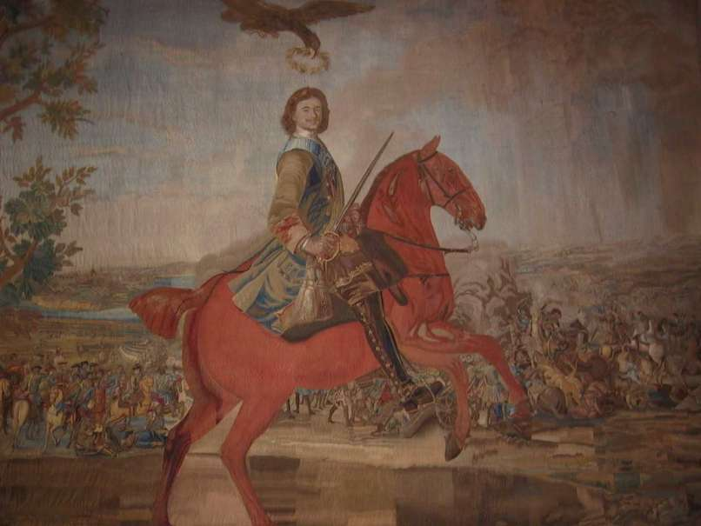
Divine Right
The power for the monarch to rule comes from God and that the king is an agent of God.
Absolute monarchs used this power to justify their rule.
Divine Right allowed the monarch to control all aspects of the government because the people believed that monarch was God’s agent on earth.

Slide 3
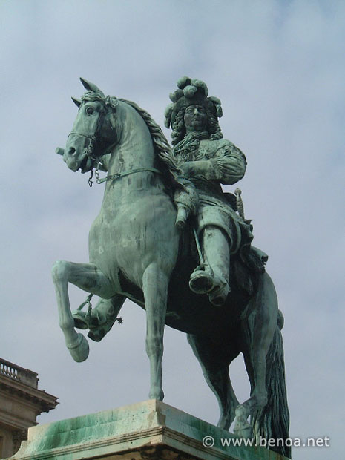
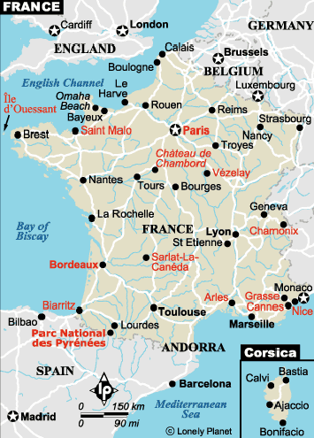
  Louis XIV(14)
  He was the 14th king of France.
  He was an absolute Monarch during the 17th century.
  Louis XIV was the only one to totally free himself from the Parliament, which controlled the King.
  Louis XIV coined the phrase “L'état, c'est moi”, which means “I am the state.”
  Louis XIV centralized the government and made all the laws for France
  Louis XIV put France into debt by spending money building the Palace of Versailles and fighting wars.

Slide 4
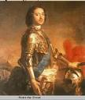

Peter the Great
Peter the Great was an absolute monarch in Russia, he was the czar from 1682 to 1725.
He worked to centralize royal power
Reduced the power of nobility and gained control of the Russian Orthodox Church.
Peter wanted to modernize Russia. He traveled from Western European cities to study western technology and brought back the ideas to westernize Russia.
  Simplified Russian Alphabet, developed mining and textiles.
Peter sometimes resorted to force and terror to achieve his goals.
Created the largest army in Europe in the late 1600s and used it to expand Russian territory.

Slide 5
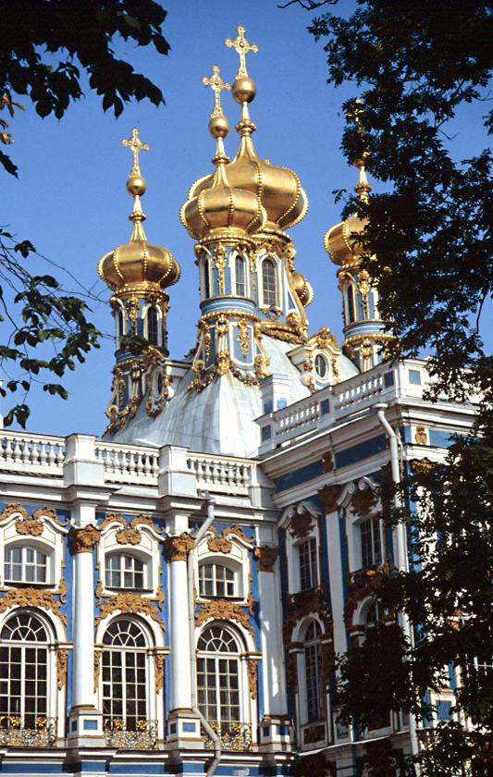
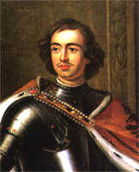
Westernization under Peter
Peter wanted a modernized Russia, went to Western Europe to study technology, brought back ideas, simplified the Russian alphabet, developed mining and textiles, capital at St. Petersburg served as symbol of new Russia, used force and terror to gain goal

Slide 6

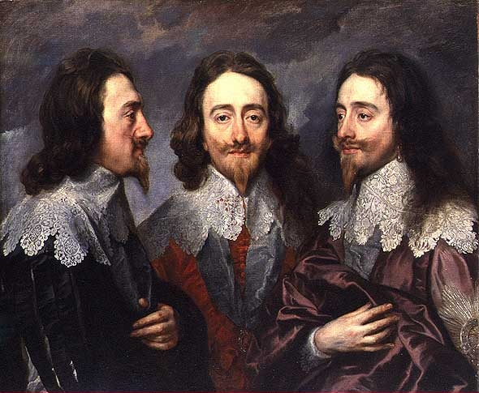
Petition of Rights(1628)
King Charles I had to call Parliament to ask for money
They refused to give him any until he signed the Petition of Rights
In the Petition the king agreed to:
  Not imprison subjects without due cause
  Not levy taxes without Parliament’s consent
  Not house soldiers in private homes
  Not impose martial law in peacetime
The king agreed to the Petition but after he ignored it
The petition was important because it set forth the idea that the law was higher even then the king.

Slide 7
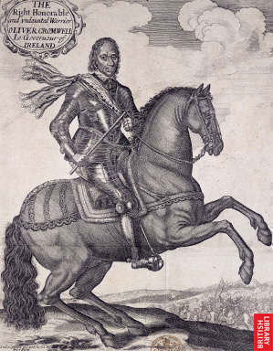
English Civil War
Charles I offended the puritans by upholding church rituals and a former prayer book
Charles tried to force the Presbyterian Scots to accept a version of the Anglican prayer book
Lead to a conflict between the supporters of parliament and the supporters of English monarchy from 1642-1649

Slide 8
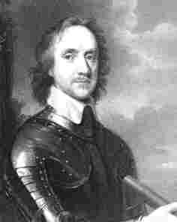
Oliver Cromwell
Was a skilled military leader who overthrew the British king.
King Charles I was put in prison and put on trial. He was sentenced to death by way of beheading. He was the first king to be executed by his own subjects.
After the kings execution Parliament’s House of commons abolished the monarchy, the House of Lords, and the official Church of England. England became a Commonwealth.
Charles II the heir to the throne revolted against Cromwell and attacked England from Ireland and Scotland. Cromwell sent troops into Ireland and Scotland to crush the uprising.
Cromwell took the title of Lord Protector. At the time of his death in 1658 many people were tired of Puritan rule.

Slide 9
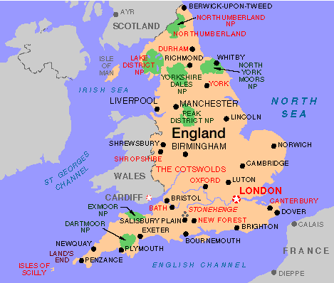
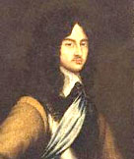
The Restoration
During the year of 1660, Parliament asked Charles II to become the King of England.
When Parliament asked Charles II to become King it marked the restoration of the Stuart monarchy.
In 1685 James II, who was Charles brother inherited the throne in England.
James II who was currently King in England, was unpopular to the people because of his Catholicism and his Absolutist policies.

Slide 10
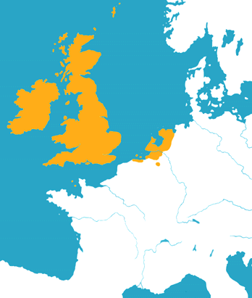
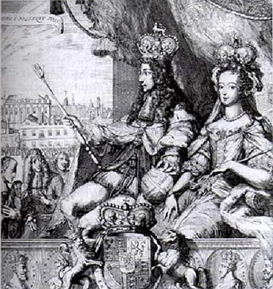
The Glorious Revolution (1688)
Parliament feared Catholic dominance
Mary and William (Dutch) take English throne.
Both protestant.
When they arrived, James II fled.
Bloodless overthrow of power.

Slide 11
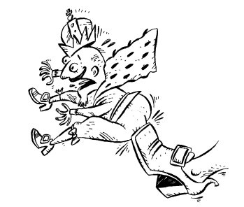
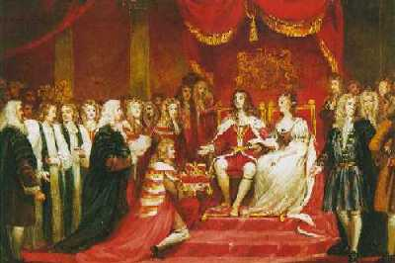
English Bill of Rights
The bill was drafted in 1689.
England had become a constitutional monarchy meaning there were laws that limited the ruler’s power.
The English Bill of Rights listed the things the leader could not do.
There were four laws- 2 dealt with not interfering with Parliament speech or laws and 2 dealt with not taxing the citizens without the consent of Parliament and letting the citizens petition.

Slide 12
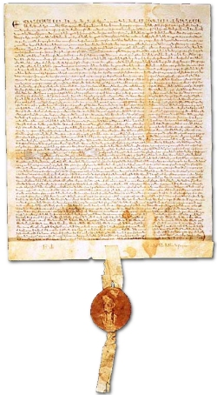
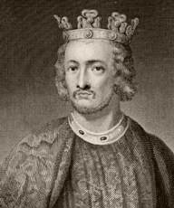
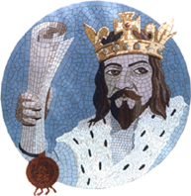
Magna Carta
“Great Charter”
A document guaranteeing basic political rights in England, drawn up by nobles and approved by King John in A.D. 1215.
This charter was a form of revolt, rebelling against the unfair leadership of King John.
John failed as a military leader. He was horrible to his subjects and tried to squeeze money out of them. To finance his wars, John raised taxes to an all-time high.
The nobles wanted to guarantee certain basic political rights and limit the power of the king.
Guaranteed rights included no taxation without representation, a jury trial, and the protection of the law.

Slide 13
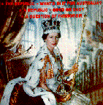

Limited monarchy (1660)
Started after the restoration
Passing of habeas corpus act
Parliament passed the bill of rights in 1689
No monarch could rule without parliaments consent
Also called a constitutional monarchy

Slide 14
Age of Revolutions

Slide 15
Scientific Revolution

Slide 16
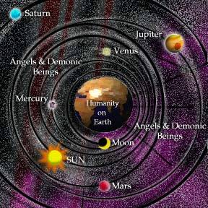
Geocentric Theory
The belief that the earth was the center of the universe and everything else revolved around it.

Slide 17
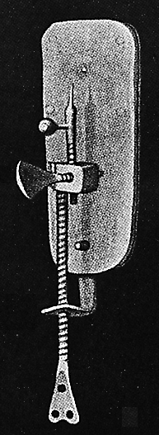
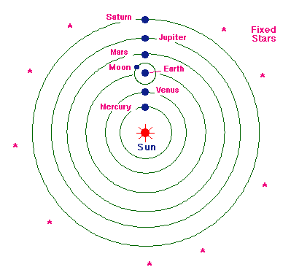
Scientific Revolution
Period of time in which a new way of thinking came about. The beliefs held by many for so long were now being questioned.
Use logic and reason to solve the problems of the world (Secular not church thought)
New ideas about the solar system such as Copernicus’ Heliocentric theory and inventions like Galileo’s telescope allowed scientists to learn more about the universe.
Also, many new medical discoveries were made. Anton van Leeuwenhoek used a microscope and first saw red blood cells.

Slide 18
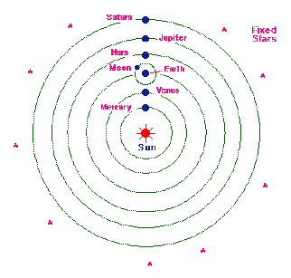
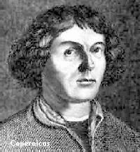
THE SCIENTIFIC REVOLUTION
1500’s when people started to challenge the old ideas about the world
The Scientific Method – approach to science using experimentation and observation
  Copernicus – Heliocentric (theory that the world revolves around the sun)
  Galileo – helped proved Heliocentric theory
  Isaac Newton – Newton’s Laws of Physics
  Brought upon Enlightenment!
  Copernicus Heliocentric Theory

Slide 19


Heliocentric (mid- 1500’s)
Nicholas Copernicus was a Polish scholar who challenged the common belief that the Earth was the center of the universe.
Copernicus suggested that the universe actually revolved around the Sun.
This theory was called heliocentric.
At the time most scholars rejected Copernicus’s theory.

Slide 20

Copernicus-1500’s
Developed the Heliocentric or sun-centered theory
Theory stated that the sun is the center of the universe and that everything revolves around it
It took Copernicus 25 years of studies to come up with this theory
He wrote a book on his findings but feared persecution. He therefore didn’t publish it until 1543. He received a copy of his book on his death bed.

Slide 21
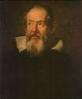
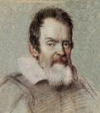
Galileo
Galileo Galilei was a young Italian scholar, who discovered the law of the pendulum and proved Aristotle’s idea to be wrong, by watching a chandelier swing on its chain, and timing it with his on pulse and discovered that each swing of the pendulum took the exact same amount of time.
In another study, Galileo found that falling objects accelerate at a fixed and predictable rate. He again proved Aristotle’s findings to be wrong. Aristotle had stated that heavier objects fall faster than lighter ones. From the Tower of Pisa, Galileo dropped items of different weights, and calculated how fast each one fell. Contrary to Aristotle’s belief, the objects fell at the same speed.
Galileo had found out that a Dutch lens marker had built an instrument that would allow the looker to enlarge far-off objects. Galileo had not even seen this device, yet he was able to build his own, and with a few adjustments he was able to use his version of the telescope to study the stars.
In 1610, Galileo had a series of newsletters published called the Starry Messenger, which described his astronomical discoveries. He described his findings on the planets, the constellations, etc.
Galileo’s findings led to major conflict with the Church, since his findings proved the Church wrong. The Church did not want its followers to believe Galileo, because if they had known that they were wrong about the Solar System, they might be wrong about religion too.

Slide 22
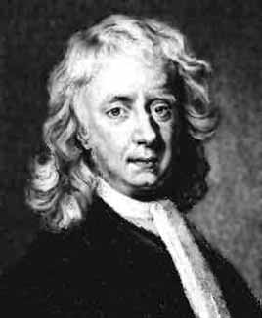
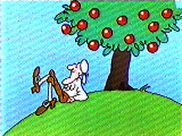
ISSAC NEWTON
Born January 4, 1643; Died March 31, 1727
At 25 years old he began revolutionary advances in math, physics, astronomy and optics.
Sir Isaac Newton created the law of gravity and disproved Aristotle’s idea that every object attracts every other object
In 1967 Isaac Newton published his book Mathematical Principles of Natural Philosophy
This book is one of the most important scientific books ever written.
He discovered that most everything in the universe could be expressed mathematically

Slide 23
Scientific Method (1600’s)
It is a logical procedure for gathering and testing ideas.
    It begins with a question or problem arising from an observation.
    Next you form a hypothesis
    Then test the hypothesis by doing experiments and collecting data
    Lastly, analyze and interpret data to reach a conclusion, that conclusion either proves or disproves your hypothesis
The work of two important thinkers helped to advance the new approach:
Francis Bacon
    An English politician and writer
    He criticized the way both Aristotle and medieval scholars arrived at their conclusions
    He felt that they should experiment first and gather information, and than use that information to draw their conclusions (this is called the experimental method)
Rene Descartes
    Developed analytical geometry, which linked algebra and geometry
    Like Bacon he believed scientists needed to reject old assumptions, but by using mathematics and logic
    Everything should be doubted until proved by reason
    “I think, therefore I am”

Slide 24
Enlightenment

Slide 25

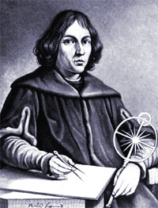
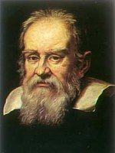
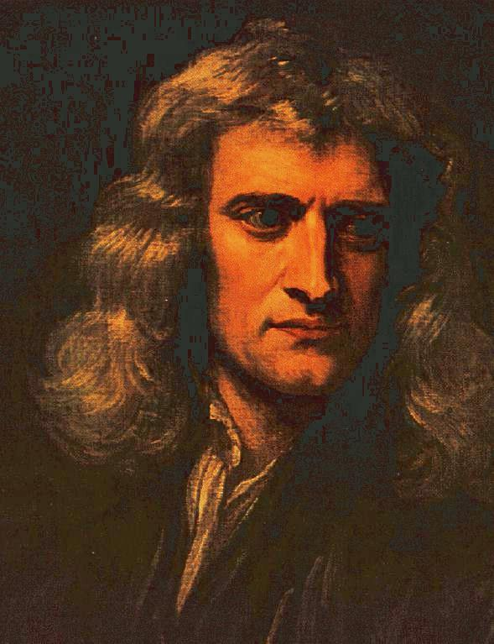

Enlightenment 1500s
Enlightenment was the idea that man could use logic and reason to solve the social problems of the day.
Philosophers spread this idea of logic and reason to the people
Some famous philosophers were John Locke and Jean Jacque Rousseau
This Enlightened thinking lead people to begin to question the ideas of government and the right for absolute monarchs to rule.

Slide 26
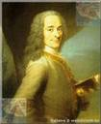

Voltaire
Voltaire lived from 1694-1778. He was one of the great philosophers during enlightenment.
Francois Marie Arouet, or Voltaire, published more than 70 books of political essays, philosophy, history, fiction, and drama.
Voltaire often used satire against his opponents, such as:
The clergy.
The aristocracy
The government
Voltaire was sent to prison twice and exiled to England for two years. On returning to France, he found he liked England’s government more than his own. He then targeted the French government and even began to question Christianity.
Fearing another imprisonment, he fled France.
Voltaire fought for tolerance, reason, freedom of religious beliefs, and freedom of speech.

Slide 27
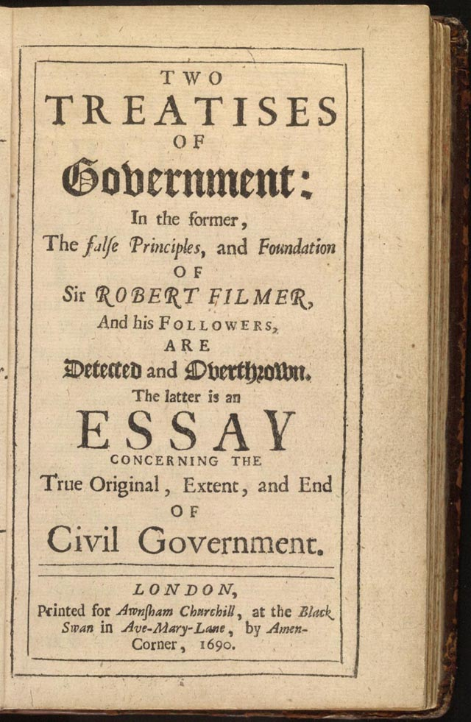
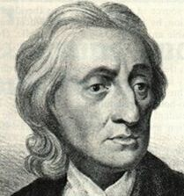
John Locke
Locke was a philosopher who held a positive view on human nature.
He believed people could learn from experience and improve themselves.
He believed people have a natural ability to govern their own affairs and to look after the welfare of society.
Locke criticized absolute monarchs and favored the idea of self-government.
According to Locke all people are born free and equal, with three Natural Rights- Life, Liberty, and Property
The purpose of government, said Locke, is to protect these rights, if it fails to do so, citizens have a right to overthrow it.
The famous novel, Two Treaties of Government was written by John Locke.

Slide 28
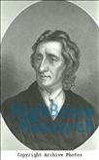
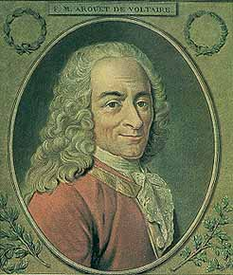
Natural Rights
Laws that govern human behavior
In the early 1700’s during the Enlightenment writers wanted to solve the problems of society
Developed by John Locke in the late 1600’s
People possess natural rights – the rights to life, liberty, and property
People form governments to protect their rights
If a government does not protect natural rights people have a right to overthrow the government
Later inspired American revolutionaries to write the Declaration of Independence

Slide 29
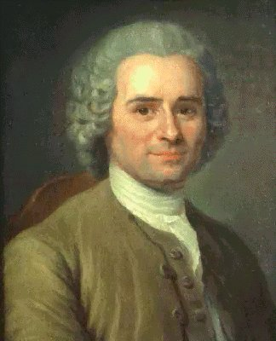

Jean Jacques Rousseau
A French philosopher in the 1700’s.
Wrote the book the Social Contract
Believed that people were naturally good but corrupted by society.
Saw the unequal distribution of property as an evil in society
Believed that government should be run for the good of the majority
If government did not support the majorities rights they had the right to do way with that government.

Slide 30
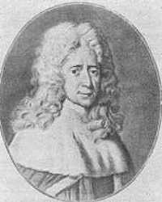

Montesquieu-1740’s
Baron de Montesquieu devoted his studies to political liberty.
He was an aristocrat and a lawyer.
He studied the history of ancient Rome.
With similar beliefs to Voltaire, they both believed that Britain was the best-governed country of their day.
Separation of Powers
His beliefs for separation of government included
- King and ministers held executive power- carried out laws of the state
- The Members of the Parliament held legislative, or the lawmaking power.
- Judges of the English court held the judicial power- interpreted laws and applied them to each case.
His ideas would later be called, “Checks and Balances”
Wrote the book, On the Spirit of Laws. This book stated that separation of powers would keep one branch from overpowering the others.

Slide 31
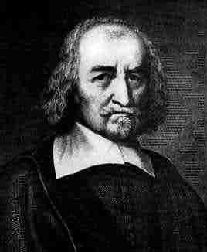
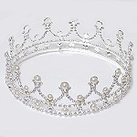
The Social Contract(1651)
During the scientific revolution the social contract was invented by Thomas Hobbs.
The idea behind the contract was that a ruler would have absolute power given to him by the people who were under exact control.
Hobbes invention of this theory was partially due to him seeing the horrors of the English Civil War and coming to the conclusion that all men were wicked and selfish.
Hobbes was a believer in Absolute Monarchy or a ruler’s complete unquestionable control over his/her people.
Absolute monarchy
Thomas Hobbes

Slide 32
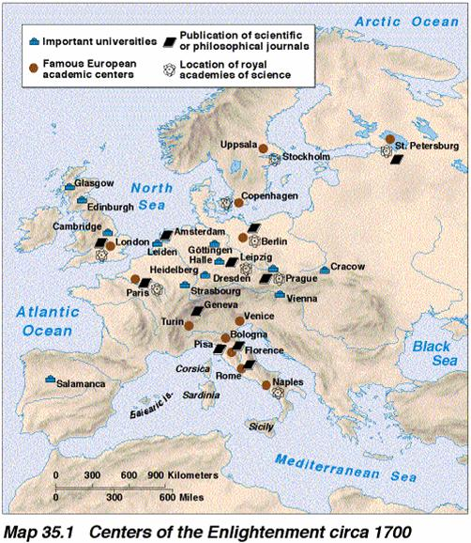
Impact of the Enlightenment
The Enlightenment sparked new political, social, artistic and scientific ideas.
During the Enlightenment people learned to use reason and logic to solve their problems.
New concepts of freedom and individual rights arose.
Philosophers influenced history. For example, many of John Locke’s new political theories were used in the writing of the Declaration of Independence.
People began to question established beliefs in government and social status

Slide 33
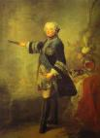
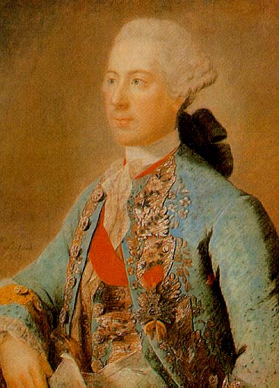
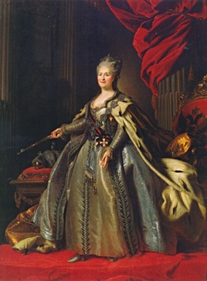
Enlightened Despot (1700)
In the 1700s, Paris was the cultural and intellectual capital of Europe.
Young people from around Europe-and also from the Americas-came to study, philosophize, and enjoy fine culture.
The brightest minds of the age gathered there. From their circles radiated the ideas of the Enlightenment.
…the Enlightenment spirit also swept through Europe’s royal courts.
Many philosophers believed that the best type of government was a monarchy in which the ruler respected the people’s rights.
The philosophers tried to convince monarchs to rule justly.
Some monarchs embraced the new ideas and made reforms that reflected the Enlightenment spirit.
They became known as Enlightened Despots. Despot means absolute ruler.
The enlightened depots supported the philosophers ideas. But they also had no intention of giving up any power.
The foremost of Europe's’ enlightened despots were Frederick II of Prussia, Holy Roman Emperor Joseph II of Austria, and Catherine the Great of Russia.

Slide 34
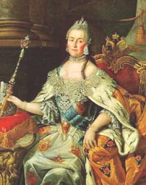
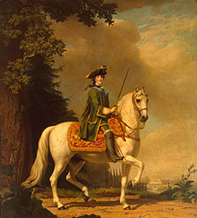
Catherine The Great
Catherine the Great was also known as Catherine II and ruled Russia from 1762-1796.
She was well-educated and read the works of philosophers.
She ruled with absolute power, but took steps to modernize Russia.
In 1767 she proposed that the laws be reformed to follow Montesquieu and Beccaria.
She wanted to allow religious toleration and abolish torture and the death penalty, however these goals were not accomplished.
She granted limited reforms but did little to help the serfs, causing a revolt in 1773 which she had brutally put down.
She wanted to end serfdom, but she needed the support of the Nobles so stay in power, so serfdom stayed.

Slide 35
The French Revolution

Slide 36
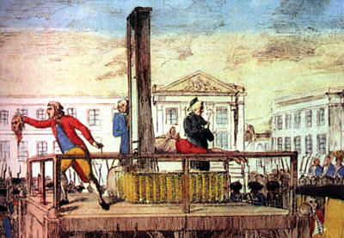
Louis 16th
Executed on January 21 1793
Became King of France in 1774 and was the last Absolute Monarch of France
Borrowed money heavily to help American Revolutionaries
Bankers said no to lending the government money in 1786 this posed serious economic problem for Louis 16th
He tried to tax the third estate and this led to his downfall.
Was executed in 1793 during the reign of Terror

Slide 37
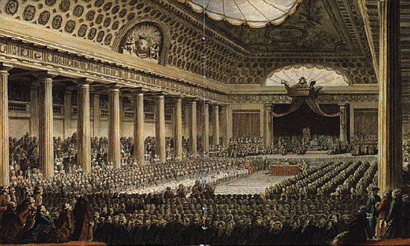
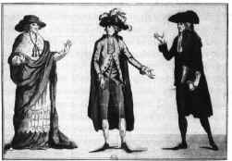
Estates General
Estates General is an assembly of representatives from all three estates
The First estate was made up of
  Clergy men from the Roman Catholic church
  They scorned enlightenment ideas
The Second estate
  Made up of rich nobles
  They held the highest offices in the government
  They disagreed about enlightenment ideas
The Third estate
  Made up of the bourgeoisie, urban lower class, and peasant farmers
  They held no power in government
  They also liked the enlightenment ideas

Slide 38



National Assembly
A French congress established by representatives of the Third Estate on June 17, 1789, to enact laws and reforms in the name of the French people.
The National Assembly was mostly made up of the bourgeoisie whose views had been shaped by the Enlightenment, were eager to make changes in the government.
They insisted that all three estates meet together and that each delegate have a vote. This would give the advantage to the Third Estate, which had as many delegates as the other two estates combined.
On June 17, 1789, they voted to establish the National Assembly, in affect proclaiming the end of absolute monarchy and the beginning of representative government.
Three days later, the Third Estate found themselves locked out of their meeting room. They broke down the door to an indoor tennis court, pledging to stay until they drew up a new constitution. This was called the Tennis Court Oath.
King Louis tried to make peace by ordering the First and Second Estates to join the National Assembly.

Slide 39

Declaration of the Rights of Man
These were the basic layout for what man should and shouldn’t do.
The rights are liberty, property, security, and resistance to oppression.
It was established in 1789 by the national assembly during the French Revolution.
The declaration of independence was used as its model.
It declares that it is the job of the government to protect the natural rights of man and guarantees equality among men.
States that anyone is free to practice any region of their choice without prosecution.
It promises to tax people only on how much they can afford.

Slide 40


Storming the Bastille
Causes…
Loius tried to make peace with the Third Estates by yielding the National Assembly’s demands.
Loius ordered the nobles and clergy to join the National Assembly but the king stationed his army in Paris.
Rumors flew that the foreign troops were coming to massacre French citizens.
July 14th 1789…
A mob tried to get gunpowder from the Bastille but the angry crowd overwhelmed the king’s soldiers and the Bastille fell into the control of the citizens.
Storming the Bastille was the symbol of the French Revolution. It is known as a national holiday in France.

Slide 41

MAXIMILIEN ROBESPIERRE
MAXIMILIEN ROBESPIERRE :was one of the people that lead the Reign of Terror .
A radical revolutionary Robespierre tried to keep the virtue of the revolution alive.
During the Reign of Terror tens and thousands of people were executed, and thousands more were put into prison.
After a year the people tried of Robespierre and he was executed , ending the Reign of Terror.

Slide 42

Committee of Public Safety
The leader of the Committee of Public Safety was Maximilien Robespierre.
He had to decide who should be considered enemies of the public.
They wanted to keep the true virtues of their revolution alive.
They executed thousands of people.
Used the slogan “Liberty, Equality and Fraternity”

Slide 43





Reign of Terror (1793)
September 5, 1793 the Reign of Terror begins.
Robespierre slowly gained control and wanted to destroy Frances past monarchy and nobility.
Robespierre was a brutal man who beheaded anyone who opposed him including priests, kings, and rival leaders.
18,000-40,000 people were killed during the reign of terror.
1,300 people were executed in the month before this terror ended.
The “REING OF TERROR” was finally over on July 28th, 1794 as Maximilian Robespierre was beheaded.

Slide 44
Napoleon

Slide 45

Napoleon(1804-1814)
NAPOLEON WAS A LOW-LEVEL MILITARY OFFICER WITH DREAMS OF GLORY
HE ROSE IN THE RANKS AFTER WINNING VICTORIES AGAINST THE BRITISH AND THE AUSTRIANS
SELECTED BY THE DIRECTORY AFTER THE FRENCH REVOLUTION TO SECURE THE COUNTRY AND END THE RIOTS.
NAPOLEON HELPED OVERTHROW THE WEAK DIRECTORY IN A COUP D ETAT OR REVOLT BY MILITARY LEADERS TO OVERTHROW A GOVERNMENT.
HE ORAGANIZED A NEW GOVERNMENT AND PUT HIMSELF IN CHARGE
THREE YEARS LATER HE TOOK THE NAME EMPEROR OF FRENCH
HE CREATED THE NAPOLEONIC CODE
THIS WAS A CODE THAT INCLUDED MANY ENGLIGHTMENT IDEAS SUCH AS THE LEGAL EQUALITY OF CITIZEN RELIGIOUS TOLERATION.

Slide 46


Coup d ’etat
A REVOLT BY MILITARY LEADERS TO OVERTHROW A GOVERNMENT
THE ACTING OF OVERTHROWING A GOVERNMENT IN FAVOR OF ANOTHER, USUALLY THROUGH VIOLENT MEANS
NAOPLEON USES A COUP D ETAT TO TAKE OVER THE DIRECTORY AND MAKE HIMSELF DICATOR OF FRANCE.

Slide 47


Napoleonic Codes
Definition: Napoleons comprehensive system of laws.
These codes gave the country a uniform set of laws, although it eliminated many injustices. It limited liberty and promoted order and authority over individual rights.
The code took away women’s rights, for example the right to sell their property which had been earned during the revolution.
Also freedom of speech and press, which had also been won from the revolution, had been restricted because of the code.
With these new laws, slavery had been brought back to life in the French colonies of the Caribbean.

Slide 48


Continental System
Napoleons policy of preventing trade between Great Britain and continental Europe, intended to destroy Great Britain’s economy.
The blockade however was not tight enough to stop trading.
Aided by the British, smugglers were able to bring cargo from Britain into Europe.
It weakened the British trade but it did not destroy it.

Slide 49


Napoleon’s War With Russia
Napoleon
Napoleon was upset at the Russia for trading with Britain.
When Russia refuses to stop then Napoleon declared war on Russia.
Napoleon invades Russia in June however by November cold weather had set in was Napoleon’s army was freezing to death.
The Russian also used a tactic of scorched-earth where they burned all the crops and killed the livestock so Napoleon’s army had no food.
Napoleon’s army is defeated by the cold weather and large size of Russia.
Napoleon enters Russia with 500,000 troops and leaves with about 20,000.
This defeat weakens Napoleon’s army and he is overthrown by Prussia and Great Britain and Napoleon is sent into exile.

Slide 50


Napoleon Spreads Nationalism
Napoleon spreads feelings of pride among French.
  By taking over countries in Europe Napoleon inspires pride in the French people.
Napoleon also increased feelings of nationalism across Europe.
  Napoleon also showed the nations he took over how to develop nationalism and a desire or common goal to drive the French out of their nations.

Slide 51


Napoleon Spreads the French Revolution (1812)
Napoleon
A French general who greatly expanded Frances boundaries during the Revolution.
The Spread Of The Revolution
Napoleons many conquests sparked nationalism and democracy ideas in various country’s.
Many country’s believed they could also be as successful as France was at gaining independence.
The revolution spread all throughout the world, as far as Latin America
The French Revolution inspired a brotherhood or Liberty, Equality and Fraternity among other nations of Europe and the World.

Slide 52
Latin American Independence

Slide 53


Toussaint L’Ouverture
Toussaint L’Ouverture was a former slave who was self educated and became familiar with the ideals of the Enlightenment
In 1789, he led the people of Haiti in a rebellion against their French rulers, and freed Haiti by 1798
In 1802 Napoleon Bonaparte attempted to reestablish French control in Haiti
Toussaint L’Ouverture fought a guerilla war against the French
By 1804 Haiti gained it’s independence.

Slide 54


Jose de San Martin
(1778 – 1850)
One of the main leaders of the Latin American independence movement.
He was a strategic genius who used his skills to help fight against Spanish Rule.
He is known as one of the principal liberators of South America.
He was a hero in South America but mostly in Argentina.

Slide 55

Simon Bolivar
A Creole educated in Europe.
Believed in the ideas of the Enlightenment and the French Revolution.
Further inspired by the American Revolution
Vowed to drive the Spanish out of South America.
Called the “Liberator”
One of the greatest nationalist leaders of Latin American independence.

Slide 56

Hierarchy Triangle
Latin America
Latin American colonial society was separated into classes based on the origins and race of the people.
All the titles of the groups of people made up hierarchy Triangle which determined the place in the community of the people.
The Triangle
At the top were the Penninsulares, men who were born in Spain. They were the only men who could run in office of the government. They made up 0.1% of the population.
Below the Penninsulares were the Creoles, Spaniards born in Latin America. They couldn’t hold high-level in the political office. They had pretty much the same rights as the Penninsulares. They were about 22.8 % of the population.
Below the Creoles came the Mestizos, the people of European and Native American ancestry.
At the bottom were the Mulattos, people of both African and European descent.

Slide 57

Problems of Latin American independence
Regional differences
  Geographic barriers
  Border disputes
  Regional rivalries for power
Cuadillos
  People were illiterate
  Ill repaired to create a representative democracy
  Leaders had power over the military and became dictators\
Economic and social inequality
  Over throw or colonial rule
  Ended mercantilism
  Gap between rich and poor grew greater
  Unequal social status
Conservatism of the church
  Powerful force in Latin American society
  Oppose liberal changes that benefit the majority

Slide 58
Nationalism

Slide 59


Nationalism
Definition
The belief that people should be loyal to and have pride in their nation
Nationalism can be like a bomb blowing nations apart or a magnet pulling them together
Common Bonds of Nationalism
Common language, culture, history, land

Slide 60

Congress of Vienna
After Napoleon leaders were looking to have long lasting peace and stability in Europe
Congress of Vienna called to set up new policies in Europe
Most of the Decisions made at Vienna were made by King Frederick William III of Prussia, Czar Alexander I of Russia, Emperor Francis I of Austria, Britain and France
The Containment of France
Congress made the weak countries surrounding France stronger
This allowed the countries to contain France and prevent it from overpowering weaker nations
Balance of Power
The Congress did not want to weaken France to much
The French were required to give up all land that Napoleon had taken, but besides that remained in tact
France still remained a strong country
Legitimacy
This policy restored as many rulers as possible that Napoleon had taken from their thrown be put back into power
Long-Term Legacy
The Congress left a legacy that would influence politics for the next 100 years

Slide 61


Balance of Power
Definition
distribution of political and economic power that provides any one nation from becoming too strong
The Congress of Vienna
1815- leaders of Austria, Russia, England, and France met
wanted to devise a peace settlement and restore stability and order to Europe
A balance of power is what the leaders at the Congress of Vienna wanted after Napoleon’s defeat to avoid another instance of what happened with France (too powerful).

Slide 62

Russification
Promoted Russian history, language, and culture, sometimes forbidding the cultural practices of native peoples
Appointment of Russians to key posts in the government and secret police.
Redrawing the boundaries of many republics to ensure that non-Russians would not gain the majority.
Russification was making sure that the Russians stayed in control of Russia.

Slide 63


Giuseppe Mazzini
Fought for freedom and unification of all Italian speaking people by forming “Young Italy.”
Called the “soul” of Italy for his fiery speeches and writings.
Led revolts and fought for democracy and social justice.
One of the three leaders of Italian Nationalism.

Slide 64

Count Camillo Cauvor
    Who was Cauvor?
    He was a middle-aged, wealthy aristocrat.
    Was named prime minister of Piedmont-Sardinia in 1852 by the king Victor Emmanuel II
    He worked to expand Sardinia’s power, was mistrusted that he just wanted more power in stead of trying to unite Italy.
    What he did
    He strived to gain control of northern Italy, through diplomacy and cunning.
    Austrians were a roadblock to unification, so he made allies with the French who helped him drive out the Austrians from northern Italy
    This provoked a war with Austria, but the Sardinian army won quickly.
    Gained all of northern Italy except for Venetia.

Slide 65


Giuseppe Garibaldi
Garibaldi’s greatest dream was Italian unity
Garibaldi led a small army of Italian nationalists in May 1860
He and his followers always wore bright red shirts, so they were call the Red Shirts
The southern areas he conquered, he then united
Lived from 1807-1882

Slide 66


Otto von Bismarck
Unified Germany in 1871
Master of Realpolitik-”Politics of Reality”-tough power politics with no idealism
Believed only Blood and Iron (War) would unite Germany
Formed an alliance with Austria to gain some land, then turned on them in the 7 Weeks War
Manipulated a diplomatic document to provoke France into war, then beat them (Franco-Prussian War), taking land away from France and making France bitter towards Germany
Both cunning and deeply religious

Slide 67


Blood and Iron
A concept created by Otto von Bismarck, which stated that Germany would be unified not through speeches and majority decisions, but through war.
This theory was put into use during the Franco-Prussian War of 1870.
Using nationalism and hatred against France, Prussia gained land.
In 1871, through Blood and Iron, the German states became united under the Prussian King William I.

Slide 68


Franco-Prussian War
Bismarck needed the support of a few southern German states, and believed that he could gain it through a war with France
He published an altered version of a diplomatic telegram that he had received , and gave a false description of a meeting between Wilhelm I and the French Ambassador.
In the description Wilhelm seemed to insult France, and reacting to the insult the French declared war on Prussia on July 19, 1870.
The Prussian army poured into northern France. In September 1870 the Prussian army surrounded the main French force at Sedan.
Only Paris held out against the Germans. For four months Paris withstood German siege. Finally, hunger forced them to surrender.
With the defeat of France nationalistic fever finally seized the people in southern Germany, and they accepted Prussian leadership.
On January 18, 1871 at the captured French palace of Versailles, King Wilhelm I was crowned Kaiser or emperor of Prussia.
Led to hard feelings between France and Germany for many years, and indirectly led to WWII

Slide 69

Global Nationalism: Kaiser
Kaiser
German word meaning “emperor” used for German kings of the late 1800’s and early 1900’s
On January 18,1871, at the captured French palace of Versailles, King Wilhelm I of Prussia was crowned Kaiser, or emperor.
Germans called their empire the Second Reich.
Bismarck had achieved Prussian dominance over Germany and Europe “by blood and iron,” as he had set out to do

Slide 70


Zionism
Defined
Movement in the 1800’s dedicated to building a Jewish state in Palestine.
Jews faced a long history of exile and persecution, known as Anti-Semitism.
Jews had a strong want for their own homeland.
The land in which they would pursue was called Palestine.
In the 1890’s, a movement known as Zionism developed to follow this goal.
Leader
The leader of the Zionist movement was Theodor Herzl, a writer in Vienna.
In 1897, he organized the first world Congress of Zionists.
Herzl’s dream of an independent Israel was realized a little more than 50 years later.

Slide 71

Young Turks
The movement established by the Turks in the late 1800’s to reform the Ottoman Empire
Young Turks wanted to strengthen the Ottoman Empire and end threat of Western Imperialism.
Wanted to return to a traditional Muslim government and leadership
The Sultan was overthrown and the government was taken over by the Turks in 1908.
They supported Turkish nationalism.

Slide 72

Pan-Slavism
Russia had encouraged this form of nationalism in Eastern Europe
The movement tried to draw together all Slavic peoples
Russia was the largest Slavic nation
It was ready to defend a young Slavic nation in the Balkans, Serbia
Small Slavic populations throughout the Balkans looked to Russia for leadership in their desire for unity
Austria-Hungary opposed Slavic national movements

Slide 73
Industrial Revolution

Slide 74


Agrarian Revolution
Increased Food Production-
Change in methods of farming…
Technology-
The Dutch began building dikes and made ways to protect their farmland form the sea and used fertilizer to improve the soil.
British invented new ways to increase food production, Jethro Tull, invented the Seed Drill, which planted seeds in rows.
Enclosure Movement-
The neighboring farmers took down their fences in an attempt to increase the food production by having larger crops, and also, it increased the size of fields from small strip crops to larger crops.
Population Explosion-
The Revolution lead to a great increase in population, and Europe’s population increased form about 120 million to about 190 million people.

Slide 75


Enclosure Movement
Enclosure
  The combining of many small farms to make one larger farm which produces more food
Made farming more efficient
  Fewer farmers were needed
    Unemployed farmers moved to cities to look for work
Improved agricultural production

Slide 76

Population Explosion
In the 1800s, after the Agrarian Revolution, more people had a larger and better selection of food for their diets.
People began to live longer and be healthier and because of this the population grew.
Because of this population explosion many people began to move to the cities looking for work.
This was called urbanization
Most city’s population doubled, or even tripled

Slide 77

Causes of the Industrial Revolution
Agrarian Revolution:
  Build dikes to protect to protect farmland from the sea
  Animal fertilizer to improve soil
  Invent seed drill
    more food production
Population Explosion:
  People eat better
  Women give birth to healthier babies
  Better medical care
    Slows death rate
Energy Revolution:
  Water wheels power new machines
  Coal used to fuel steam engine

Slide 78

Factory System
Factories were first used to mass produce textile goods.
They used inventions like the flying shuttle, spinning jenny, and the spinning mule to quickly produce large amounts of product.
The factory system cut prices of goods by lowering the number of workers needed to create the products.
In the early 1800s factories began appearing in large numbers along river banks, where they could use water as an energy supply.

Slide 79

TEXTILE INDUSTRY
Began in Britain.
Quickened the work process in Britain.
Britain was able to take raw cotton from the U.S. and quickly turn the cotton into a finished good and sell the good back to the U.S. at a higher price.
John Kay invented “the flying shuttle” that carried thread speedily back and forth on the loom while the weaver pulled the handle.
Many new inventions in the textile industry allowed this industry to become the first factory system.

Slide 80


Rise of Big Business
The need for the investment of large amounts of money in business
Business owners sold stocks, or shares in their companies, to investors
This allowed businesses to expand into many areas
Investors and businessmen made large sums of money in short period of time

Slide 81



Working Conditions of the Industrial Revolution
Factory work hours were long.
Men, women, and even children worked for 12 to 16 hours a day.
Mass production methods led to work that was boring.
Many machines were dangerous.
Many people lost limbs in machines.
Dim lighting.

Slide 82

New Class Structure
During the Industrial Revolution a new class structure emerged.
Upper Class
Very rich business families
Members of the class often married into nobility.
Upper Middle Class
Business people and professionals (Lawyers and Doctors)
High standard of living
Lower Middle Class
Below the upper middle class
Made of teachers, office workers, and shop owners
The Bottom
Factory workers and peasants.
Harsh living and working conditions.

Slide 83


Changes in Social Roles
The upper class was mostly made up of very rich industrial and business families. These people often married into noble families.
Upper middle class consisted of: Lawyers and Doctors (business people/professionals)
Lower middle class consisted of: Teachers, Office Workers, Shop Owners, and Clerks.
The lower class was mostly made up of factory workers and peasants. These people faced harsh work and living conditions.

Slide 84


Rise In The Standard Of Living
During the Industrial Revolution many economic and social changes came.
Settlement patterns shifted over time. People who could afford it now moved out of the center of cities to cleaner and better sections of the cities
The rich lived in pleasant neighborhoods on the edge of the cities
The poor were crowded into the slums in city centers, near factories.
Over time, conditions in the cities improved.
People were eating more varied diets and were healthier, thanks to the advances in medicine.

Slide 85


Adam Smith
Writer of The Wealth of Nations in 1776 Adam Smith defended the idea of a free market economy
He believed that economic liberty guaranteed economic progress
He argued in his book that if people followed only their own self interest then the world would be an orderly and progressive place. And that the economy would not require any government interference.
These ideas were central to the development of capitalism
Born 1723 died 1790

Slide 86


Laissez-Faire Economics
“ Laissez faire refers to the economic policy of letting owners of industry and business set working conditions without government interference.”
Laissez faire roughly translated is “Let people do as they please.”
This policy comes from French 18th century enlightenment philosophers.
These philosophers thought that government restrictions and regulations interfered with the production of wealth.
Laissez faire stresses that free trade is necessary for a prosperous economy.
Adam Smith wrote a book The Wealth of Nations, in 1776 and in this book he defended the free market idea and said that “economic liberty guaranteed economic progress.”

Slide 87

Socialism
The ideas of socialism were founded by French reformers Charles Fourier and Saint-Simon, these ideas were to offset the cirrcumstances that emerged as a result of the industrial revolution.
The means of a production in a socialist community are owned and opperated by the public for the good of the community.
All means of transportation and production should been opperated and owned by the government.
The mian intention behind socialism was to eliminate poverty, create equality and end social descrimination between the classes of rich and poor.
Marxist communism and the Communist Manifesto were later based on socialist ideas and philosifies.

Slide 88


Karl Marx
Karl Marx studied philosophy at the university of Berlin before hr turned to journalism and economics
A German journalist who introduced the world to a radical type of socialism called Marxism.
Marx described communism as a form of complete socialism in which the means of production, all land, mines, factories, railroads, and businesses, would be owned by the people. All goods and services would be shared equally.
Marx believed that the Industrial Revolution had caused the rich to become richer and the workers to become more impoverished.
History was a class struggle between wealthy capitalist (bourgeoisie) and working class (proletariat) and that the proletariat would rise up and overthrow the bourgeoisie.

Slide 89

Marxist Socialism
This is a new kind of economic system.
This is means that everybody shares the wealth.
This idea came from the view of the Industrial revolution that the rich become richer while the poor become poorer
The founder of socialism is Karl Marx.
History was a class struggle between wealthy capitalist (bourgeoisie) and working class (proletariat)
In order to make profits the capitalist took advantage of the working class (Lower wages).
The proletariat would
  Rise up and overthrow the capitalist system
  Create their own government.
  Take control of the means of production.
  Establish a classless, communist, society.
  Wealth would be shared.
KARL MARX

Slide 90


Mass Starvation in Ireland
British Rule
Migrations occurred from Ireland, under British rule most of the land was used for farming.
The British got all if the crops accept for the potato crops which the Irish made their main food which supported the Irish for until 1845.
In 1845 a disease had destroyed the potato crops, other crops where not affected.
The British still continued to ship products out of Ireland
4 years later, 1million Irish had died of starvation, millions of others moved to the U.S. and Canada.

Slide 91
Japan and the Meiji Restoration

Slide 92

Tokugawa Isolation
European traders first arrived in Japan in the 1500’s.
In 1600’s Tokugawa shoguns had gained control of Japan.
They brought stability but also banned almost all contact with the outside world.
They also limited trade.

Slide 93


Treaty of Kanagawa
Shogun of Japan opens Japan’s ports to American ships, had powerful impact, some Japanese felt Shogun had shown weakness, some felt Japan needed to modernize, caused a rebellion that overthrew the Shogun and restored the emperor

Slide 94


Meiji Restoration
In 1867 daimyo and samurai led a rebellion to remove Tokugawa Shogun from power
Meiji means enlightened rule and in 1868 the Meiji Emperor was established as the ruler of Japan
In this time they ended feudalism and began to modernize by selectively borrowing from the west in Japan.

Slide 95

Borrowing from the West
The Meiji reformers were determined to strengthen Japan against the West.
Members of the government traveled abroad to learn about western government , economics, and customs
Foreign experts from the U.S., Great Britain and Germany were invited to Japan.
The Japanese took western manufacturing and modernized the country by building factories, railroads and roads.
Using western ideals allowed Japan to modernize in about 40 years.
Japan now went from and imperialized nation to an imperialistic nation.

Slide 96

Japanese Military Power
Japan began to create a modern military with help from the United States and Great Britain. The United States taught them tactics the they would use on the United States when the bombed Pearl Harbor
By 1890 Japan had modernized its army and navy. No longer were the samurai the only warriors. Because of the all men had to enter into the military.
When Japan fought Korea in 1894 they won easily.
Soon the Japanese beat Russia in Manchuria. This marked the first time that an Asian power had defeated a European power and made Japan a world power

Slide 97

  Sino-Japanese War
  In 1876, Japan had grown in their military, political and economical strength.
  Japan later wanted to invade Korea, as did China.
  China and Japan signed a “Hands off” agreement, to keep Korea off limits to each other.
  In June of 1894, China broke the agreement.
  This turned into the Sino-Japanese war.
  Japan won.

Slide 98



Russo- Japanese War
Russo-Japanese War (1904-05). The war began on Feb. 8, 1904
The Russo-Japanese War was a military conflict in which a Japan fought Russia
The Reason for the war was to abandon Japans expansionist policy in the Far East.
The Russo-Japanese War developed out of the rivalry between Russia and Japan for dominance in Korea and Manchuria.
Japan easily won making them a world power

Slide 99
Imperialism

Slide 100

Imperialism (1800)
Economic, political, and social forces accelerated the drive to take over land in all parts of the globe.
The take over of a country or territory by a stronger nation with the intent of dominating the political, economic, and social life of the people of the nation is called Imperialism.
The Industrial Revolution provided European countries with a need to add lands to their control for both natural resources and new markets.
As Europeans nations industrialized. They searched for new markets and raw materials to improve their economics.
The race for colonies grew out of a strong sense of a national pride as well as from economic competition.

Slide 101


Social Darwinism(1800’s)
Social Darwinism was based on the theories of Charles Darwin.
His ideas of plants and animals were applied to economics and politics.
  The leader of this thinking was Herbert Spencer
Social Darwinism applied to Darwin’s theories and renamed “the survival of the fittest.”
  Businessmen believed the best companies would make money, the inefficient ones would lose money and go bankrupt.
  People who were fit for survival would be wealthy while the poor would remain poor because they were unfit.
  They also believed that there were “lesser peoples” and “superior races”.
  Imperialists felt they had the right to take over weaker countries.
  Social Darwinists believed it was natural for stronger countries to dominate weaker ones

Slide 102

Old Imperialism
The takeover of a country or territory by a stronger nation with the intent of dominating the political, economic, and social life of the people of that nation.
Between about 1500 and 1800, European nations established colonies in the Americas, India, and Southeast Asia, and gained territory on the coasts of Africa and China. Still, European power in these regions of the world was limited.
Under old imperialism, the colonies were more of a liability than an asset.
Types of imperialism: Colony – a country or a region governed intentionally by a foreign power.
Protectorate – a country or territory with its own internal government but under the control of an outside power.
Sphere of Influence – an area in which an outside power claims exclusive investment or trading privileges.
Economic Imperialism – independent but less developed nations controlled by private business interests rather than by other governments.

Slide 103
New Imperialism (1870-1914)
Imperialism is the domination of one country of the political, economic, or cultural life of another country.
Between 1870 and 1914, nationalism had produced strong, centrally governed nation-states
The industrial revolution had made economics stronger as well
During this time, Japan, the United States, and the industrialized nations of Europe became more aggressive in expanding onto other lands
The new imperialism was focused mainly on Asia and Africa, where declining empires and local wars left many states vulnerable
In Africa, many states had been weakened by the legacy of the slave trade

Slide 104


Causes of Imperialism(1870-1914)
Nationalism and social Darwinism
Nationalism promotes the idea of national superiority, imperialists felt that they had the right to take control of countries they viewed as weaker.
Social Darwinism applied to Darwin's theory of survival of the fittest to competition between nations.
The theory lead people to believe that it was natural for stronger nations to dominate weaker ones
Military Motives
Colonies were important as bases for re-supply of ships
A nation with many colonies had power and security
Economic motives
Raw materials are needed for factories
New markets were also needed
White Man’s Burden
This poem offered a justification for imperialism
White imperialists had a moral duty to educate people in nation they considered less developed.

Slide 105


White Man’s Burden (1899)
The title of a poem by Rudyard Kipling.
Offered justification for imperialism.
Expressed the idea that white imperialists had a moral duty to educate people in nations considered “less developed.”
Missionaries spread western ideas, customs, and religious beliefs to Africa and Asia.
White Englishmen had on obligation to support and run less fortunate countries.

Slide 106
Imperialism In India

Slide 107



British East India Company
The East India Company started to take over India in 1757.
It was the leading power in India after the British victory in the Battle of Plassey.
The power expanded over time to Modern Bangladesh, most of southern India, and areas along the Ganges River.
The company ruled with little interference from the British government and had their own army with Indian soldiers called sepoys.
India known as the “Jewel in the Crown” because it was the most important British colony and had many natural resources.
The company would not allow Indian economy to operate on its own.

Slide 108



‘JEWEL IN THE CROWN’
INDIA!
India was considered Britain's most valuable colony
  Major supplier of raw materials
  Large market for British-made goods
British East India Company ruled India until the Sepoy Rebellion, then the British Government took over.
Sphere of Influence – Britain had exclusive trade rights with India
        + =

Slide 109


Sepoy Mutiny (1857)
Indian soldiers, Hindus and Muslims fighting for the British.
Heard rumors of casing bullets in pig and beef fat which neither Hindus or Muslims could eat
Soldiers were jailed disobeying soldiers
Rebelled and captured the city of Delhi.
Took a year for British to regain control
British East India company lost control as a result of the mutiny
The British Government took control of India, made it a colony and the government was called the Raj.

Slide 110
Imperialism in Africa

Slide 111


Berlin Conference
European Powers met together to divide up Africa. The African nations themselves had no say in their own land.
European powers divided up Africa with no regard to the tribes that lived in Africa
One could obtain a colony thorough:
occupation
Notification of other European states of occupation and claim
Showing that they could control the area.
Only Liberia and Ethiopia were free of European control.

Slide 112


Boer War
Dutch farmers in South Africa, the Boers, fought against the British starting in 1899.
The Boers wanted the diamonds and gold in South Africa to belong to them, and not the “outsiders” (British).
The Boers used guerrilla warfare tactics against the British.
The British struck back by imprisoning women and children in concentration camps and burning Boer farms.
The British won the war.
The Union of South Africa, controlled by the British,
replaced the Boer Republic in 1902.

Slide 113
Imperialism in China

Slide 114

End to Isolationism
Africa was divided into Colonies and ruled directly by Europeans.
China came under Imperialist control by using Spheres of Influence.
Europeans used leases and concessions to gain control of China.
In the 1790’s China was not interested in western influence.
China refused western technology.
China was self-sufficient.
  Good agriculture
  Extensive mining and manufacturing
  Finely produced goods
    Porcelain, cottons, and silk

Slide 115


Opium Wars (1839)
The supply of opium started to grow which started to cause social, moral, and monetary problems of the country
The Qing emperor became angry and he talked with Queen Victoria of England
Pleas of the Qing emperor went unanswered and Britain refused to stop trading the opium with China
As a result the British and the Chinese clashed and started the opium wars
China was so behind the British in technology that the British was able to defeat China with their cannons and gunboats
In 1842 the British and the Chinese signed a peace treaty, the treaty of Nanjing and this gave Britain a sphere of influence or exclusive trade rights to China.
The treaty gave the British the island of Hong Kong

Slide 116


Treaty of Nanjing
The Treaty of Nanjing was written after the Opium Wars between the Chinese and British
The British naval technology was far better than that of the Chinese
The Chinese were humiliated in an easy win for the British
The Treaty of Nanjing was written in 1842
- British gained Hong Kong

Slide 117

Sphere of Influence
Sphere of influence – a region where the foreign nation controlled trade and investment.
The British had a sphere of influence over China during Imperialism.

Slide 118



Boxer Rebellion
The widespread frustration among the Chinese people erupted, the people were upset with the foreigners getting special treatments and privileges, they also resented the Chinese Christians, who were getting special privileges as well.
The peasants demonstrated their discontent by forming a secret organization called the Society of Harmonious Fists. They later became known as the Boxers.
Their campaign against the Dowager Empress’s rule and foreigners privileges was known as the Boxer Rebellion.
In the Boxer Rebellion, the Boxers descended on Beijing, shouting “Death to the Foreign Devils”. The Boxers surrounded the city for several months, and the Empress expressed support for the Boxers, but did not back her words with military support.
In August, 20,000 troops marched toward Beijing, and soldiers from Britain, France, Germany, Austria, Italy, Russia, Japan, and the United States defeated the Boxers.

Slide 119


Sun Yixian and the Chinese Revolution
Sun was the founder of the Chinese Republic in 1911 when the Last Emperor stepped down.
When he stepped down rival warlords fought for power
Several movements were formed
May Fourth Movement – students wanted to make China stronger through modernization, introduction of western ideas like democracy and nationalism
Communist –Mao inspired by Marx and Lenin
Nationalists – formed by Sun Yixian, called Guomindang
After Sun’s death Jiang Jieshi took over Guomindang
Civil war began between Nationalists and Communists

Slide 120


Effects on the Colonies (Imperialism)(1750-1914)
Short term effects
Large numbers of Asians and Africans came under foreign rule
Individuals and groups resisted European domination
Famines occurred in lands where farmers grew export crops for imperialist nations in place of food for local use
Western culture spread to new regions
Long term effects
Western culture continued to influence much of the world
Transportation, education, and medical care were improved
Resistance to imperial rule evolved into nationalist movements

Slide 121

Cash Crop Economies
Economic Problems
Under colonial rule, Latin American economies had become dependent on trade with Spain and Portugal.
Latin Americans relied on a cash crop economy.
The colonies sent raw materials such as sugar, cotton, and coffee to Europe and had to import manufactured goods.
Dependence on one or two crops is not good for a nation’s economy and makes them very unstable.

