Slide 1
Cultural Exchange

Slide 2
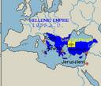
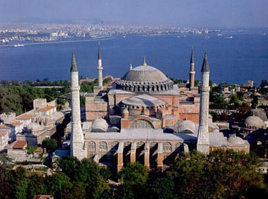
The Byzantium Empire
In 395, the empire officially divided into two.
Western roman empire was outrun by Germanic tribes.
The new Rome
Constantinople, the new capital or the empire.
In 527, Justinian I becomes emperor.
High ranking Byzantine nobleman
Ruled with absolute power
Won Italy and Spain
He ruled almost all the territory all Rome had ever had
Made Justinian's code, set of laws, severed the empire for 900 years
In 671, Greek fire was invented.
In 1054, Christian church divides
Eastern orthodox
Roman catholic
In 1453 Constantinople falls to the Turks.

Slide 3
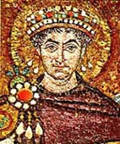
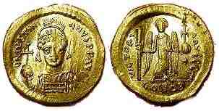
Justinian Code
To regulate a complex society, Justinian set up a panel of ten experts.
The panels task was to create a single, uniform code for Justinian’s New Rome.
The result of the panel’s work was a body of civil law known as the Justinian Code.
After its completion the code consisted of four works;
1. The Code contained about 5,000 Roman laws.
2. The Digest quoted and summarized the opinions of Rome’s greatest legal thinkers about the laws. This work was ran to a total of 50 volumes.
3. The Institutes was a textbook that told law students how to use the laws.
4. The Novellae (New Laws) presented legislation passed after 534.
The Justinian Code decided legal questions that regulated whole areas of Byzantine life.

Slide 4
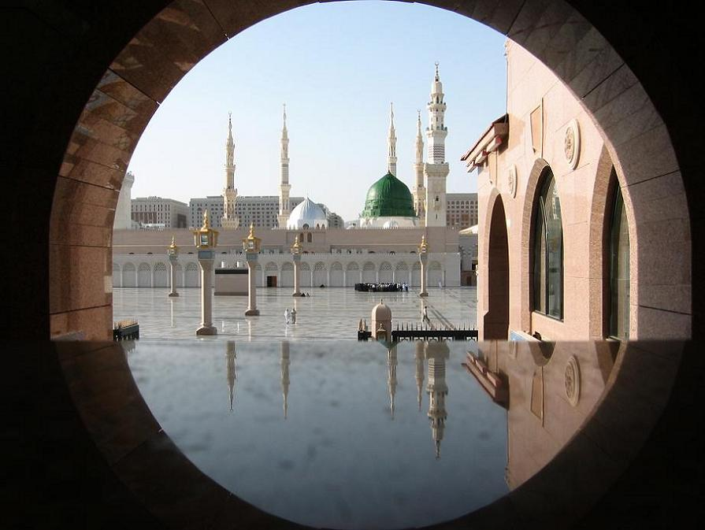
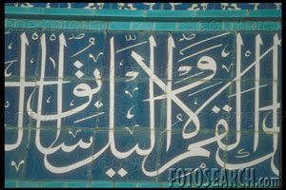
Islam’s Golden Age
Islam Civilization -
Islam began in the Arabian peninsula in the early 7th century.
It spread from the Middle East to Africa , Spain and Sicily. Then to India and SE Asia.
Islam’s Success -
The strength of the Arab armies brought Islam it’s power.
Arab armies conquered much territory.
Abbassid Dynasty -
(750 - 1258) The ruling family of the Islamic Empire
Responsible for many achievements.
The Islamic culture became a mixture of Arab, Persian, Egyptian, and European traditions.
The Golden Age became an era of stunning intellectual and cultural achievements. (art, literature, religion etc.)

Slide 5
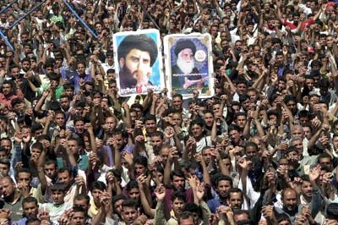
Shiites
The 2nd largest branch of the Islamic religion.
Shiites account for 10%-15% of all Muslims.
The central belief for Shiites is of the 12th Imam.
The 12th Imam is considered to be the only legitimate ruler, and the Shiites believe that the Muslim state can not be successful without this ruler in charge.
Khomeini served as the one who brought activism back into the Shiite mainstream.
During the Iranian Revolution in 1979, the Shiite activists tried to press their ideology onto the people.
They believe Islam should live as a tool to empower the oppressed.

Slide 6
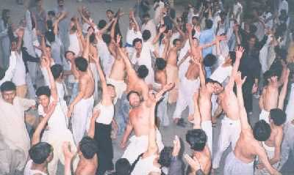
Sunnis
In 661, a family called the Umayyad came to power, and set up a hereditary system of succession in Syria
They moved the Muslim capital from Mecca to Damascus to make ruling conquered territories easier
They abandoned a life of simplicity to surround themselves with wealth
The movement of the capital, along with their drift from Muslim beliefs, caused a fundamental divide in the Muslim community
A small group called the Shi’a openly resisted Umayyad rule
Those who did not openly resist, but disagreed with Umayyad rule were called Sunnis, meaning followers of Muhammad’s example
They believed the Umayyad had become too worldly and lost their religious faith

Slide 7
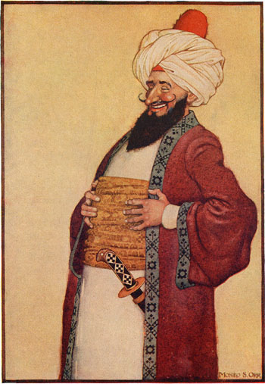
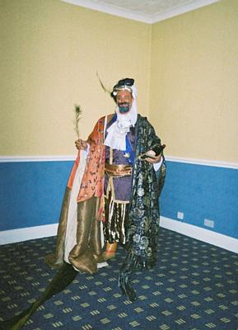
Caliph
Caliph means “successor” or “Deputy”
A caliph is a supreme political and religious leader
Some famous caliphs are Abu-Bakr the first caliph, Umayyads was elected, and Abbasides who took control

Slide 8
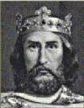
Charlemagne
During the 800’s, Charlemagne, a Frankish king, built an empire (modern-day France, Germany, and part of Italy)
Cooperation with the Church
Charlemagne helped Pope Leo III defeat rebellious Roman nobles.
In return, Pope Leo III crowned Charlemagne “Emperor of the Romans”
Charlemagne wanted a united Christian Europe and helped spread Christianity
Government
Appointed nobles to rule local areas (He gave them land, they help defend the empire)
Sent off officials called missi Domenici to check on conditions throughout the empire
Learning
Encouraged learning
Set up school to educate government officials and established libraries where scholars copied ancient texts.
End of Charlemagne’s Reign
Died in 1814- empire fell apart as heirs battled for control
843- Charlemagne’s grandsons signed Treaty of Verdun- divided Charlemagne’s empire into 3 separate kingdoms (one for each grandson).
Charlemagne’s strong government was a model for future medieval rulers

Slide 9
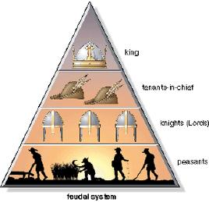
Feudalism
A system of government in which local lords control their own lands but owe military service and support to a greater lord.
The land was divided into estates.
The lesser lords were called vassals.
Local lords owned serfs who would work the land
The serfs were able to live on the land in manors.

Slide 10
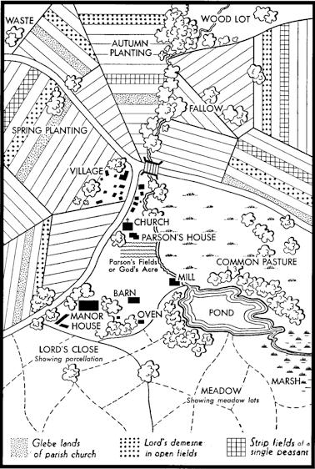
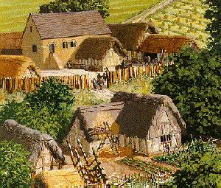
Manorialism
Self-Sufficiency
Manors were the basic economic arrangement during the Middle Ages
The lord provided serfs with protection, housing, and strips of farmland
The serfs worked for the lord and maintained the estate
Peasants rarely traveled from their manor
Nearly everything they needed was produced: crops, fuel, cloth, lumber, and leather goods
The manor contained a church, mill, blacksmith, water, fields, anything that was needed
Troubles of Manor Life
Serfs had to pay taxes for grain, marriage, and 10% of their income as a tithe, or church tax
Serfs lived in crowded cottages, with dirt floors and straw beds
The peasants believed that God determined their place in society

Slide 11
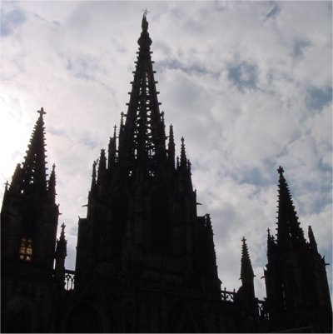
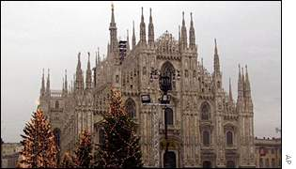
Gothic
A style of church architecture that developed in medieval Europe, featuring ribbed vaults, stained-glass windows, flying buttresses, pointed arches, and tall spires.
Developed in the 1100s, replacing the old Romanesque style of churches.
Gothic cathedrals, unlike the grave and ominous Romanesque buildings, stood very tall, as if reaching toward heaven.
Cathedrals started off in Germany and quickly spread throughout medieval Europe.
Soon, they were found in Paris, Chartres, Reims, Amiens, and Beauvais.
Nearly 500 Gothic cathedrals were built between 1170 and 1270.
Other forms of art centered around the Gothic style, such as sculpture, woodcarvings, and stained-glass windows.

Slide 12
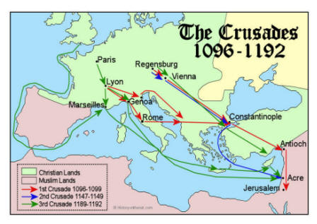
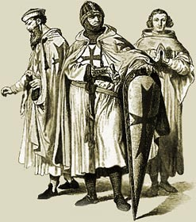
Cultural Exchanges: The Crusades
Crusades
During the Middle Ages, Europeans had only one significant unifying aspect of life. The Catholic Church permeated every aspect of society.
For about 200 years, Western Europe under the sway of the Catholic church attempted to retake the Holy Land away from the Muslims. The largest target was the holy city of Jerusalem, however, other areas were fought over, such as the city of Constantinople.
Although the crusades were considered there were some positive effects. Europeans began to gain an expanded view of the world. Trade increased drastically. Crusaders brought home new fabrics, spices, and perfumes.

Slide 13
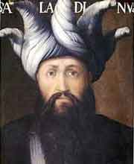
Saladin
∙ Respected Muslim Leader
∙Saladin united the Muslim world in the late 1100’s.
∙He was respected by both Christians and Muslims.
∙Saladin went to Jerusalem and the Christians had their mind set on stopping him.
∙Taking of Jerusalem
∙There was no Christian victory when they went to stop Saladin.
∙Crusaders in Jerusalem surrendered, but Saladin would not let his soldiers kill or harm them the Crusaders or the people.
∙Richard the Lion-Hearted
∙King of England in 1189.
∙He wanted to take Jerusalem from Saladin.
∙Richard won a lot of victories during the Third Crusade.
∙Richards forces were unable to capture the city.

Slide 14
Impact of the Crusades
Increased Trade
Before the crusades trade with the Byzantine empire sparked interest in goods form the east
Crusaders returning from Europe brought home new fabrics, spices, and perfume
Ships used to carry crusaders now became trade ships
Both Eastern and Western economies benefited from trade
Encouragement of Learning
As Europeans were exposed to the Byzantine and Muslim culture they began to take interest in learning
They were exposed to advances in math, science, literature, art, and geographic knowledge
Changes in the Church
The Crusades increased the power of the pope for a short time
Problems between Eastern and Western Churches grew after the crusader’s attack on Constantinople
Changes in the Feudal System
Crusades increased the power of Monarchs
Feudalism was weakening
Serfs had been to pay for land using food, but now Lords demanded payment in the form of money to finance the crusades
An economy based on money, not land, took over

Slide 15
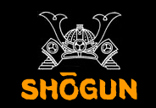
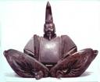
Feudal Japan Samurai:
Rival lords in Japan surrounded themselves with body guards called Samurai.
They lived according the demanding code, Bushido.
They were expected to show reckless courage, reverence for the gods, fairness, and generosity toward those who are weaker than themselves.
Dying an honorable death was more important than living a long life. Kamakura Shogun:
The shogun had the power of a military dictator over: Officials, judges, taxes, armies, roads- all were under his authority.
Although tradition was the Emperor still reigned, even though the Shogun had the real power.
The emperor became more of a puppet head than a political influence.
The Kamakura Shoguns were strong enough to turn back the two naval invasions by the Mongols.
Although this drained the Shoguns’ treasury and loyal samurais weren’t getting paid.
Samurais became attached more closely to their local lords and soon local lords were fighting each other as fiercely as they fought the Mongols.

Slide 16
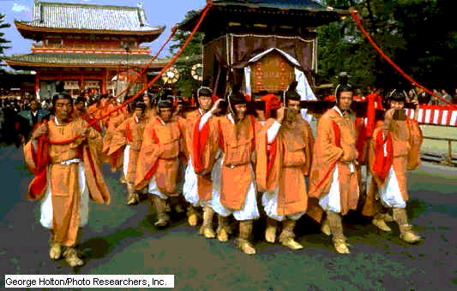
Shinto
What is Shinto?
It was a Japanese religion in which each clan in Japan worshipped their own Nature Gods and Goddesses.
It was varied because of different customs and beliefs
Shinto meant “way of the Gods”
It had no rituals or philosophy, but instead based on respect for the forces of nature.
Worshipers believed in kami or divine spirits in nature.
An abnormal tree, rock, waterfall, mountain could be home to kami

Slide 17
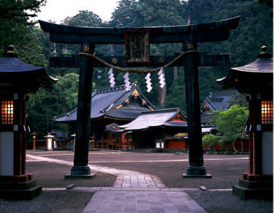
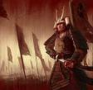
Tokugawa Shogun
Tokugawa Ieyasu
United Japan in 1600
Held landowner’s (Daimyo) families hostage in the capital of Edo to ensure obedience
Founded the Tokugawa Shogunate, which continued until 1867
Society under the Tokugawa Shogun
Japan enjoyed over 200 years under the new Shogun
Merchant class and rich prospered
Rich and poor benefited from a growing Japanese culture

Slide 18
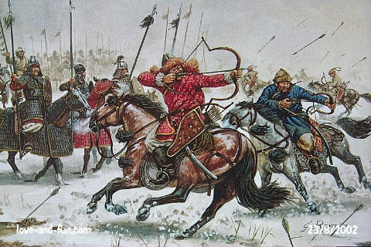
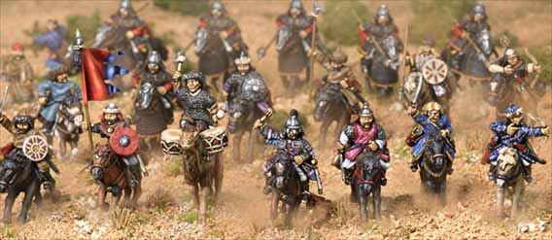
Rise of Mongols
Who and where?
In the 1200’s, a ferocious group of horsemen from central Asia fought their way into Russia. These nomads were Mongols.
They exploded onto the scene under the leadership of Genghis Khan, one of the most feared military leaders of all time.
When Genghis Khan died in 1227 his successors continued the conquering that he had begun.
Mongols In Russia
Under Mongol rule the Russians could follow all their usual customs as long as the made no sign of rebellion. The Mongols tolerated all the religions in their realms, and the Church acted as a mediator between the people and the Mongols.
The Mongols demanded two things from the Russians: Extreme Obedience, and massive amounts of tribute.
Mongol Rule Serves Russian Interests
The Mongol rule in some ways helped unite Russia. They viewed Russia as their unified Empire. The rise of the city of Moscow also began under Mongol rule.

Slide 19
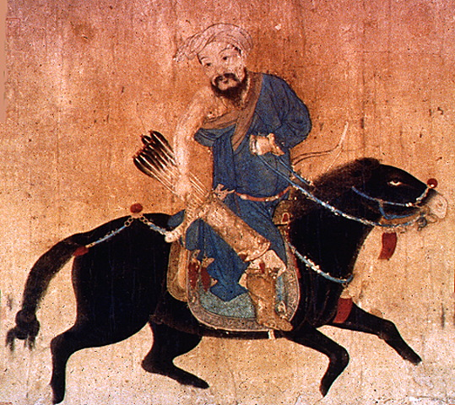
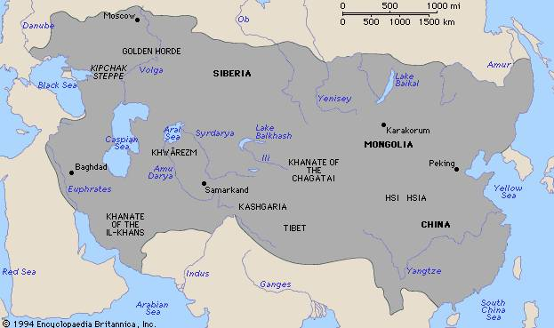
Genghis Khan
In the middle 1200’s, a ferocious group of horsemen from central Asia slashed their way into Russia.
These nomads were the Mongols.
They had exploded onto the world scene at the beginning of the 1200’s under Genghis Khan.
He was one of the most feared warriors of all time.
When Genghis Khan died in 1227, his successors continued the conquering that he had begun.
At the fullest extent, the Mongol Empire stretched from the Yellow Sea to the Baltic Sea and from the Himalayas to northern Russia.
After the death of Genghis Khan, the Mongolian Empire slowly began to fall apart.

Slide 20
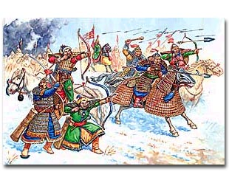
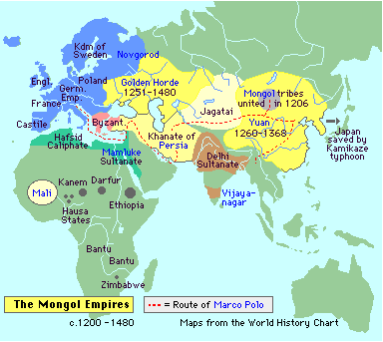
Golden Horde
During the time of Genghis Khan the Mongols invaded Eastern Europe
After his time they attacked Russia, Hungary, and Poland
His grandson, Batu, led Mongol armies into Russia and other lands of Eastern Europe between 1236 and 1241
This group was known as the Golden Horde because of the color of there tents
They conquered many Russian cities
They ruled from a capital on the Volga River for 240 years
The Golden Horde were fierce warriors but relatively tolerant rulers

Slide 21
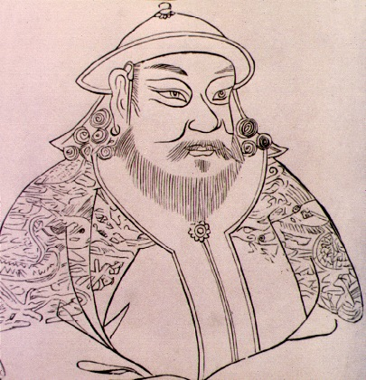
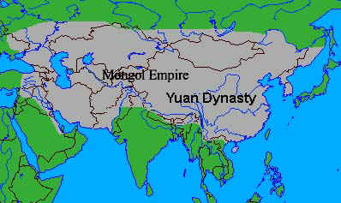
Mongol Dynasty
Kublai Khan-
Khan was another grandson of Genghis Khan, completed the job of conquering China. He did so by dominating the south, he did not only rule China, but also Korea, Tibet, and some of Vietnam.
Yuan dynasty-
Kublai Khan adopted the Chinese name of the Yuan dynasty for his dynasty because he did not want the Mongols to become involved with Chinese civilization.
However, Khan gave his best government jobs to Mongol workers and only allowed Mongols to serve in the army.
But, Chinese officials still governed the provinces.
Kublai Khan

Slide 22
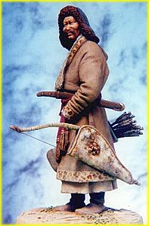
Mongol Impact
Reached it’s greatest extent in 1300.
Stretched into Russia, Europe, Asia, and China
Destruction and Conquest
Most of the leaders ruled with tolerance
Genghis Khan allowed art and education in his conquered countries
They ruled Russia for 250 years
They cut it off from the rest of Europe

Slide 23
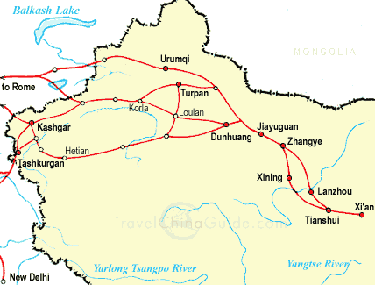
Mongol Impact
The Mongols were nomadic herders of central Asia. By 1300, they controlled much of Asia and eastern Europe.
The Mongol influence led to increases in trade and cultural spread over Asia and Europe.
In Russia, the Mongol idea of Absolutist government stuck after the Mongols left, but it also isolated Russia from Western Europe, leaving it behind in arts and science.
Mongol rule promoted trade between Europe and Asia. The Mongols guaranteed safe passage along the Silk Road, which increased trade greatly.

Slide 24
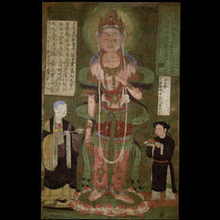
Expansion of Chinese Trade
Trade in Chine bloomed in the Yuan dynasty in the 1200’s.
The Silk Road helped transport goods to Asia Minor, Russia, and other lands. Marco Polo used the Silk Road.
When the Ming dynasty took over China in 1368, economic prosperity came over the land and trade and cities expanded.
China began overseas expansion and in 1404, Zheng He traveled to many different lands and promoted Chinese trade and culture.
Chinese city, Canton, became a global center of trade and traders were sent there from all over the world.

Slide 25
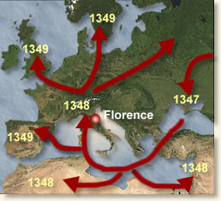
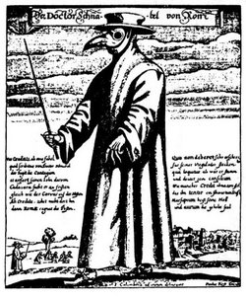
Bubonic Plague
Approximately two thirds of the population in China were wiped out by a deadly disease called the bubonic plague, that also destroyed populations of Muslim towns in Southwest Asia and killed about one third of Europe’s population.
It started in the 1300s.
The Plague began in Asia.
The disease became known as the “Black Death.”
It got its name from the purplish or blackish spots that it produced on the skin.
The disease was spread by black rats that carried fleas from one area to another. These fleas were infested with a bacillus called Yersinia pestis, and because people did not bathe and because of unsanitary conditions the bubonic plague spread very quickly.
Effects of the disease were high fever, chills, delirium, and in most cases death.

Slide 26
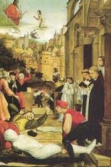
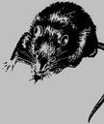
The Effect Of The Bubonic Plague
In 1347 approximately one third of European’s population died of the deadly disease known as the bubonic plague.
The bubonic plague was also known as the black death and began in Asia.
The black death traveled the trade lines infecting Asia, the Muslim world and eventually Europe.
It got its name by the black spots that produced on the persons skin infected.
The plague killed almost 25 million Europeans and millions in Asia and North Africa.
The economic effects of the plague were enormous. Town populations fell and so did trade.
The church suffered a loss of prestige when its prayers and penances failed to stop the plague.
The bubonic plague and its aftermath disrupted medieval society, hastening changes that were in the making.
The society of the middle ages was collapsing.

Slide 27
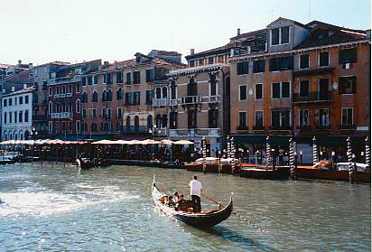
Italian City-States
1300’s: Northern Italian cities were great places of industry and trade.
City-states that became rich and powerful: Venice, Genoa, and Florence.
Venice took control of the spice trade with Asia due to its location.
Venice took up a partnership with Egypt and both areas became prosperous.
Trade from Italy went as far as Great Britain and the Baltic Sea.

Slide 28
Renaissance
1300-1600
A period of great change throughout Europe that involved advances in everything from art to technology.
The concept of humanism was developed during the early stages of the renaissance, this way of thinking focused on the present and individual achievements.
The artistic mentality of the renaissance was much like the art and sculpture of the golden ages of Rome and Greece. Architecture also returned to Greco-roman fashions.
Artisans were supported by rich nobles, princes and popes.
Some of the most famous artisans include Michelangelo, Leonardo Da Vinci and Albrecht Durer.
Writing also changed during the renaissance, common language began to be used. Machiavelli, Shakespeare, and Dante were three of the most famous for their literary works.
The invention of the printing press made books more available to common people, literacy increased.
The protestant reformation led by Martin Luther and John Calvin sought to make changes in the church, the result was two churches, Catholic and protestant.

Slide 29
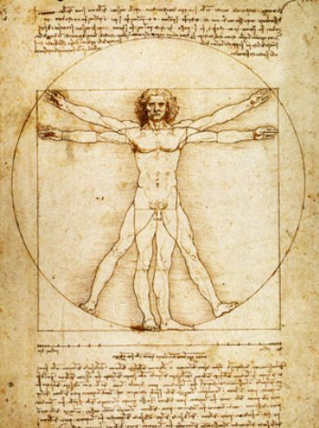
Humanism
During the Renaissance, Europeans developed a new way of thinking called humanism.
A Renaissance intellectual movement at the heart of the Renaissance that focused on worldly subjects that the ancient Greeks and Romans had studied, rather that religious ones. They hoped to use ancient learning to increase knowledge about their own times.
Humanists influenced artists an architects to carry on classical traditions.
Philosophers and writers had wondered about life after death during the middle ages. Renaissance humanists, on the other hand, were more curious about life in the present.

Slide 30
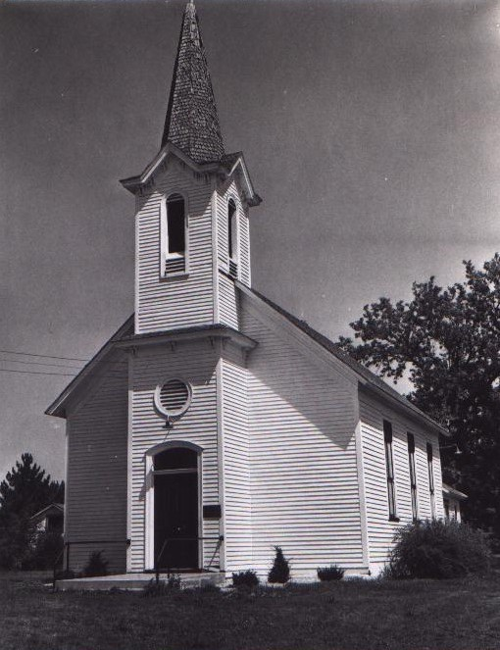
Secular
Secular teachings occurred during the Renaissance in Italy
Secular teachings were more concerned with worldly matters rather than spiritual
Secular teachings went against the church
Some church leaders though became more worldly rather then sticking with the church
They began to live in mansions, lavish banquets, and wore expensive clothing

Slide 31
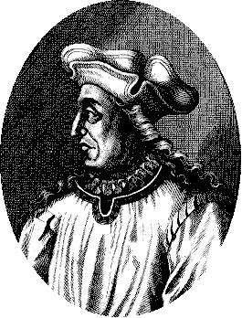
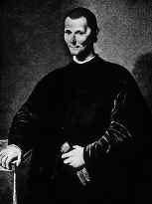
Machiavelli
What he did?
Machiavelli was the a writer , One of his master pieces was The Prince in 1513.
Machiavelli said that most rules can gain power and keep it in spit of there enemies.
In the book The Prince, Machiavelli was not concerned with what was morally right, but with what was politically effective.
He was also a states man and a political philosopher

Slide 33
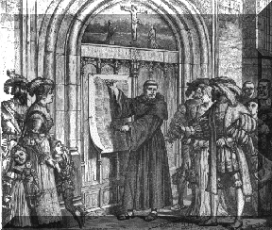
95 Thesis
WHO: Written by Martin Luther
WHAT: Martin Luther posted a list of 95 Theses, or formal statements, that he wrote on the door of a castle church in Wittenberg,
WHERE: Posted them on the door of the castle church in Wittenberg, became known all over Germany
WHEN: October 31, 1517
WHY: he did those because he did not agree with how a friar named John Tetzel was raising money to rebuild a church in Rome. Tetzel was selling indulgences to people who have sinned, which would release them from performing the penalty.

Slide 34
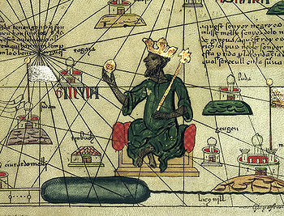
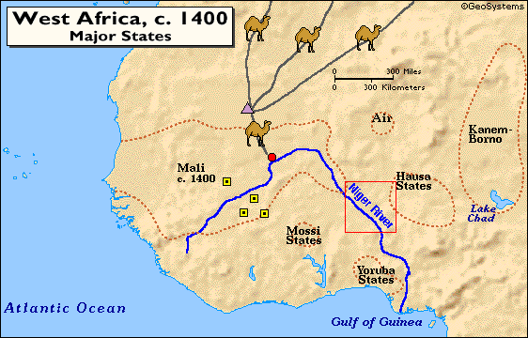
Mansa Musa
He was an African American ruler
He may have been the grandnephew of Mali’s first leader, Sandiata
Musa was a skilled military leader and exorcised royal control
He was a devout Muslim, he went on a hajj to Mecca from 1324 to 1325
Controlled and ruled a vast empire in Africa

Slide 35
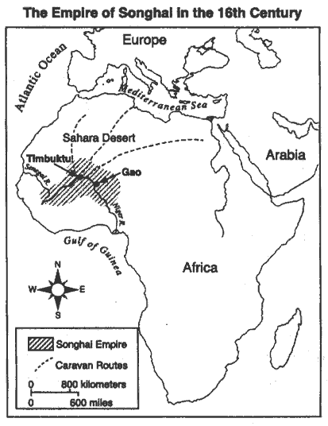
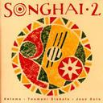
Songhai
The Songhai was a West African empire that conquered Mali and controlled trade from the 1400’s to 1591.
They built up an army and extended their territory to the Niger River near Gao, and gained control of all the important trade routes.
Until the late 1500’s, civil war broke out. Invaders from the north defeated the forces of Songhai, and caused downfall of the kingdom.

Slide 36
The First Global Age

Slide 37
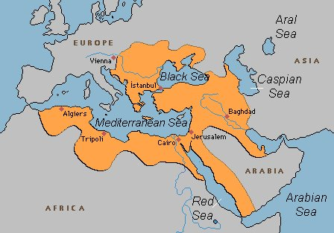
Rise Of The Ottoman Empire
The Ottoman Empire began in the 11th century
There were Ottoman Turks, and after the 13th century there was a new group of people called the Ottoman Empire lead by Osman I.
When people were captured by the Ottoman Empire they were used for military purposes instead of killing them.
During the 16th century, the Ottomans gained control of Egypt and Syria, then also Iraq, Hungry, and Albania, which led to the beginning of a naval force in the Mediterranean Sea.
The Ottoman Empire turned into a great power of Europe.

Slide 38
Suleiman’s Golden Age
First Came to the throne of the Ottoman Empire in 1520 and ruled for 46 years
Known by his own people as Suleiman the Lawgiver and in the west as Suleiman the Magnificent
The Ottoman conquered all of the eastern Mediterranean under Suleiman’s rule.
Suleiman became the most powerful monarch on earth
He required a good form of government for his large empire and so he simplified the system of taxation and reduced the government bureaucracy in order to keep the peace and his people happy.
In 1571 this golden age of Suleiman ended when his sons fleet was destroyed by Spain and Italy Suleiman’s Mosque

Slide 39
Europeans “Age of Exploration”
Motivated by the 3 G’s
Gold, God & Glory
New technology allowed them to cross large bodies of water
Astrolabes, Compass, Printed Maps, Carvel ships
The Portuguese and Spanish were the first to establish new trading routes to Asia by going around Africa
Astrolabe

Slide 40
Columbus’ Voyage connects 3 Continents
The Triangle Trade Routes

Slide 41
Middle Passage
The Middle Passage was the voyage that brought captured Africans to be used as slaves to the west Indies
Later they were brought to North and South American
It was named the Middle Passage because it was in the middle leg of the transatlantic trade triangle.

Slide 42
The Columbian Exchange

Slide 43
Mercantilism
Definition:
An economic policy under which nations sought to increase their wealth and power by obtaining large amounts of gold and silver and by selling more goods than they bought.
Ideas of mercantilism:
The nation’s ultimate goal under mercantilism was to become self-sufficient, not dependent on other countries for goods.
Two ways to increase the nations wealth, according to mercantilism, was to gain as much gold and silver as they could and establish a favorable balance of trade, in which it sold more goods than they bought.

Slide 44
Absolutism

