Slide 1
World War One

Slide 2


Militarism(1895)
A policy of glorifying Military power and keeping a standing army always prepared for war.
It was first used before World War One, when Britain and Germany were competing on who could have a better navy.
Both Germany and Great Britain were building up their Navies to make it better than each others so that they would be ready if a war came.
This policy was part of what started the war along with nationalism, imperialism, and alliances.

Slide 3
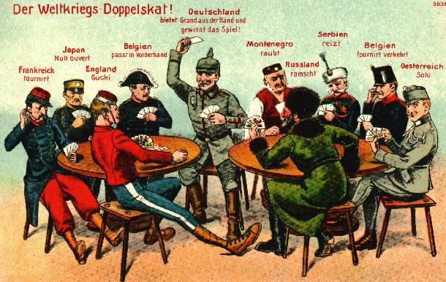
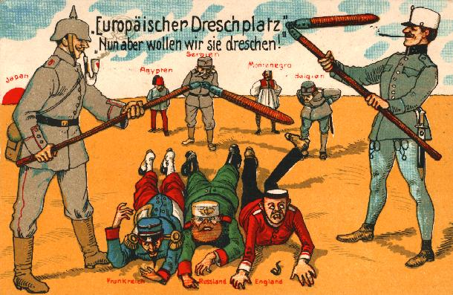
Alliances
Allies agreed to help one another fight or give war supplies to, if the other was attacked
World war one:
  The central powers were Germany and Austria Hungary
  They were against the allied powers which were Great Britain, France, and Russia
  Japan joined the allied powers in a week and Italy which at first was neutral joined the allied powers in 9 months
World War two
  Axis powers were Germany, Italy, Japan, Hungary, Romania and Bulgaria
  They were versus the allies which were U.S., Britain, France, USSR, Australia, Belgium, Brazil, Canada, China, Denmark, Greece, Netherlands, New Zealand, Norway, Poland, South Africa, Yugoslavia

Slide 4
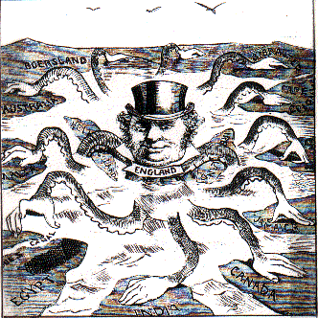
Imperialism (1800’s)
The domination by one country of the political and /or economic life of another country.
Britain, France, Germany major imperialists
Competed for colonies and economic power.
One of the causes of WWI

Slide 5
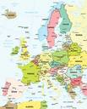
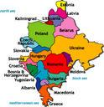

Nationalism for the Cause of WWI
Nationalism the belief that people should be loyal mainly to their nation—that is, to the people with whom they share a culture and history—rather then to a king or empire.
Nationalism can serve as a unifying force within a country. However, it can also cause intense competition between nation, with each seeking to overpower another.
By the turn of the 20th century, a fierce rivalry indeed had developed among Europe’s Great Powers. Those nations were Germany, Austria-Hungary, Great Britain, Russia, Italy and France.
The increasing rivalry among European nations stemmed form several sources. Competition for materials and markets was one.
Germany competed with Great Britain for industrial dominance because Germany’s many new industries made its economy the fastest growing power on the continent.
Nationalistic rivalries also grew out of territorial disputes. France for example, had never gotten over the loss of Alsace-Lorraine to Germany in the France-Prussian War (1870) Austria-Hungary and Russia both tried to dominate the Balkans, the intense nationalism of the people that lived there however, led to demands for independence.

Slide 6
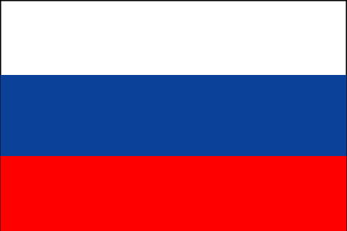
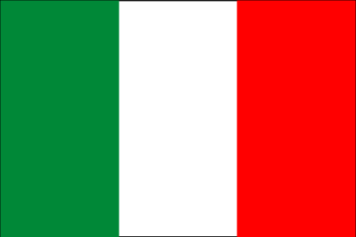



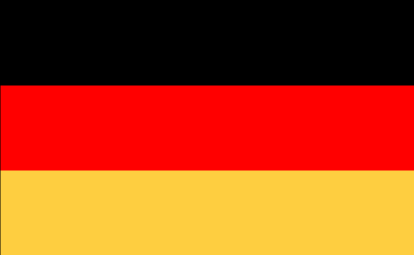
Powder Keg of Europe
The Powder Keg of Europe was the Balkans
The Ottoman Empire also known as the “Sick Man of Europe” was having problems holding on to the Balkans
Both Austria-Hungary and Russian wanted the area.
Ethnic groups such as the Serbs also wanted their own freedom in the Balkans.
Because of tensions in the area and the fear of a nationalistic revolt it was believed that this would be the area that would start a “great war”.
With the assassination of the Archduke Francis Ferdinand in the Balkans it was the spark that started World War One

Slide 7
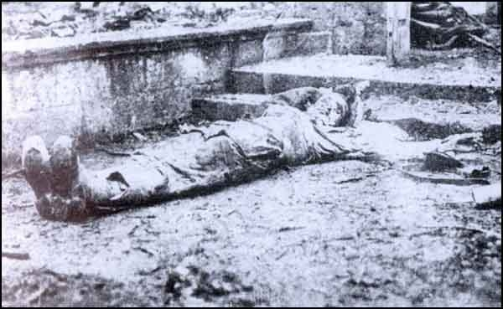
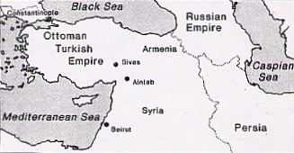
Armenian Massacre
In the 1880’s 2.5 million Christian Armenians in the Ottoman Empire begun to demand their freedom.
Relations between the Armenians and the Turks grew strained.
Throughout the 1890’s, Turkish troops killed tens of thousands of Armenians.
When World War I erupted in 1914, the Armenians pledged their support to the Turks’ enemies.
In response, the Turkish government deported nearly 2 million Armenians, along the way more than 600,000 died of starvation or were killed by Turkish soldiers.
It was the first genocide of the 20th century

Slide 8
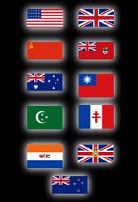
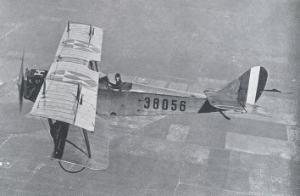
Allied Powers and Central Powers-1914
Military alliances during World War One.
Allied Powers Central Powers
-Britain Germany
-France Austria-Hungary
-Russia Ottoman Empire
-Italy, and US later joined
In 1914, millions of soldiers went off to war after
They happily marched off due to the thought of a short war.

Slide 9
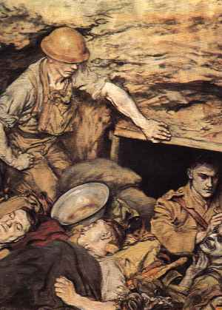
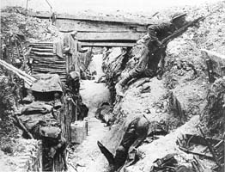
Trench Warfare
When French and British troops stopped the advance of the German Army in France both sides dug in trenches.
Neither side was able to advance over the next four years.
Life in the trenches was horrid
  Rats
  Mud
  Lack of sleep
  Death
If militarism glorified war, trench warfare did everything it could to demystify the idea of a glorious war

Slide 10
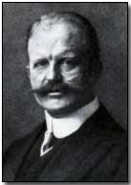
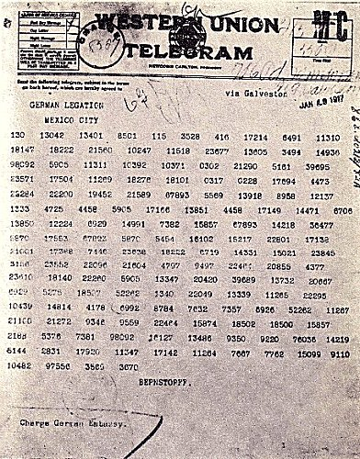
The Zimmermann telegram
During world war one, the British intercepted a telegram from German foreign secretary, Arthur Zimmermann to the German Ambassador in Mexico. The message said that Germany would help Mexico get Texas back if Mexico would be Germany’s ally. The British gave the message to the United States and they got mad. America declared war against Germany.

Slide 11
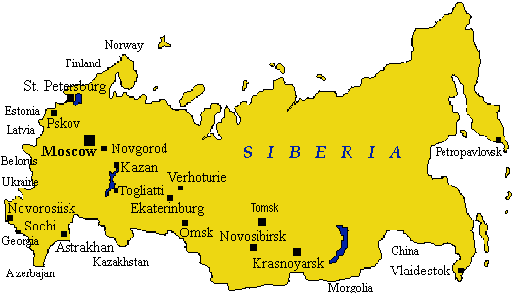
Russia withdraws from the war
Because of low morale the Russians couldn’t put up a fight anymore so they signed a treaty with Germany taking them out of the war in 1917
Russia’s withdraw from the war angered Britain and France
The treaty was called the treaty of Brest-Litovsk, it was signed in march of 1918
It was a big lose for Russia because it gave Germany a large part of the Russian territory
Although, Lenin thought it was required that they make peace with Germany at any cost so that they could deal with there own enemies at home in Russia.

Slide 12
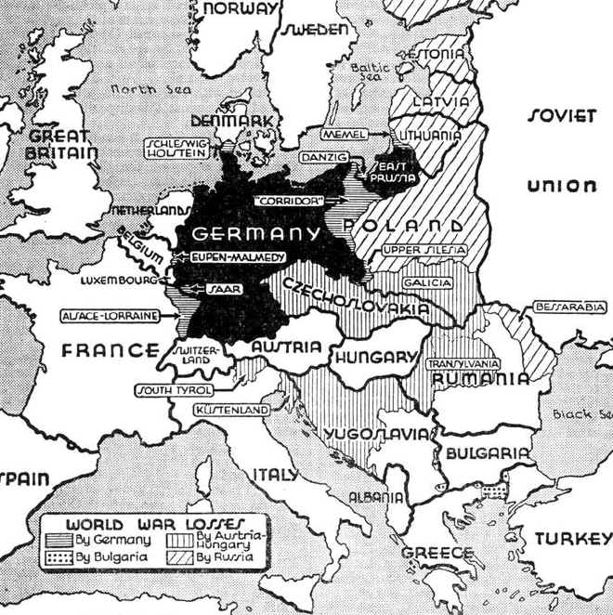
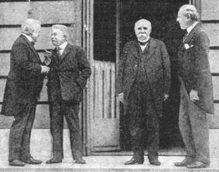
Treaty of Versailles
June 28th 1919...
The peace treaty signed by Germany and the allied powers after World War One.
The treaty punished Germany- “war guilt clause” was known as Germany had responsibility for the war and had to pay reparations to the allies.
The League of Nations was developed with the 5 allied powers (U.S. ,Great Britain, France, Italy and Japan). It was an international peace organization and Germany and Russia were excluded.
The treaty limited the size of Germany, forbidden Germany to build or buy submarines, and Germany returned Alsace-Lorraine to France.
The treaty was caused for a bitter Germany and led to World War Two.

Slide 13
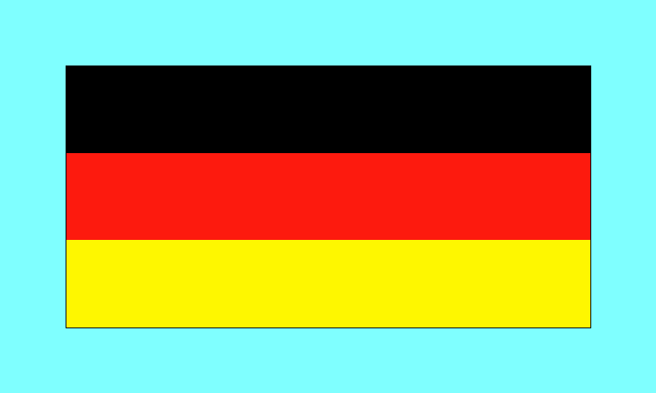
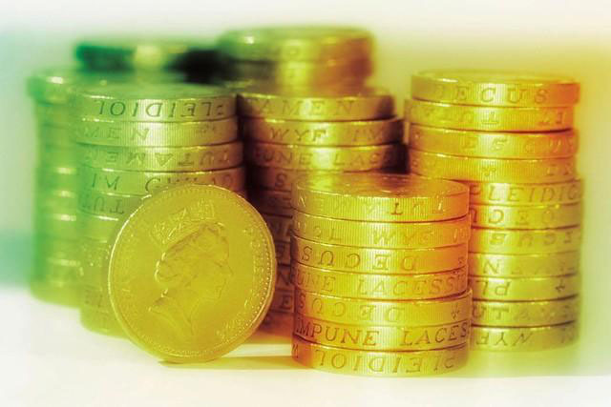
War Guilt Clause
Treaty Of Versailles
The Treaty of Versailles was signed by Germany and the allied powers, after World War I, on June 28,1919.
Part of this treaty included a clause called the war guilt clause.
This clause placed the guilt, or responsibility, of the war entirely on Germany.
Germany was forced to pay the allies $33 billion in reparations over 30 years.
This clause was unfair because it placed all the guilt upon Germany.
This clause would later lead to World War II.

Slide 14



League of Nations
An international association formed after WW1 with the goal of keeping peace among nations
The League of Nations had no military backing and could not stop conflicts between nations
The League of Nations also lacked the support of the United States
The League of Nations was considered a failure and could not stop World War Two.
It was disbanded after World War Two and The United Nations was formed.

Slide 15
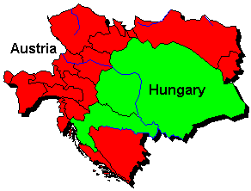
Break up of Austria-Hungary
Due to the war Austria-Hungary’s government fell apart.
New nations formed as a result.
Including: Austria, Hungary, Czechoslovakia, and Yugoslavia.

Slide 16
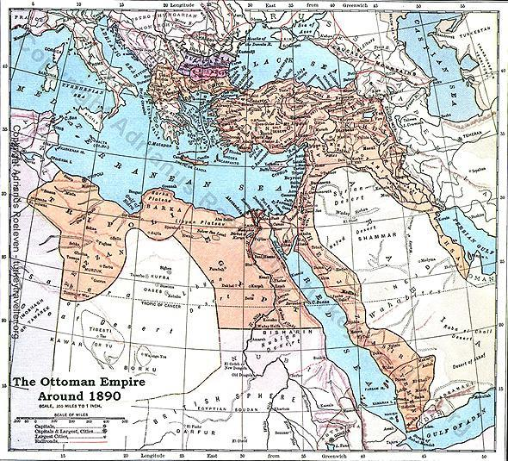
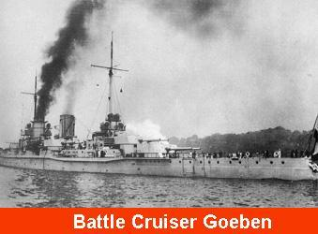
The Fall Of The Ottoman Empire
With the end of the war the Ottoman Empire fell apart.
Many of the lands in the Middle East were taken over by the British and the French
Areas such as the Balkans became independent states
Turkey became it’s own independent state

Slide 17
Russian Revolution

Slide 18
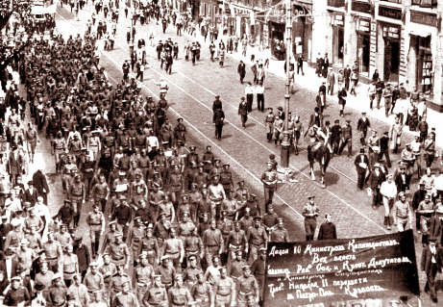

Causes of the Russian Revolution
CZARIST RULEA : In the late 1800s Alexander and his son wanted to industrialize the country and build Russia's economic strength.
PEASENT UNREST : the rigid system of social classes still existed in Russia at the beginning of the war. Landowning nobles, priests, and an autocratic czar dominating country. The peasants faced many difficulties , most were to poor to buy the land they worked on , and the ones who did own land were to poor to feed there families .
PROBLEMS OF URBAN WORKERS : Some oesents had to move to the cities and found jobs in new industries. They worked long hours, and their pay was low. Most lived in slums that had a lot of disease and poverty.

Slide 19
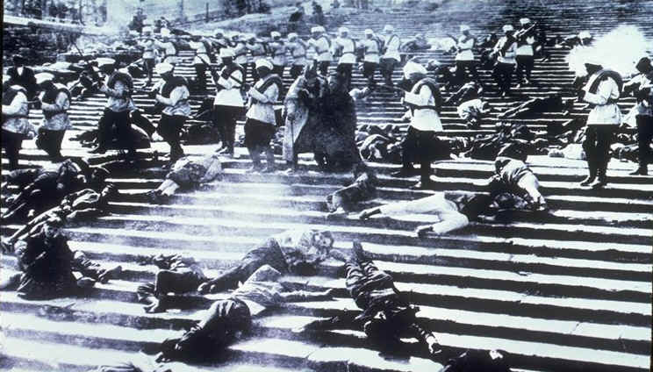

Bloody Sunday (1905)
January 22, 1905…
200,000 workers and their families approach the czar’s palace during a peaceful protest.
They had a petition asking for better working conditions, more freedom and an elected national legislature.
The soldiers killed between 500 and 1,000 unarmed people.
October 1905…
Nicholas promised more freedom, although he still opposed reform.
Bloody Sunday Provokes…
Bloody Sunday sparks other strikes and violence across the country.
Effect…
The Czar is forced to make reforms and the Duma is created.

Slide 20
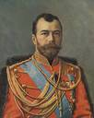

Duma (1905- 1917)
Nicholas II
The Russian czar before and after the loss in war against Japan
Bloody Sunday
Nicholas massacres a peaceful protest
Formation of the Duma
In attempt to calm the Russian peasants forms “the Duma”
The duma is a committee that must approve all laws and rights in Russia before they are passed
The Rise
After Nicholas was shot by own army in a protest, the duma took control of Russia.
The Fall
When Lenin came to power he dissolved the duma with communism.

Slide 21

LENIN(1917-1924)
LENIN AND THE BOLSHEVIKS GAINED POWER BY PROMISING “PEACE, LAND, AND BREAD.”
THE PEOPLE WERE TIRED OF RUSSIS INVOLVEMENT IN WORLD WAR ONE.
HE WAS THE LEADER OF RUSSIA
CHIEF GOAL WAS TO CREATE A COMMUNIST CLASSLESS SOCIETY
ALLOWS SOME OF THE PRIVATE BUSINESS TO SUCCEED SUING HIS NEP OR NEW ECONOMIC POLICY
LETS SOME PEASANTS HOLD LAND
STANDARD OF LIVING RISES FOR MANY WORKERS AND PEASANTS

Slide 22


Bolsheviks
Definition: a small group of Russian workers who came together to overthrow the czar
The leader of the Bolsheviks was Vladimir Ilyich Ulyanov, who later adopted the name Lenin.
Later in 1917 the Czar stepped down due to the demands of the people over the shortage of food, fuel, and the war. Lenin and the Bolsheviks decided to take action to gain power.
Lenin created the slogan “Peace, Land, and Bread” to gain wide respect from the people. This started The Bolshevik Revolution.

Slide 23

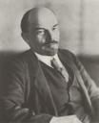
Reasons for Success of Communism
Communism succeeded in Russia because:
The peasants of Russia were oppressed under the rule of the czar.
The peasants made up the majority of the population, so when they revolted, they significantly out numbered the Czar’s supporters.
Once communism was established, the peasants were happy because they now had a guaranteed supply of food, and a piece of land to live on.
The Russians were also able to keep up with the rest of the world economically using the Five Years Plan, even after having been so far behind.

Slide 24
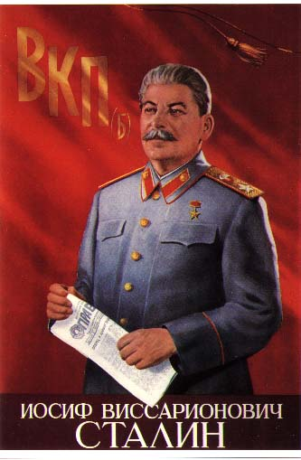
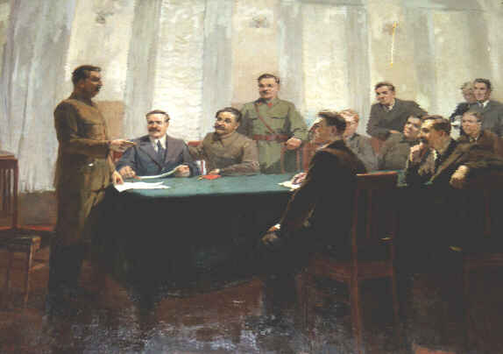
Stalin
Born into poverty.
Not well educated.
Was seen a a crude man. Was also cold, hard and cruel
Would use brutality and murder to enforce his reign as dictator.
Stalin will become one of the most brutal leaders in history.
In 1928 Stalin obtained control of the government.
Stalin turned the Soviet Union into a totalitarian state.
Stalin was the dictator and controlled the one party system of government.
Stalin created his totalitarian state by getting rid of his enemies.

Slide 25
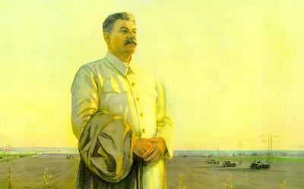
Great Purges
In 1934 Stalin turned against the members of the communist party
He launched a campaign of terror directed towards eliminating the Bolsheviks
Thousands of Bolsheviks were forced to stand trial and were executed for crimes against the Soviet state
The police could arrest on the most minor acts
Even the police were arrested if they did not meet their quotas for arrested criminals

Slide 26
  Stalin's Forced Famine
Many peasants resisted having to farm for the government.
Kulaks or wealthy farmers burned their crops and killed off their livestock to resist Stalin’s collectivization.
Some peasants continued to resist and only grew enough crops for themselves.
Stalin seized all these crops.
Entire communities starved.
Areas like the Ukraine who were opposed to collectivization had five million people die of starvation.

Slide 27
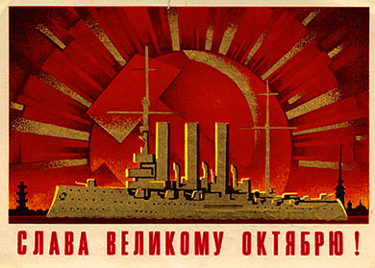

Five Year Plan
Stalin outlined the first five year plan.
There was several five year plans.
The plan was to catch up to the rest of the world or industrialize.
The plan set high quotas to increase the output of major goods.
Stalin decided to break up the progress of the country using 5-Year Plans.
The plans would
  Strengthen the country
  Make the country self-sufficient
  Lead to a true workers society.
5 Year Plans were a success.

Slide 28
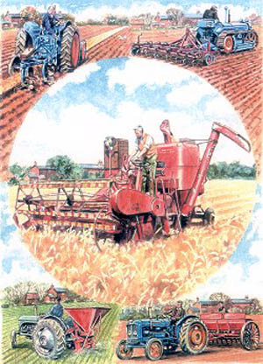
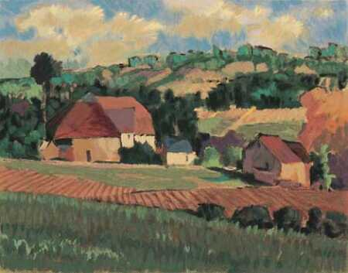
Collectivization
Work farmers needed to produce enough food for industrial workers.
When Stalin felt farmers weren’t making enough food he took over the farms.
Stalin then created collective farming.
These involved small farms joining forces to form large-scale units. (Like enclosures)
Farmers could then afford the latest machinery and share farming.
Stalin believed this would lead to increased production.
Collectives were a failure.

Slide 29
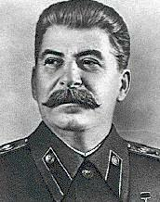
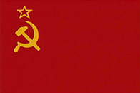
Command Economy
An economic system in which the government makes all economic decisions.
Under this system political leaders identify the countries economic needs and determine how to fulfill them.
The Soviets used this economy.
Stalin ushered in revolutions in industry and agriculture.

Slide 30
The Rise of Dictators

Slide 31
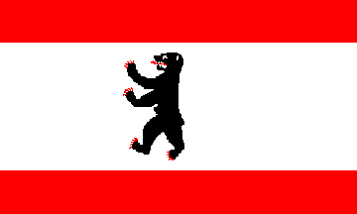
Totalitarian State
Exercises total control over the people
Dominates government
State controls
  Business
  Family life
  Labor
  Youth groups
  Religion
  Education
  The arts
  Housing
Demands total obedience to authority and personal sacrifice to the state
Use force, such as police terror, to crush all opponents
Totalitarian leaders
  centralize the government
  control every aspect of public and private life
  appear to provide a sense of direction
  limit values such as freedom, dignity and individual worth.

Slide 32
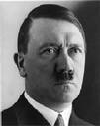
Hitler
    Hitler’s rule
    He was a dictator, created the Third Reich in Germany
    Gained control with a slim majority.
    Used propaganda and brute force to glorify himself and War.
    He moved his armies into countries like Austria and Czechoslovakia
    Eventually his aggressive behavior started the bloody WWII.
    It becomes a fight between the Allied and the Axis powers
    Millions died in the war
    Holocaust
    He had hatred for Jews, Anti-Semitism, and started persecuting them.
    Laws prevented Jewish rights, and on Kristallnacht many were persecuted
    The Final solution began to exterminate Jews by the millions in concentration camps.
    About 6 million were murdered

Slide 33
Weimar Republic
Germany’s Democratic government set up in 1919. (named after the birth place of National Assembly)
At the time, the Weimar Republic was weak because of Germany’s lack of democratic tradition.
The economy was very weak.
The people blamed the democratic government for both the depressions in Germany and for signing the Treaty of Versailles.
The Weimar Republic became and easy target for the Nazi Party to rise up against.

Slide 34
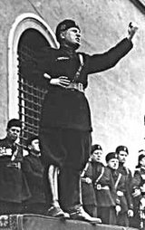
Fascism
Fascism emphasized loyalty to the state and obedience to the leader.
Fascists promised many things and gained favor of the peasants.
Fascism is based mostly on nationalism, or loyalty to one’s country.
Also believed in a strong military
Fascists used propaganda and wore certain colored uniforms to display their authority.
Fascism like communism, the country was ruled by a dictator who used fear and terror.
Stared in Italy in the later 1920’s.
Fascists believed that each class had a certain place and function unlike communism.

Slide 35
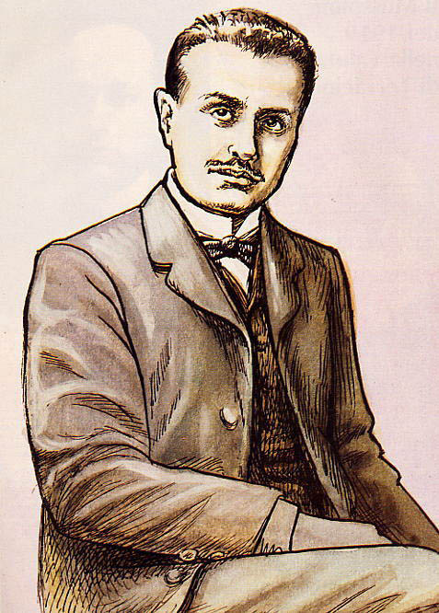
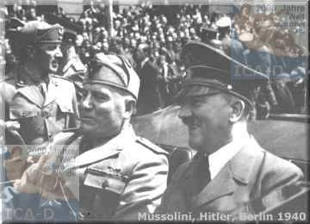
Mussolini
He was a newspaper editor and politician who promised to rescue Italy by reviving its economy and rebuilding it’s armed forces.
He vowed to give Italy strong leadership.
He founded the Fascist party in 1919.
He failed to gain widespread popularity at first, but as the economy worsened his popularity rapidly increased.
Mussolini publicly criticized Italy’s government and a group of Fascists attacked communist and socialists.
Because Mussolini played on the fear of a workers revolt he began to win support of the middle class, the aristocracy, and the industrial leaders.
Thus after widespread violence and a threat of armed revolt Mussolini “legally” took power.
When in power he abolished democracy and all the other political parties besides Fascism.
He put censors on the press, so they could only report Fascist doctrines.
His country became the model for other fascist governments.

Slide 36
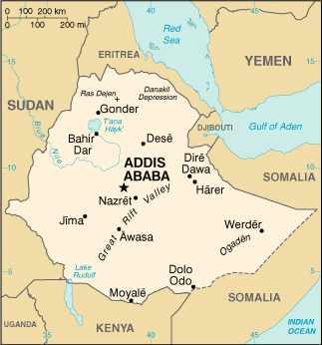
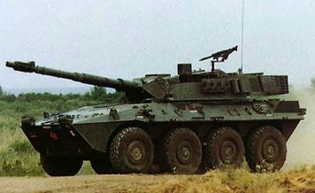
Italy Invades Ethiopia
1935- Italian army invaded African country of Ethiopia
Ethiopians resisted, but the Italians had armored vehicles, aircraft, and poison gas (much better weapons then Ethiopian weapons).
The Ethiopian king appealed to the League of Nations
The League of Nations agreed to stop the sale of weapons and other war materials to Italy.
The agreement was not honored by all nations.
Ethiopia fell to Italy and the League of Nations showed it was powerless to stop the rise of dictators.

Slide 37
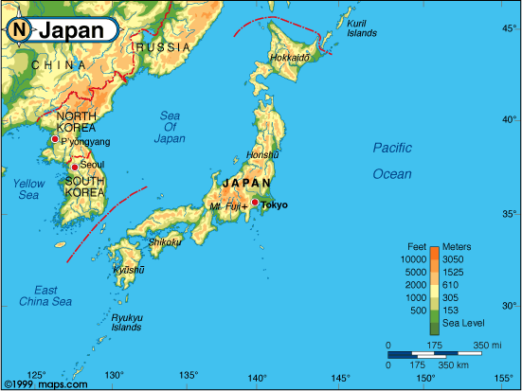
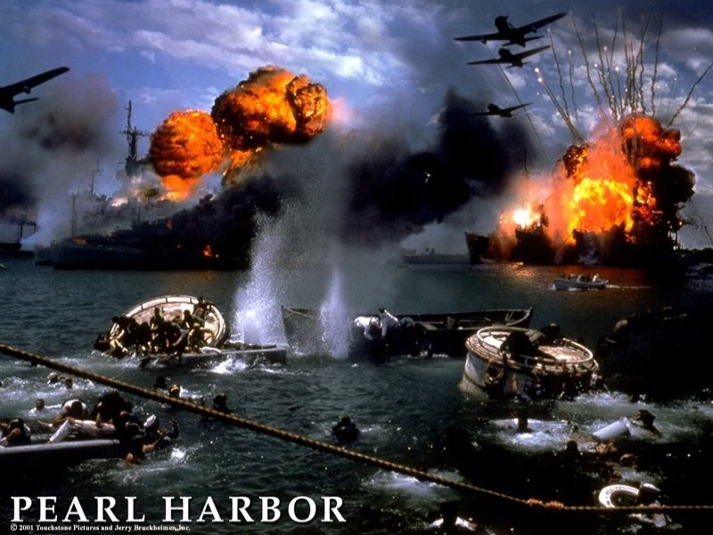
Japan-Militarism and Expansion
Why Japan expanded
Japan was an modernized country that needed resources they lacked like oil, steel, and coal.
Japan decided to go out into other countries and get those recourses
When Japan expanded
Japan’s expansion started 1931
What came from Japan’s expansion
Japan with its expansion they wanted as much land as possible
Japan attacked Pearl Harbor Dec 7th, 1941
This lead to World War II

Slide 38
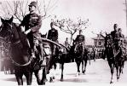

Japan Invades China
In 1931, Japan watched China’s Communist vs. Nationalist civil war with interest
Took advantage of the country’s weak situation and invaded Manchuria-start of WWII in Asia
In 1937, Japan launched an all-out invasion of China
Massive destruction of villages and farms, starvation was rampant in China
Communists and Nationalists temporarily formed a truce to fight off the Japanese
The invasion of China by Japan caused strained relations between Japan and the U.S. and the U.S. cut off it’s oil supply to Japan
This would lead to Japanese aggression towards the U.S. and the bombing of Pearl Harbor.

Slide 39
World War Two

Slide 40
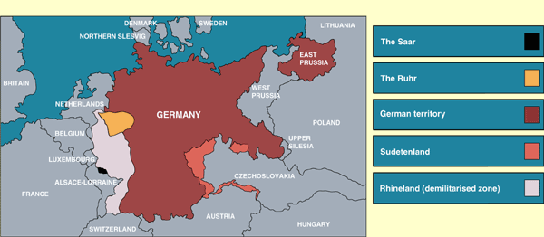
Appeasement
Definition: Appeasement is giving in to an aggressor in order to preserve peace.
Appeasement was used in WWII.
On March 7, 1936 German troops moved into the Rhineland, and the stunned French were unwilling to risk war.
The British urged appeasement to keep from starting another war with Germany.
Hitler later admitted that if the French and British had challenged him and not practiced appeasement that he would have backed down and WWII could have very well been avoided.

Slide 41
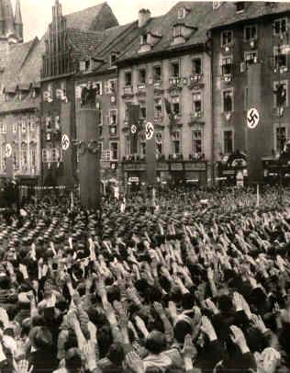
Munich Pact
In September 1938 Hitler demanded the western part of Czechoslovakia known as the Sudetenland become part of Germany.
Hitler claimed that 3 million German speaking people lived there and should be German territory.
The Czech Government refused to give the Sudetenland to Hitler.
The Czech’s had an alliance with France and asked France for help.
Britain and France began to prepare for war.
To avoid war the British, French Germans and Italians meet at the Munich conference.
Great Britain in a effort to avoid war appeases Germany and gives Hitler the Sudetenland. Hitler promises not to take anymore land in Europe.
6 months later Hitler takes the rest of Czechoslovakia.
Appeasement was a failure.

Slide 42
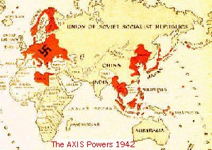
Axis Powers
During World War II
Alliance between Germany, Japan, Italy
Known as the Berlin-Rome-Tokyo Axis
They set out to gain world domination.
Agreed to help fight for and protect each other if other countries declared war on them.

Slide 43
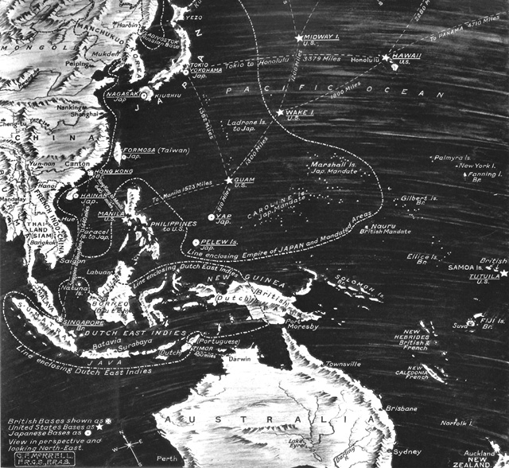

Pearl Harbor
Japan began its expansion in 1931. To increase their resources, Japanese leaders looked toward the rich European colonies of Southeast Asia.
The United States knew that if Japan conquered European colonies there, it could also threaten United States island colonies.
After the United States cut off oil supply in Japan, the Japanese began planning a massive attack on Southeast Asia and in the Pacific, both at the same time.
On December 7, 1941, American sailors at Pearl Harbor in Hawaii awoke to the roar of explosives.
It was mostly an air strike, and within two hours, the Japanese had sunk or damaged 18 ships.
The day after the attack, Congress declared war on Japan.
President Roosevelt described December 7 as “a date which will live in infamy.”

Slide 44


Battle for Stalingrad
Stalingrad was a major industrial center of the Soviet Union
The battle began on August 23, 1942
Stalin told his soldiers to defend the city at all costs, “Not one step backward”
By November, the attacking Germans controlled 90% of the city
Soviets outside the city counterattacked, surrounded the Germans, and cut of their supplies
In February, the 90,000 remaining of the 330,000 German army surrendered to the Soviets
This was a turning point, with the Germans now on the defensive

Slide 45


D-Day
D-Day invasion
By May 1944, the invasion was ready. (WW2)
Thousands of planes, ships, tanks, landing craft, and 3.5 million troops were ready to move
American General, Dwight D. Eisenhower, planed to strike the coast of Normandy
The Germans knew and attack was coming but they did not know where
The allies sent a dummy army to the France seaport of Calais
The code name “Operation Overload” was the greatest invasion in history
The day chosen for the invasion was June 6th 1944, D-Day
The Battle
The American, French, British, and Canadian troops were deployed on a beach in Normandy
The Germans protected them selves by staying behind concrete walls and using machine guns
About 3,000 Americans died that morning
The Allies eventually won the battle and within another month 1 million more troops had landed there
The Germans were forced into full retreat

Slide 46


Hiroshima/Nagasaki
The two cities in Japan that the United States bombed at the end of World War II.
The cities were completely destroyed, Hiroshima first and Nagasaki three days later.
President Truman decided to drop the bombs on Japan when Japan failed to surrender to the U.S. in 1945.
The affect that the Nuclear bombs had on these cities was deadly. 70,000 people died immediately, and 200,000 were killed due to the bombs’ repercussions.
Japan surrendered to the U.S. on September 2, 1945. With the surrender, World War II had officially ended.
The dropping of the bomb made the U.S. a superpower
The creation of these bombs lead to an arms race between the U.S. and the Soviets, each country fearing that they were weaker than other.

Slide 47


Winston Churchill
Prime Minister of England during WWII-
Churchill and his country England were an ally of the United States, Russia, and France during the World War II.
Yalta Conference-
In 1945, Winston Churchill, Roosevelt, and Stalin met to decide what would happen as the World War was coming to a close.
They decided to divide up Germany and Russia, England, and the United States would all have a portion.
All knew, that everybody would go for creation of new governments after the war in Europe.
Also, they knew that Stalin would oversee the creation of new governments in Eastern Europe.
Churchill is well known for his good leadership and involvement with World War II, and help with the United States.

Slide 48

Genocide
In the present Convention, genocide means any of the following acts committed with intent to destroy, in whole or in part, a national, ethnical, racial or religious group, as such:
(a) Killing members of the group;
(b) Causing serious bodily or mental harm to members of the group;
(c) Deliberately inflicting on the group conditions of life calculated to bring about its physical destruction in whole or in part;
(d) Imposing measures intended to prevent births within the group;
(e) Forcibly transferring children of the group to another group.

Slide 49


World War Two: Holocaust
The Holocaust:
The murder of over 12 million people mainly Jews, also Gypsies, Homosexuals
Lead by Adolf Hitler who came to power following WW2 and took power with his Nazi power spreading Anti-Semitism or the hatred of Jews throughout Germany
The Jews were used as a scapegoat, the cause of Germany’s problems
By eliminating the Jews he was promoting his Aryan race, a pure German race superior to others
The plan to eliminate all the Jews was called the Final Solution, Jews were executed by the masses, gassed to death in gas chambers, starved in ghettos and death camps, and humiliated all because they were different

Slide 50

Nuremburg Laws
These were laws that deprived Jews and made discrimination against them legal
All Jews were required to wear a yellow star of David to identify them
Treatment of the Jews continued to worsen until they were sent to slave labor camps, and death camps
Nuremberg Laws
  In 1933 after Hitler comes to power he enacts the Nuremberg Laws.
  These laws were designed to treat Jews as second class citizens.
    It took away their rights
      To vote
      Fly the German flag
      Had to wear the Star of David
      Change their name from a German name to a Jewish name.

Slide 51

Kristallnacht
A major increase of Nazi persecution of Jews.
November 7th , 1938 a Jew shot a German official.
November 9th 1938, Nazis attacked Jewish homes, synagogues, and businesses.
The streets were littered with glass and the attack was named Kristallnacht or Night of the Broken Glass.
Around 100 Jews were murdered that night.
It was the first outright violence against the Jews in Germany and Austria and is considered the start of the Holocaust

Slide 52

Final Solution
∙Hitler’s Plan
Once World War Two started Hitler wanted to expand the boarders of Germany eastward.
The problem was what to do with the Jews and Slavs who occupied the land.
The first measure was to deport the Jews to Ghettos, areas set up in major Polish cities.
The Final Solution was a program of genocide.
It was the systematic killing of an entire group of people.
Gas chambers were used for mass murder killing up to 6,000 humans a day.
∙Other Races
The Nazi’s eliminated other races too, not just the Jews.
These races included: Poles, Russians, homosexuals, the insane, the disabled, and the incurably ill.
∙The Final Stage
Six million Jews died in the mass killings.
Five million others also died during the Holocaust

Slide 53

Concentration Camps
During the Holocaust, Nazi Germany imprisoned millions of Jews in concentration camps.
The first concentration camps started in the early 1930s. They held fewer people at the time, and did not use lethal tactics as often.
From the start of the Holocaust to 1945, over 6,000,000 Jews were killed.
Some of the major camps were Dachau, Auschwitz, and Treblinka.
Prisoners often died from forced labor, mass starvation, and execution

Slide 54


Nuremburg Trials
To deal with Germany’s guilt in World War Two, the International Military Tribunal, representing 23 nations, put Nazi war criminals on trial in Nuremburg, Germany
22 Nazi leaders were charged with waging a war of aggression, as well as violating the laws of war and committing crimes against humanity
Of the 22 defendants, 12 were sentenced to death for their actions during the war and the Holocaust
One of the twelve committed suicide, and the other 11 were hanged on October 16, 1946

Slide 55


ddd
Effects on Europe and the World
Human losses:
Over 75 million people died in WWII.
- 38 million died in European countries alone.
- The Soviets suffered the heaviest loss, losing 22 million people.
Economic Losses:
Cities and country sides were in ruins throughout Europe and Asia.
War Crime Trials:
Trials were held in Nuremburg from Nov. 1945 to Sept. 1946 for those accused of “crimes against humanity”.
Occupied Nations:
- To prevent another world war the U.S. occupied Japan and West Germany and the Soviets occupied East Germany and Eastern Europe.

Slide 56
Nationalism After WWII

Slide 57



Turkish Nationalism
The breakup of the Ottoman Empire and growing Western influence in Southeast Asia spurred the rise of nationalism in this region.
After WWI Turkey was all that remained of the Ottoman Empire.
Their sultan was weak and corrupt.
Turkish nationalists overthrew the last Ottoman sultan, by the leadership of Mustafa Kemal.
In 1923, the leader of the overthrow became president of the new Republic of Turkey, the first republic in Southwest Asia.
He ushered many reforms that helped transform Turkey into a modern nation.

Slide 58
Nationalism in India

Slide 59

Indian Nationalism
In India people had very few rights under British Imperialism.
During World War I Britain had promised Indians that who ever fought in the war for them would be freed and that they would have their own self-determination
After the war Britain fail to fulfill these promises
The Amristar Massacre
  In 1919
  Riots and attacks on British citizens in the city of Amristar
  Public meetings were banned
  When a large group of Indians assembles on April 13 the British troops were called in
  They fired upon the Indians without notice and killed about 400 people
Gandhi
  Headed the Indian Nationalist movement
  He taught non-violent resistance and civil disobedience
  Used non-violent protesting such as boycotts
  Rejected the caste systems and urged equal rights for all, including women
  India did not get independence until 1947, one year before Gandhi's death

Slide 60


Indian National Congress
In 1885, the Hindu nationalist leaders in India formed the Indian National Congress.
The Congress was made up mostly of Hindu professionals and business leaders, who called for equal opportunity to serve in the government of India. They wanted greater democracy and western style modernization, looking toward self rule.
Their opposing party was the Muslim League, which was made up of Muslims who wanted to protect Muslim interests, and were concerned that the Hindu Congress Party would be looking out for Hindu interests more so than Muslim interests.
The leader of the Muslim League, Muhammad Ali, had been a former member of the Hindu Congress Party, but he insisted that he only spoke for Muslims.
Despite what he said, many people wanted him to resign from the position and felt that he could not be trusted.

Slide 61


Muslim League
The Muslim League was a group of people formed in 1906 to get rid of foreign rule in India.
Although problems existed between the Muslims and Hindus, they joined together and found a common ground to get rid of the British.
Both groups worked toward the goal of National Independence.
They finally gained their independence in 1947.

Slide 62

Amritsar Massacre
1919 India
To protest the Rowlett act10,000 Hindus and Muslims gathered at Amritsar and at a huge festival intended to fast, pray and listen to political speeches.
This demonstration particularly the alliance of Hindus and Muslims alarmed the British rulers or Raj.
The British felt that the Hindu and Muslims who wanted Nationalism would protest at this festival.
Only days previously the British had banned public meetings however most people at the festival were unaware of the decree.
British commander Reginald Dyer ordered his troops to open fire, the shooting lasted 10 minutes 400 were killed and 1200 wounded.

Slide 63

GANDHI
Gandhi was a civil rights activist who wanted to free India from British oppression.
Gandhi used civil disobedience to catch the attention of the world
In the 1920’s Gandhi began his system of civil disobedience.
Gandhi wanted to weaken the control of the British government over the Indian people.
Gandhi called for the following measures.
  Called for Indians to boycott British goods.
  Gandhi called for Indians to make their own clothing.
  Gandhi spent one hour a day at the spinning wheel making his own thread.
  The spinning wheel becomes the symbol of Indian Nationalism.
He spent a lot of his time in the prisons fasting.
Conducted the Salt Marches against British who controlled the sale of salt.
Gandhi had shown the people that they could survive without the British.
That the people could make their own salt, clothing,
and run their own government.
Gandhi showed the people the way.
Gandhi was assassinated by a Hindu who
thought Gandhi favored the Muslims

Slide 64


Civil Disobedience
Gandhi developed the principle of satyagraha or “truth force”. In English, it is called passive resistance or civil disobedience.
Civil disobedience is the deliberate and public refusal to obey an unjust law.

Slide 65


Salt March
One of his most striking actions was the Salt March that started on March 12, 1930 and ended on April 5
Gandhi led thousands of people to the sea to collect their own salt rather than pay the salt tax.
The salt march was when Gandhi and his followers boycotted British salt
The British were taxing the salt
Gandhi marched 240 miles to make his own salt from the sea
Gandhi had shown the people that they could survive without the British.

Slide 66


Quit India
The 'Quit India' movement was followed, nonetheless, by large-scale violence directed at railway stations, telegraph offices, government buildings, and other emblems and institutions of colonial rule.
There were widespread acts of sabotage, and the government held Gandhi responsible for these acts of violence, suggesting that they were a deliberate act of Congress policy.
Gandhi resolutely denied these charges, but the deadlock was not to be resolved.
It has been suggested that though Gandhi himself did not authorize violence, he had grown skeptical of the efficacy of non-violence.
The 'Quit India' movement was a failure in that it invited the government to unleash repression, and therefore led to the detention of the Congress leadership.
The 'Quit India' movement remains, in any event, among the most controversial episodes in Gandhi's life and modern Indian history.

Slide 67


JAWAHARLAL NEHRU
Born November 14, 1889;
He rose to become the top political leader of the Indian National Congress Party for independence from Britain
In his road to the top he was jailed seven times and after independence he served as the Prime Minister
from 1947 until the day he died may 1964
He was also one of the founders of the non alignment movement.

Slide 68


Indira Gandhi (1966 – 1984)
After the death of Jawaharlal Nehru, his daughter, Indira Gandhi became the Prime Minister of India in 1966 and was re-elected in 1980.
Under her rule the country increased their food grain production.
Gandhi faced problems with Sikh extremists,
  Sikh terrorists took refuge in the Golden Temple.
  The Indian Army overran the temple killing 500 Sikhs and destroying sacred property.
  In retaliation of this act Indira Gandhi was shot and killed by two of her Sikh bodyguards.

Slide 69


Pakistan
Pakistan gained its independence in 1947.
After Pakistan’s independence they suffered from religious and ethnic fighting with India
For the civil war in Pakistan, they began as a divided nation with more than 1,000 miles of Indian territory as the divider.

Slide 70


Muslim / Hindu Conflict
Hindus held the majority over the Muslims in India
When British Officials drew up the borders that divided the Hindus From the Muslims In an area called Pakistan
The independence caused millions of Muslims and Hindus to migrate to their newly formed country
Many were killed crossing the border.
In later years India and Pakistan would still clash over border disputes.
Both countries possess nuclear weapons and have threatened war many times.

Slide 71
Cold War

Slide 72

Cold War
The Cold War was a continuing state of tension and hostility between the United States and the Soviet Union.
It started after World War II
It was considered a “cold” war because armed battle between the superpowers did not occur.
The United States feared communism and wanted to stop the Soviet Union from spreading it.
Even though the United States and the Soviet Union never fought directly, they fought through other countries like in The Vietnam War and The Korean War.
It was and arms race. Each country raced to have the most nuclear weapons.
It eventually turned into and economic war with the United States winning.

Slide 73


Yalta Conference
Cold War
Postwar Plan
In February 1945 Roosevelt, Churchill and Stalin met in the Soviet Union to decide what was going to happen to Europe after World War Two
They agreed to divide Germany into zones of occupation controlled by the Allied military forces, ( East and West ).
France/Britain/United States- West Germany
Soviet Union- East Germany

Slide 74


United Nations
When the UN was started
June 1945 US and Soviet Union joined with 48 other countries to form the UN
Why the UN was started
The countries wanted a peacekeeping organization that could stop wars and protect the citizens of the world.
All countries were to be invited to join the UN
The Security Council
The Security Council was 5 permanent members: Britain, China, France, US and USSR
The difference between the UN and the League of Nations was that the UN was to have the support of all countries and also have a military to keep peace in the world

Slide 75


Universal Declaration of Human Rights
In 1948, the U.N. ratified this document to set down human rights standards for all nations
It states that all human beings are born free and equal in dignity and rights
Everyone has the right to life, liberty, and security of person
Many people around the world became involved in assuring that these rights were respected
Many organizations, like Amnesty International, work to track human rights violations

Slide 76


Two Superpowers
After World War Two, many of the leading nations in the world were in decline (Germany, France, Britain).
The United States and the Soviet Union emerged after World War Two as the two world superpowers.
Superpower- describes each of the rivals that came to dominate global politics after World War Two.
Many other states in the world came under the domination or influence of these powers.
United States- Democratic
Soviet Union- Communist

Slide 77

Divided Germany
From 1945 until 1990, Germany was divided into two countries: East Germany and West Germany.
East Germany was Communist and West Germany was a democracy.
The capital, Berlin, was divided into two cities as well.
All of this was decided at the Yalta Conference.
The Soviets wanted to keep Germany weak so they could not start another World War and insisted on a divided Germany.
The western countries wanted to help Germany rebuild.
Because of these disagreements, they split Germany in two, eastern side would be controlled by the Soviets, and the western side by the United States.
Germany was united after 1989 when the Berlin Wall separating the two countries was torn down.

Slide 78


  The Iron Curtain
After the war the Soviets were responsible for re-building Eastern Europe.
Stalin wanted a buffer zone in Europe.
Soon Stalin supported pro-communist governments in eastern Europe.
Europe became divided east=communist west=democracy
This became known as the Iron Curtain.
These pro-communist countries loyal to the Soviet Union became known as satellites

Slide 79


Containment
The United States developed a program called Containment.
This policy was first outlined under the Truman Doctrine.
  The U.S. would use military alliances-NATO
  Economic aid-The Truman Doctrine The Marshall Plan
  Military involvement-Korean War/Vietnam War
To stop the spread of Communism in the world

Slide 80
Truman Doctrine
A US policy of giving economic and military aid to free nations threatened by internal or external opponents, announced by President Harry Truman in 1947
On Dec. 31, 1946, President Truman declared an end to the period of World War II.
Early in 1947 the British said they could not support the Greek government after March 31.
President Truman met the problem by asking Congress for 400 million dollars to aid Greece and Turkey. Congress appropriated the money. This policy of aid, popularly known as the Truman Doctrine, was an American challenge to Soviet ambitions throughout the world.
The Communists gained control over many nations in eastern Europe
President Truman realized that the U.S. would have to lead in the fight for freedom

Slide 81


Marshall Plan
Much of Western Europe was in ruins after World War II
Marshall Plan – U.S. would give aid to any European country that needed it
The plan cost $12.5 billion dollars, and was approved after Czechoslovakia was seized by the Soviets
This plan proved to be a success in Western Europe and Yugoslavia

Slide 82


NATO
National Alliance Treaty Organization-
After the Berlin Airlift and the division of West Germany and East Germany, western European countries formed an alliance that consisted of military support.
The members of the National Alliance Treaty Organization pledged to support each other if any member nation was attacked.
Soviet Union…a threat!-
The Soviets saw this organization as a threat to them during the Cold War.
They decided to make a reflection, and started and formed the Warsaw Pact, which consisted of other nations that supported the Soviet Union and their communist government.
The Warsaw pact was also a defense alliance, that promised military cooperation if any others were attacked or asked to do so.

Slide 83


Warsaw Pact
A military alliance formed during the Cold War, in 1955 by the Soviet Union and seven Eastern European countries.
The Soviets viewed the United States’ NATO as a threat, so they formed their own alliance as part of their containment policy – splitting the world into two sides.
The Soviets allied with Poland, East Germany, Czechoslovakia, Hungary, Romania, Bulgaria, and Albania.
The United States and Canada, along with ten Western European nations joined together to form NATO.
Some countries, like China and India, refused to ally with either the U.S. or the Soviets.

Slide 84

Berlin Wall
The wall was put up in 1949.
It separated East and West Berlin
The wall became a symbol of the Cold War-the division between democracy and communism
East was communist
West was democratic
West was It came down in 1989

Slide 85


Invasion of Czechoslovakia
In 1968, the Communist leader of Czechoslovakia, Alexander Dubcek, loosened communist constraints on the people.
This movement toward a more civil communism became known as Prague Spring.
The Soviets disliked this movement and felt they needed to stop the movement
On August 20 the Soviet Union and other Warsaw Pact countries invaded Czechoslovakia.
Dubcek was expelled from the Communist Party, and did not regain political power until 1989 when he began to share power with the Soviet Union.

Slide 86

Arms Race
∙United States and Soviet Union
Both places armed themselves preparing to withstand attack from each other.
The U.S. developed the atomic bomb during World War II.
Soviets developed their own in 1949.
Both superpowers spent a lot of money for 40 years to make more weapons.
They raised a lot of tension between one another.
People were feared that these weapons would destroy the world.

Slide 87

MAD (Mutual Assured Destruction)
The reason for the build-up was for both First Strikes and Mutual Assured Destruction of each country.
If the Soviets planned to attack the U.S. with nuclear weapons then the U.S. would respond with the same.

Slide 88


Space Race
During the Cold War the United States and the Soviet Union competed against each other to get satellites and the newest technology into orbit.
The space race started in the late 1950’s.
Both countries wanted to explore and over time control space.
The Soviet Union was the first to launch a satellite into space called Sputnik in October of 1957.
The two countries get launching men and rockets into space in hopes to outdo each other and in July of 1969 the United States puts a man on the moon..
The two superpowers realized that they would have to peacefully coexist in space as well as on earth.

Slide 89

Korean War
Korea became a divided nation with a communist north and a non-communist south
1949 both the U.S. and the Soviet Union were mostly out of Korea
The communist North Koreans tried to take over all of Korea
The United Nations voted to send in troops to fight off the invading North Koreans
The U.N. forces drove the North Koreans back to the Chinese border
China, feeling threatened gave 300,000 troops to North Korea and the U.N. was driven back to and the North Koreans captured the South Korean capitol of Seoul
Once again the U.N. fought back until each army was at the same place it started, the 38th Parallel
Each country signed a ceasefire in July 1953 and is still divided today on the 38th Parallel
Till this day Korea still remains divided

Slide 90


Castro
In 1898 Cuba gained it’s independence from Spain.
Cuba then fell under U.S. influence for 60 years.
In 1952 Fulgencio Batista takes control of the government
Batista’s government is corrupt and repressive.
Fidel Castro organizes a guerrilla army to fight Batista.
Castro does the following after taking control of the country in 1959.
  Turns the country into a communist state.
  Becomes a dictator.
  Allies Cuba with the Soviet Union.

Slide 91


Cuban Missile Crisis
After the failed Bay of Pigs invasion, that convinced the Soviet leader, Nikita Khrushchev, that the United States might attack the communist nation of Cuba.
On July 1962 he began to build 42 missile sites on Cuba.
In October, an American spy plane found one of the missile bases on Cuba and the U.S. took that as a direct threat to them.
President Kennedy demanded the Soviets stop building missile bases or he would have to take action.
Kennedy also announced a quarantine, or a blockade of Cuba to prevent the Soviets installing more missiles.
Castro protest his country being used as a pawn but Cuba was already deeply involved.
This put the Soviets and the United States on a collision course, and many people thought this would lead to World War III, A Nuclear War.
Fortunately, Khrushchev backed down in an agreement that the U.S. would not invade Cuba if the Soviets dismantled their missile bases.
The resolution of the missile crisis left Castro completely dependent on the Soviet Unions aid.

Slide 92


Vietnam War
In 1956 elections were to be held to unify Vietnam.
However the U.S. back South Vietnam government feared that the communist would gain control of Vietnam and refused to hold the elections.
The Viet Cong communist rebels who began to strike out at the South and Diem were supported by Ho Chi Minh.
The U.S. began to send troops to support Diem against the Viet Cong.
To stop communism large numbers of American troops were sent to Vietnam.
From 1959 to 1975 U.S. troops served in Vietnam. In 1969 500,00 troops were in Vietnam.
The U.S. policy for sending troops to Vietnam was the fear that if Vietnam fell to the communist then all the other countries in Southeast Asia would fall like a domino.
South Vietnam and the U.S. were unable to stop the communist.
In 1973 President Nixon orders a cease fire and begins pulling out troops.
In 1975 Vietnam is turned back to the Vietnamese. (Vietnamization)
In 1975 the communist capture all of Vietnam.

Slide 93


Non-aligned Nations
    There was a new group of countries during the Cold War, The Third World.
    These countries vowed non-alignment or did not join either of the super powers
    Two main countries that were non-aligned were India and Indonesia
    1955, Indonesia held the Banding conference, Asian and African countries attended.
    At the conference the formed the “Third Force”

Slide 94


Détente
Widespread popular protests wracked the United States during the Vietnam War.
As it tried to heal its internal wounds the U.S began backing the away from its policy of direct confrontation with the Soviet Union.
Détente was a policy of lessoned cold war tensions.
Detente replaced brinkmanship (willingness to go to war) during the administration of President Richard M. Nixon.
Nixon's move toward détente grew from a philosophy known as realpolitik.
This comes from the German word meaning “realistic politics”.
While the U.S continued to contain the spread of communism, the two superpowers agreed to pursue détente and to reduce its tensions.

Slide 95


Soviet Invasion of Afghanistan
During the Cold War, the Soviet Union invaded Afghanistan to hold onto their power there
Found themselves stuck there just like the U.S. in Vietnam
The Afghans were supplied with U.S. weapons and hid in their mountain strongholds
U.S. had sent arms to protect the rich oil supplies in the Middle East
The war ended the policy of Détente between the US and the Soviets
After a ten-year occupation, the Soviet Union finally withdrew

Slide 96

Mikhail Gorbachev
The last leader of the Soviet Union, afterward it became Russia again.
A young conservative with new ideas for the Soviet Union.
He wanted to encourage social and economic changes in the Soviet Union.
Instituted policies to create financial stability in the USSR.

Slide 97


Perestroika
What Is It?
Perestroika was a policy introduced in 1985 by Mikhail Gorbachev in Russia, and it was a policy of economic restructuring.
In 1986 Gorbachev made changes to revive the Soviet economy.
Local managers gained greater authority over their farms and factories, and people were allowed to open small private businesses.
Gorbachev’s goal was not to throw out communism, but to make the system more efficient and productive.
Gorbachev’s Perestroika was more like Lenin’s system of Communism that Stalin’s system of Communism.

Slide 98

Glasnost
Gorbachev's policy of "openness"; a social and economic plan that promoted the free flow of ideas and information with the hopes of reform and progress.

Slide 99


Star Wars Defense System
The anti-Communist president Ronald Regan took office in 1981
He continued the U.S.’s retreat from Détente
In 1983 he announced a program to protect America against enemy missiles (SDI- Strategic Defense Initiative)
He named it Star Wars after the popular movie
It was never put into effect but raised tensions between the U.S. and Soviet Union

Slide 100
Economics after WWII
The Post WW2 period has seen an increase in the growth of international trading communities and the economies of the world have become more interdependent

Slide 101

Economies of Developing Nations
"The trade policies of the industrialized countries cause great harm to the economies of many developing nations which depend heavily upon agriculture,"
Another common way to refer to developed versus developing nations is by dividing the globe along geographical lines

Slide 102

Dependence on the World Market
The global South is affected by post-colonialism. Much of the labor force is engaged in agriculture.
The global South countries depend on the developed nations for manufactured good and technology while exporting cash crops.
This leads to trade deficits, a situation in which a nation imports more than it exports.
Economic struggles and the desire to develop quickly have led to heavy borrowing from foreign banks, putting them in debt.
In 1980s interest rates rose, and there was a global economic slowdown.
Resources had to be sent on the rising interest payments. Lowering productivity and increased debt.

Slide 103

EUROPEAN COMMUNITY
In the 1970s they developed their own economic policies.

Slide 104


European Union
Joining together
The European Union is the creation of a new economy where everyone including the western nations joined
In 2000, European Nations in the EU adopted the Euro, a shared currency, designed to bring the different nations of Europe closer together

Slide 105


OPEC Oil Crisis
OPEC means the Organization of Petroleum Exporting Countries.
This was a trade group that attempts to set world oil prices by controlling oil production.
In 1973, OPEC nations halted exports of oil to certain countries.
Egypt and Israel were at war. Arab countries the embargo against the U.S. and other countries that supported Israel. This made prices skyrocket.
In the 1980’s and 1990’s, a surplus of oil allowed prices to fall.
In 1998, OPEC nations cut oil production and oil prices rose all over the world.

Slide 106


World Trade Organization
The World Trade Organization was established to supervise free trade.
Made up by mostly wealthy nations, including the United States, Great Britain, and China.
They control most of the trade in the world, often neglecting 3rd world nations.

Slide 107



Pacific Rim
The Pacific Rim is the region that has Southeast Asia and East Asia in it
It is a group of nations in Asia and America that boarder the Pacific Ocean
Countries on the Pacific Rim became important parts of the global economy
Pacific Rim Economic Nations
Increase in Canadian trade with Pacific Rim economies

Slide 108

North American Free Trade Agreement
WHO: United States of America, Canada, Mexico
WHAT: Regional Cooperation that has linked the economy of the U.S., Canada and Mexico to help to achieve prosperity and improve regional self-reliance.

Slide 109
Other forms of Conflict after WWII

Slide 110


Terrorism
Terrorism is the use of unpredictable violence, especially against civilians, to gain revenge or achieve political goals.
Terrorism is usually used by groups of people who do not have their own military power in their country.
Terrorists use tactics such as bombings, kidnappings, assassinations, and hijackings.
Terrorist are beginning to threaten other country with nuclear and chemical weapons.

Slide 111


Northern Ireland
The “Troubles” in Northern Ireland
Protestant majority controlled Northern Ireland’s government and economy.
Northern Ireland decided to stay united with Great Britain and Catholics resented the division.
In 1960’s Catholic groups began to want more civil rights.
Used violent rioting and fighting between Catholics and Protestants.
  The IRA – Irish terrorist organization who fought to unite Ireland and promote Catholic prominence in Northern Ireland
In 1994, militant groups on both sides decided to cease fire and have face-to-face talks.
  A cease-fire was declared in 1995, but incidents have continued to occur

Slide 112


9/11
World Towers attacked by terrorists killed over 2,000 people.
Terrorist who attacked the United States claimed that they wanted to drive western influence out of the Middle East.
While it was the first major terrorist attack on U.S. soil Europe, the Middle East and the rest of the world has been dealing with terrorism for decades.

Slide 113
Genocides
Germany – 1940’s
Cambodia – 1970’s
Yugoslavia – 1990’s
Rwanda - 1990’s

Slide 114


Slobodan Milosevic
Slobodan Milosevic was the president of Yugoslavia
He was a Serb and he resorted to violence against Muslims and other groups in the former Yugoslavia
The killing of these groups was called Ethnic Cleansing or a Genocide
He used the Yugoslavian army to try to prevent non-Serbs from breaking away from Yugoslavia

Slide 115


Ethnic Cleansing
The policy of removing or killing certain people of ethnic groups
Ethnic groups applies to people of certain races
The Holocaust was a form of ethnic cleansing
in this picture a Jewish boy is being hanged ex: ethnic groups

Slide 116

Cambodian Genocide
In 1975 Communist guerrillas known as the Khamer Rouge took control of Cambodia.
Cambodia is located next to Vietnam.
The leader of the Khamer Rouge Pol Pot began to remove all western influences from the country.
Millions of innocent people were murdered in an effort to promote this non western influence.
Many intellectuals were killed in the genocide.
In 1979 the government of Vietnam entered Cambodia and removed Pol Pot and the Khamer Rouge

Slide 117

Rwanda Genocide
In 1994 ethnic conflict between Hutu and Tutsi tribe members lead to a genocide.
85% of the population consisted of Hutu while 15 % consisted of Tutsi.
Hutu extremist wanted to kill off the Tutsi tribe members and in 1994 they launched and attack on the Tutsi.
In about two months almost a million people were killed. One person every 17 seconds.
The genocide was finally stopped after three month by Tutsi backed rebels.
The Hutu extremist were removed from power.

Slide 118
Current Issues in a Modern World

Slide 119
Overpopulation
Where – Mostly in the ‘developing’ nations
Lower Living Standards
Demand on Water supply
Led to problems with food production and urbanization

Slide 120


Slide 121


The Green Revolution (1960’s)
Increasing the Food Supply:
Due to the overpopulation problem in the world scientist needed to find a way to increase food production.
New fertilizers, pesticides, grains and livestock were developed.
In the 1960’s this new technology was introduced to poor, developing countries such as India and Indonesia.
The new technology was a success and was called the Green Revolution.
Problems with the Green Revolution:
While the Green Revolution increased food it did not end poverty or world hunger.
Technology had limitations.
Populations grew faster then food production.
Poor farmers could not afford the new technology.

Slide 122

Urbanization
Urbanization was the building of cities and the movement of people to the cities.
Some cities such as London and Berlin tripled or even quadrupled in size.
Cities are growing so quickly that they cannot adequately supply the necessary services
  Lacking in sanitation & sewage services
  Poor housing/roads/education services
  Lack of access to basic medical services

Slide 123


  Acid Rain
  Acid rain is formed from too much acidic compounds that build up and released as rain.
  This will then fall, and then begin to eat away at buildings, plants, and other organisms.
  Acid rain is started by factories spewing out loads of chemical bi-products into the air.

Slide 124


Global Warming
Greenhouse Effect
Scientist are concerned with the rising temperatures of the Earth.
Causes of the Greenhouse Effect
The burning of fossil fuels like coal by major industrial nations.
The burning of rain forest and other forest.
The depletion of the ozone layer
Outcome
Scientist fear that the rising temperatures could effect
  Agriculture
  Cause the melting of the ice caps and coastal flooding
In 1997 the U.N. set limits on pollutions that can be put into the air to stop this warming.

Slide 125


Desertification
Desertification is the changeover from arable, land that can not be farmed on, into desert.
Desertification is caused mostly by human activity.
  Overgrazing by livestock such as sheep and cattle eliminates the grasses that hold the soil together to prevent erosion.
  Cutting down forests robs the land of another barrier to soil erosion.
As grass and trees are eliminate, the soil loses it’s nutrients.
The expansion of deserts is one cause of famine.

Slide 126


AIDS
AIDS : Acquired Immune Deficiency Syndrome. A disease of the human immune caused by HIV.
Already, more than twenty million people around the world have died of AIDS-related diseases. In 2004, 3.1 million men, women and children have died. The term epidemic is used when HIV and AIDS are widespread
It is in Africa in some of the poorest countries in the world, that the impact of the virus has been most severe. Altogether, there are now 16 countries in Africa in which more than one-tenth of the adult population aged 15-49 is infected with HIV. In seven countries, all in the southern cone of the continent, at least one adult in five is living with the virus.
Eleven men, women, and children around the world were infected per minute during 1998—close to six million people.

