Slide 1
The Scientific Revolution

Slide 2
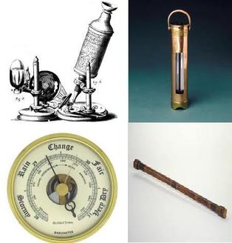
Scientific Revolution
Scientific Revolution established new way of thinking
Logic and reason replaced faith and old ways of thinking
Advances in physics, astronomy, biology, and chemistry
Influenced developments in arts and architecture

Slide 3
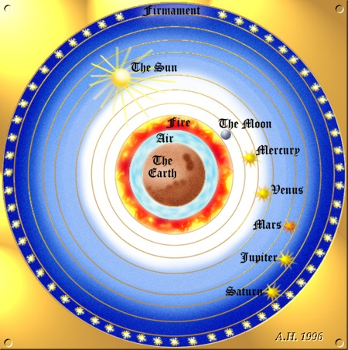
The Medieval View
Geocentric theory-believed earth was the center of the universe
Aristotle proposed this theory
Ideas were upheld by the church
God put earth at the center of the universe

Slide 4
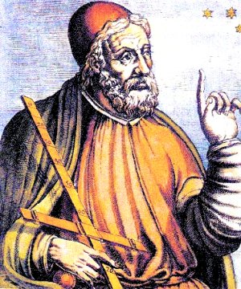
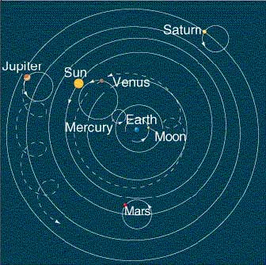
Copernicus
1500 Polish astronomer Nicolas Copernicus- geocentric theory did not explain the movement of the sun and moon
After years of observation he stated the earth is not the center of the universe

Slide 5
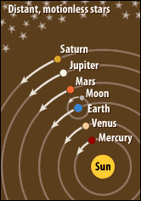
Copernicus
Heliocentric theory-the earth revolves around the sun
First scientist to create a model of the solar system
Published his ideas in the last years of his life
Church opposed his work

Slide 6
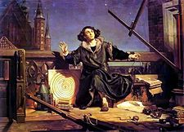
Copernicus
He thought his theory was weak
Mathematical formula did not predict the positions of the planets accurately
Did not want to face ridicule

Slide 7
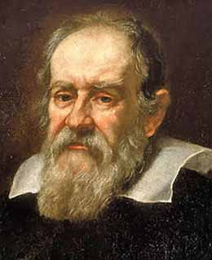
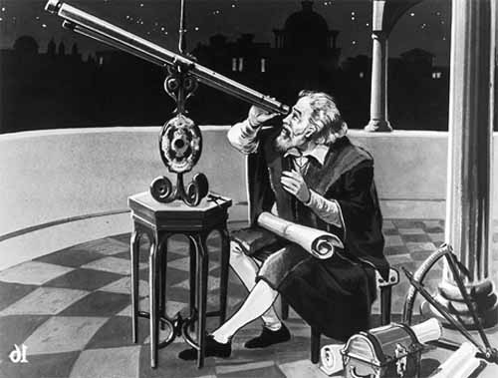
Galileo
Galileo Galilei supported Copernicus’ theory
Built first telescope in 1609
First scientist to observe
Saturn
Sunspots
Moons of Jupiter
Milky Way

Slide 8
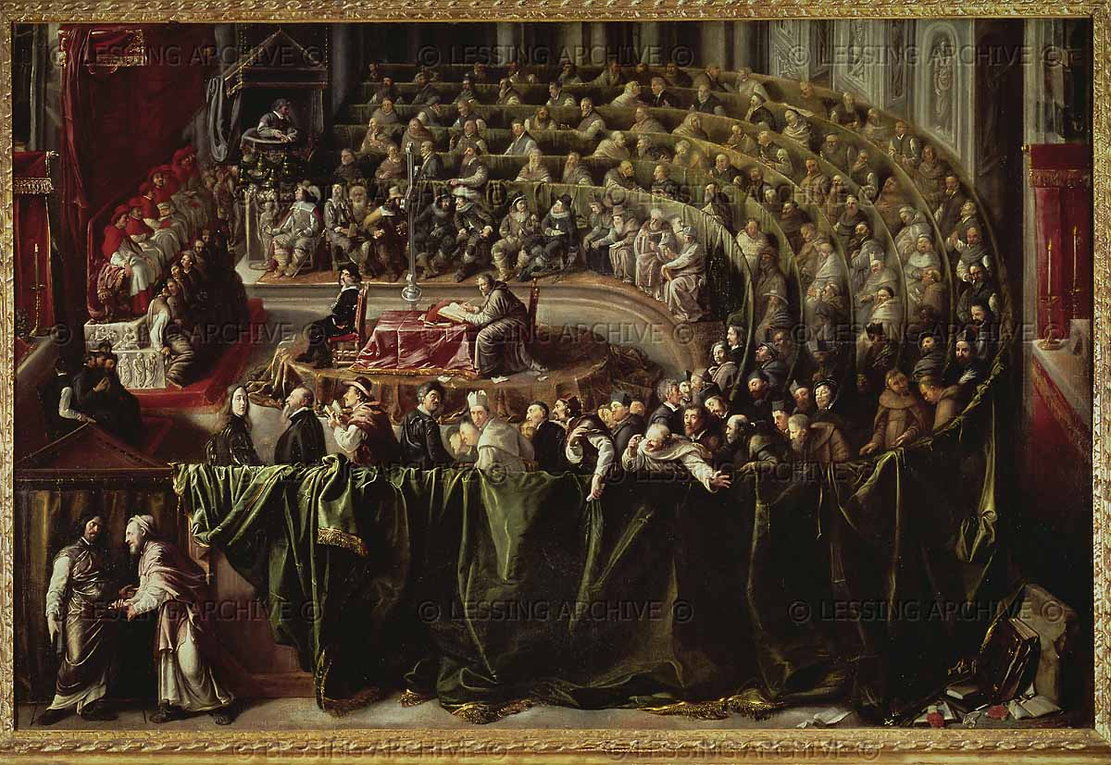
Conflict with the Church
Galileo’s theories had direct conflict
Pope Urban VII ordered Galileo to Rome for an inquisition
1633 stood trial
Placed under house arrest
Galileo said he would not use Copernicus’ theory

Slide 9
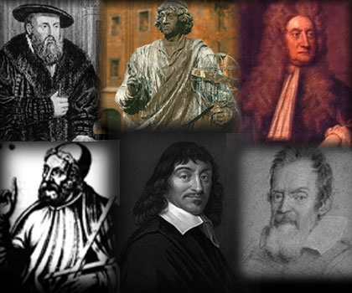
New Viewpoints
Scientific Revolution-proposed theories and developed procedures to test them
Open to new ideas
Through exploration found new animals and people
Scientists examined the natural world

Slide 10
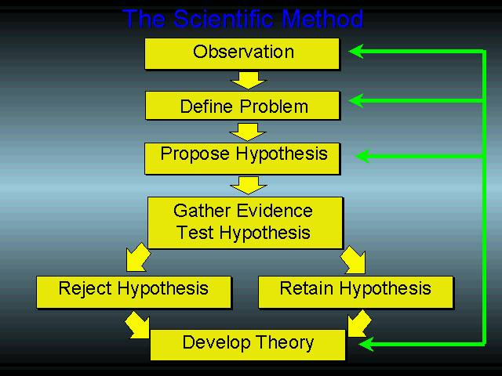
The Scientific Method
Five basic steps
One-identify a problem
Two-for a hypothesis
Perform experiments to test hypothesis
Four-record results
Five-analyze results to form a conclusion

Slide 11
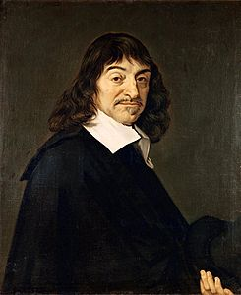
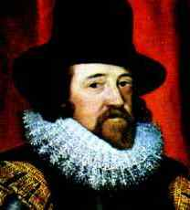
The Scientific Method
Rene’ Descartes-only way to gain scientific knowledge is through experimentation
Ancient scholars only provided information
The more scientists examined the more the ideas of the ancient world did not hold up

Slide 12
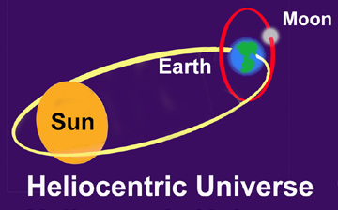
Rene Descartes
Descartes- needed to reject old teachings
Relied on mathematics and logic
The only thing he new for certain “I think, therefore I am.”

Slide 13
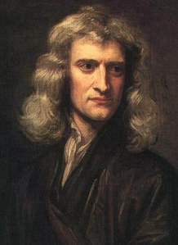
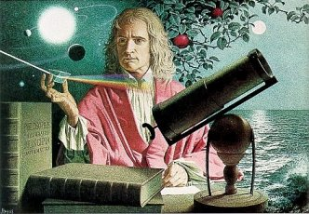
Sir Isaac Newton
Brought astronomy, physics and mathematics together
Questioned the affects of gravity in the universe
1687 published The Mathematical Principles of Natural Philosophy

Slide 14
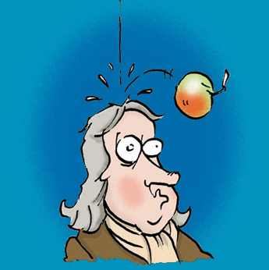
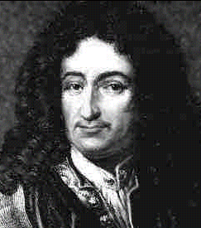
Sir Isaac Newton
Law of gravity affects things in the universe as well as on earth
Gravity causes an apple to fall from a tree
Developed calculus

Slide 15
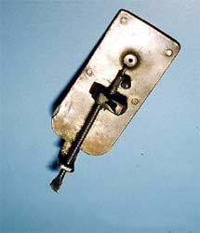
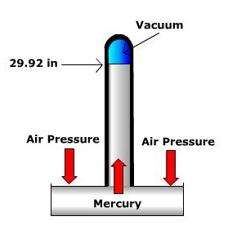
Scientific Instruments
Anton van Leewenhoek invented the microscope to observe bacteria on tooth scrapings
Evangilista Torricelli developed mercury barometer to measure atmospheric pressure

Slide 16
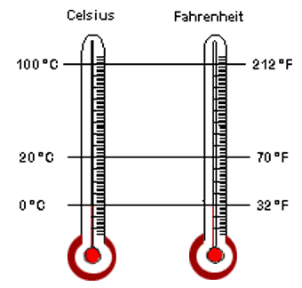
Scientific Instruments
Gabriel Fahrenheit made the first mercury thermometer
Freezing water at 32
Andres Celsius create a new thermometer that showed freezing at zero

Slide 17
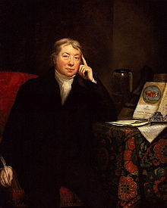
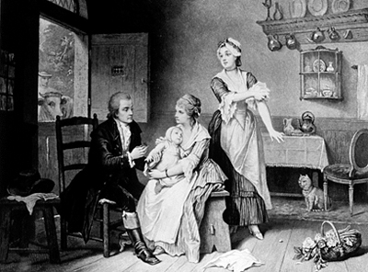
Biology
Edward Jenner- invented smallpox vaccine 1700’s
Inoculation of germs could give immunity to other diseases
Used cowpox germs to produce the world’s first vaccine

Slide 18
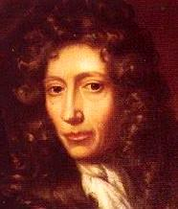
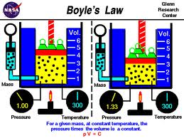
Chemistry
Robert Boyle- father of modern chemistry
1661 The Skeptical Chemist
Described matter as a cluster of tiny particles called atoms
Changes in matter happens when the clusters are rearranged

Slide 19
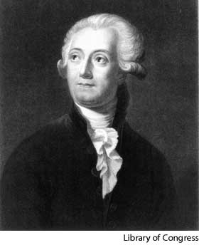
Chemistry
Boyle’s law-describes how temperature, volume, and pressure affect gases
Antoine Lavoisier developed precise measurements in the 1700’s
Discovered the Law of Conservation of mass
Matter can not be created or destroyed

Slide 20
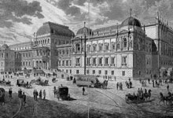
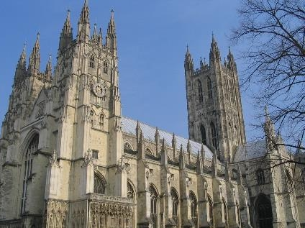
Science and Society
Church was primarily for learning and knowledge during Middle Ages
Church established universities
Most scientists were Christians
Conflicts between science and the Church

Slide 21
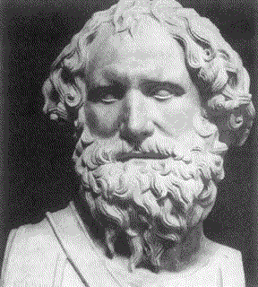
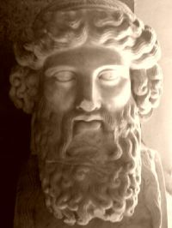
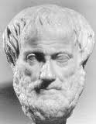
Science and Society
Early science explained things through accumulation of facts and logical reasoning
Early church rejected Greek Scholars
Became convinced reason could serve their needs

Slide 22
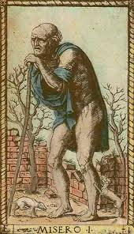
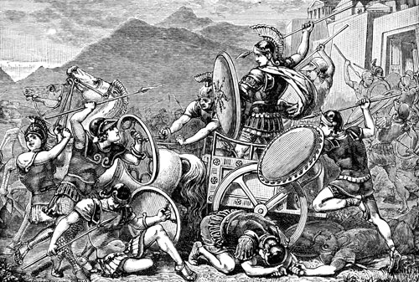
Science and Community
Reexamine old ideas
Government
Education
Religion
Economics
Wondered if they could solve poverty, war and ignorance

