Slide 1
Warm Up
Turn in your signed syllabus into the box
What are Mr. Stewart’s expectations for this class?
Why are each one of these expectations important for a good classroom environment?

Slide 2
Why study history?
History Helps Us Understand People and Societies
History Helps Us Understand Change and How the Society We Live in Came to Be
The Importance of History in Our Own Lives
History Contributes to Moral Understanding
History Provides Identity
Studying History Is Essential for Good Citizenship
History Is Useful in the World of Work

Slide 3
5 Themes of History
1. Social
2. Political
3. Innovations
4. Cultural
5. Economics
Social
Political
Innovations
Cultural
Economics

Slide 4
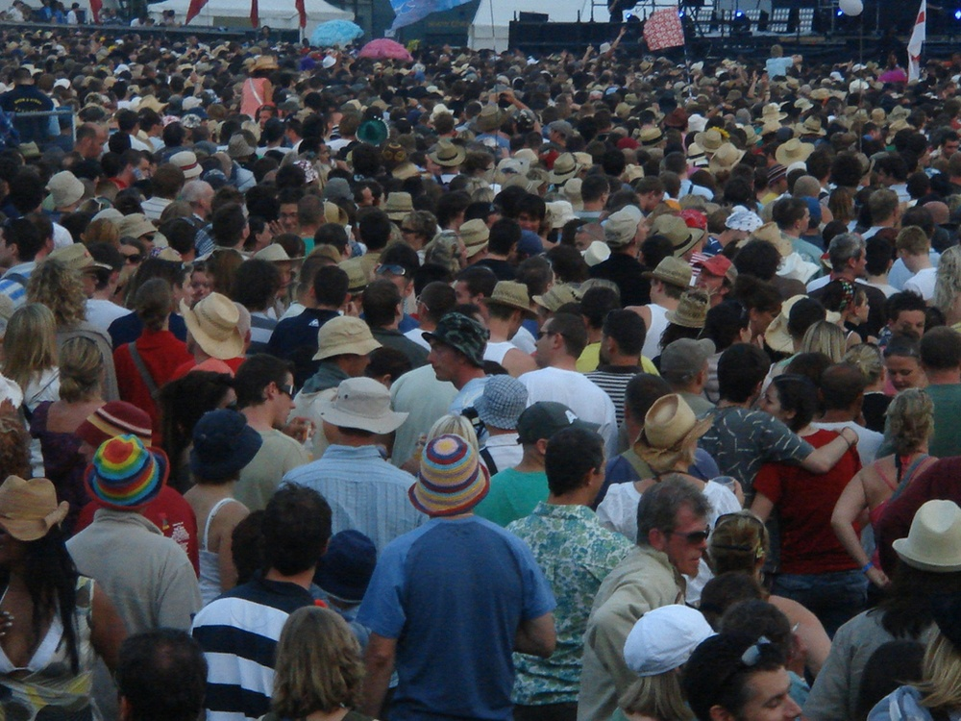
Theme 1: Social
Of or relating to human society and its modes of organization
Social classes; social problems; a social issue

Slide 5
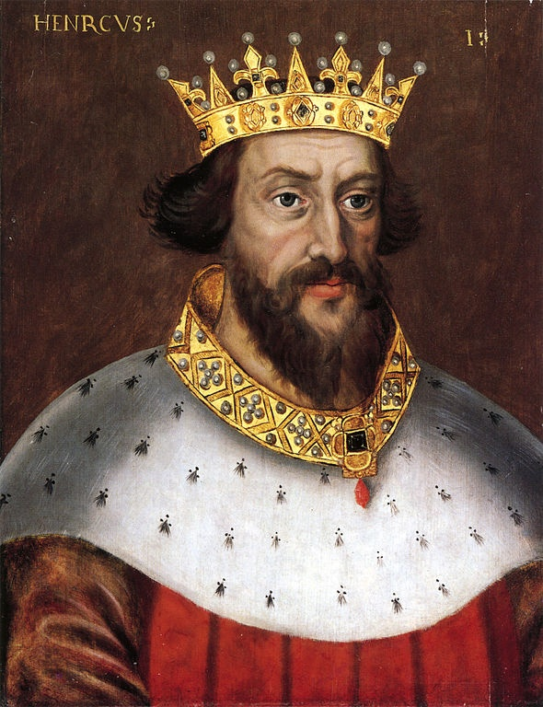
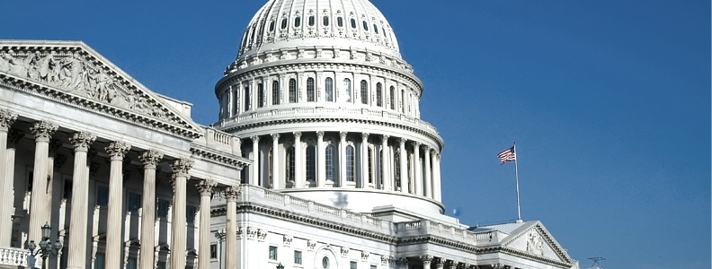
Theme 2: Political
Of, relating to, or dealing with the structure or affairs of government, politics, or the state

Slide 6
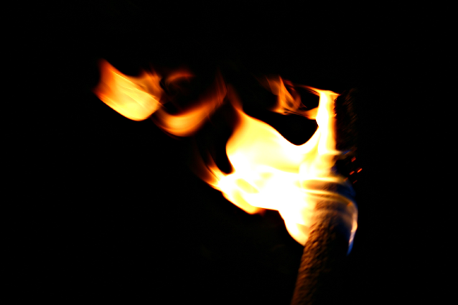
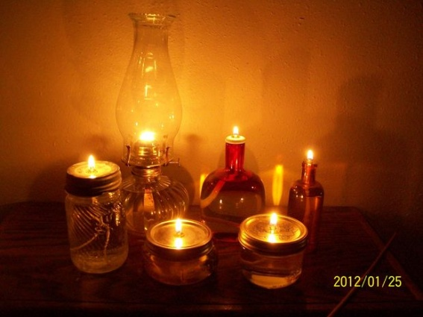
Theme 3: Innovations
A creation (a new device or process) resulting from study and experimentation

Slide 7
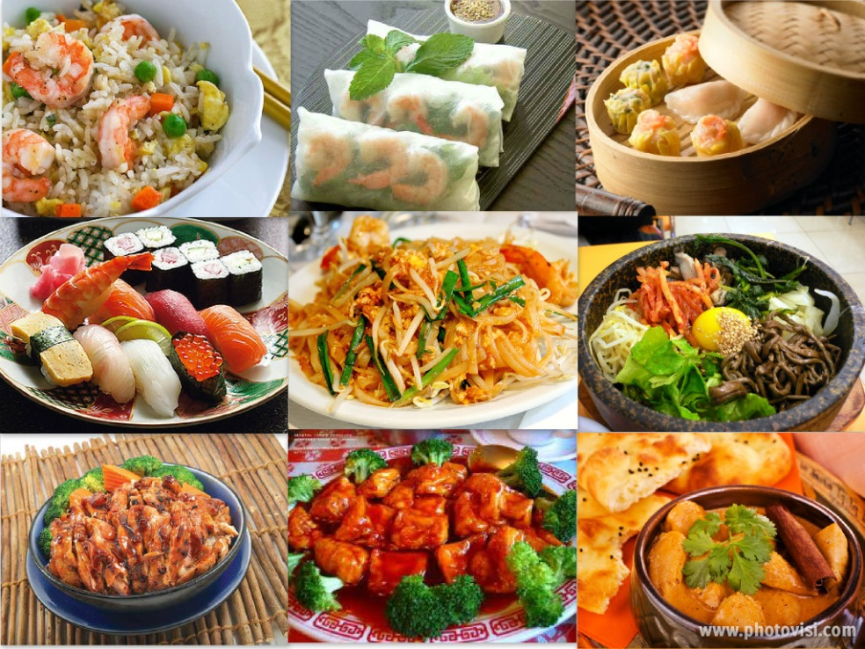
Theme 4: Cultural
The totality of socially transmitted behavior patterns, arts, beliefs, institutions, and all other products of human work and thought

Slide 8
Theme 5: Economics
The science that deals with the production, distribution, and consumption of goods and services, or human welfare

Slide 9
Bias in History
Prejudice in favor of or against one thing, person, or group compared with another, usually in a way considered to be unfair
We, as historians, must always be on the lookout for bias
Never consider only one side
Always scrutinize and ask questions
Always consider who wrote/said it and why they wrote/said it
This will help us detect bias and gain a clear understanding of the time period, event, person, etc.

Slide 10
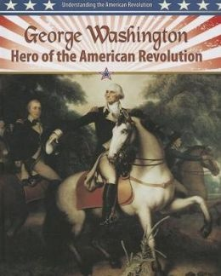
Which view is biased?
OR

Slide 11
Primary Sources
A primary source is a document or physical object which was written or created during the time under study. These sources were present during an experience or time period and offer an inside view of a particular event. Some types of primary sources include:
ORIGINAL DOCUMENTS (excerpts or translations acceptable): Diaries, speeches, manuscripts, letters, interviews, news film footage, autobiographies, official records
CREATIVE WORKS: Poetry, drama, novels, music, art
RELICS OR ARTIFACTS: Pottery, furniture, clothing, buildings

Slide 12
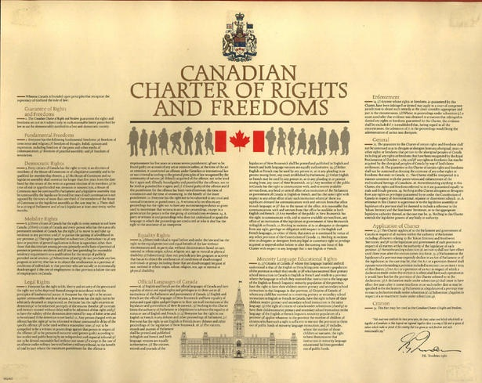
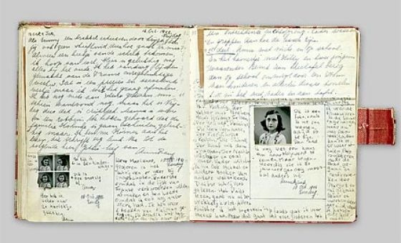
Examples
Diary of Anne Frank - Experiences of a Jewish family during WWII
The Constitution of Canada - Canadian History
A journal article reporting NEW research or findings
Weavings and pottery - Native American history
Plato's Republic - Women in Ancient Greece

Slide 13
Secondary Sources
A secondary source interprets and analyzes primary sources. These sources are one or more steps removed from the event. Secondary sources may have pictures, quotes or graphics of primary sources in them. Some types of secondary sources include:
PUBLICATIONS: Textbooks, magazine articles, histories, criticisms, commentaries, encyclopedias

Slide 14
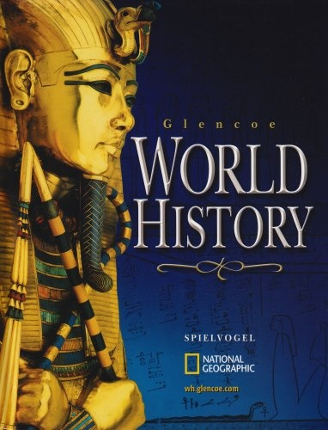
Examples
A journal/magazine article which interprets or reviews previous findings
A history textbook
A book about the effects of WWI

