Slide 1
Do Now
Take out the worksheet on the Treaty of Versailles from yesterday
Make sure you have this completed because we are going to quickly discuss it in a few minutes
_________________________________________
*If you have not taken/finished unit 5 test, you need to do that today. Take this time to study.

Slide 2
Russian Revolution of 1917
A.K.A. Bolshevik Revolution

Slide 3
Ideas of the revolution
Marxism (“Socialism”)
Developed by Karl Marx and Friedrich Engels
Society is split between the proletariats (working class) and bourgeoisie (middle to upper class)
Marx believed that eventually, the proletariats would revolt
All citizens are equal in a classless society
No private property (Houses, clothing exist though)
No private businesses
Religious freedom
Means of production owned by cooperatives or public enterprises
Work is divided according to ability of worker while benefits (profits) are shared according to individual need
Workers create change
BASIC needs of everyone must be MET
Wages with sharing of profit
Free health care and education

Slide 4
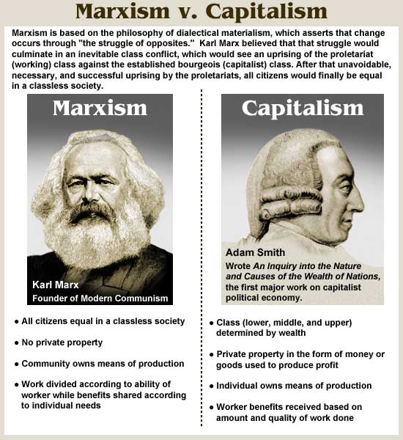
Marxism vs. Capitalism
United States has capitalism
Classes exist in capitalism
Private property in money or goods used to produce profit (means of production)
Worker benefits received based on how well work is done

Slide 5
Ideas of the revolution
Communism
Basically it is socialism on steroids
Socialist ideas with international revolts against capitalism
Behind the Soviet Union in Russia following Russian Civil War
Made famous when Marx published Communist Manifesto
Community holds all economic and political power and wealth is distributed based on needs
“Workers of the world need to unite” against capitalist enslavement
No religion
Government creates change
One party system
Community owns means of production
Have enough material goods, no money needed
Vladimir Lenin led the revolts in 1917 to establish the first ever Communist society in world history

Slide 6
Written Response
Compare slides 4, 5 and 7 and explain the main differences between socialism, communism and capitalism
You have 5 minutes and 35 seconds...GO!

Slide 7
Main shakers of the movement
Czar Nicholas II
Last czar of Russia
Corrupt and overthrown after failed promises by Lenin and the Bolsheviks
Karl Marx
Socialist ideas fueled the revolution
Classless society

Slide 8
Vladimir Lenin and the Bolsheviks
Vladimir Lenin - Leader of the Bolsheviks
Led armed workers, soldiers and sailors to take over the Winter Palace in Petrograd and then took over Moscow
Red Guards or Red Army
Bolshevik Party takes over the government
Would become the Communist State of Soviet Union (USSR)
http://www.biography.com/people/vladimir-lenin-9379007

Slide 9
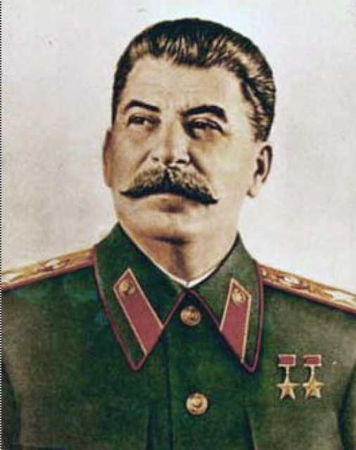
Joseph Stalin
Succeeded Lenin upon his death as leader
Known as an extremely cruel and ruthless leader
Head of the USSR during World War II
http://www.history.com/topics/russian-revolution/videos/joseph-stalin?m=528e394da93ae&s=undefined&f=1&free=false

