Slide 1
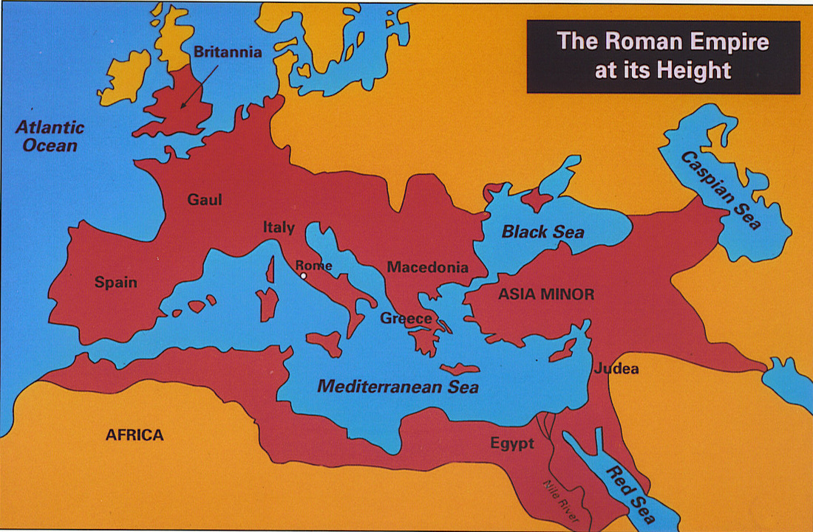
Rome (509 B.C. – 476 A.D.)
509 BC
270 BC

Slide 2
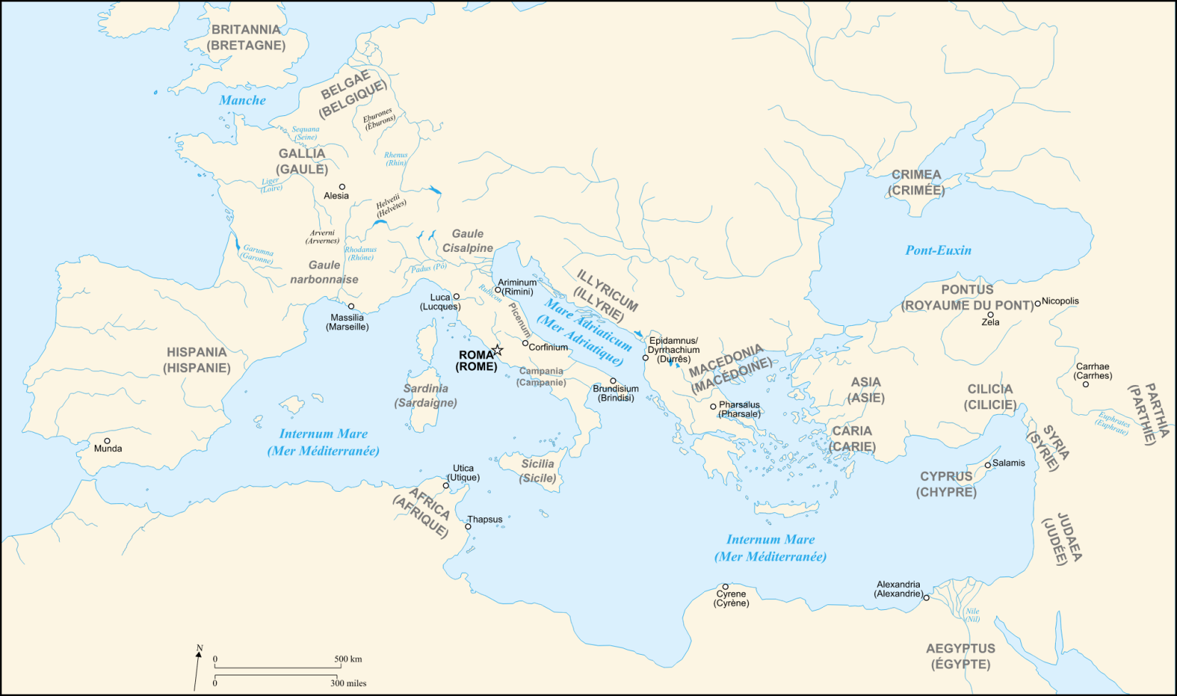
Geography of Rome
Located near the center of Italy, a peninsula located in the Mediterranean (how is this beneficial?)
Unlike Greece, Italy’s geography helped its people to unite

Slide 3
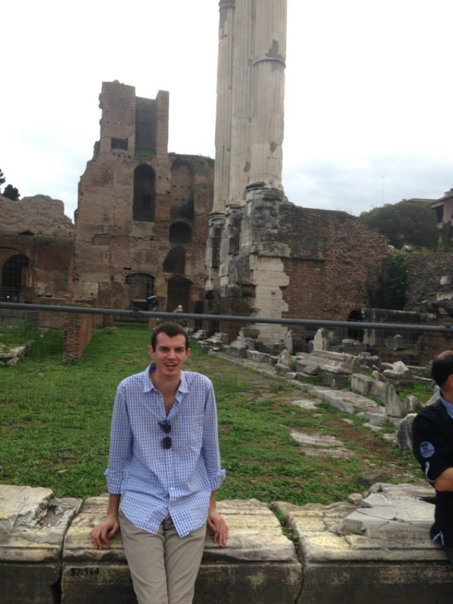
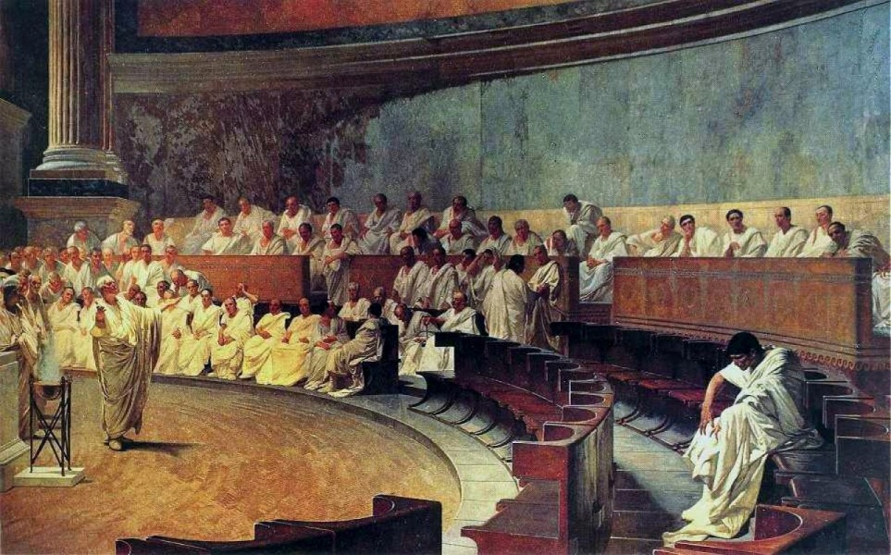
Republic & Senate
Republic: a form of government where officials were chosen by the people
Senate: most powerful governing body in Rome, made up of patricians
Patricians: landholding upper class
Plebeians: farmers, merchants, artisans, traders (had little power)

Slide 4
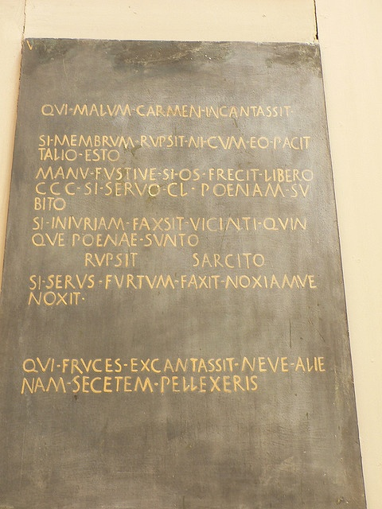
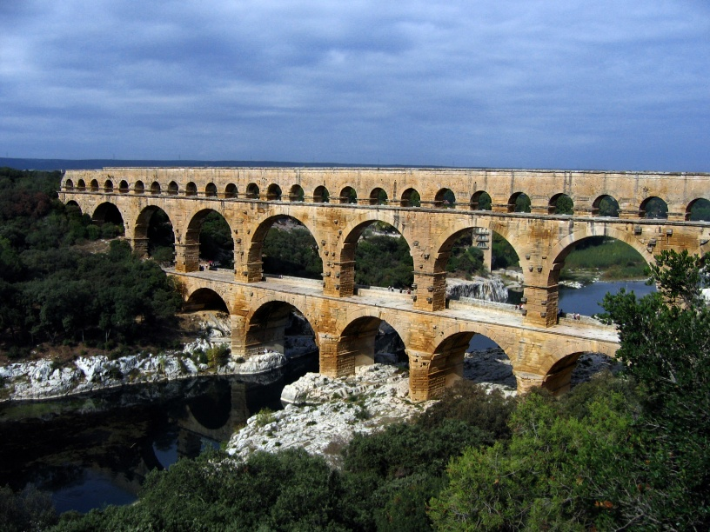
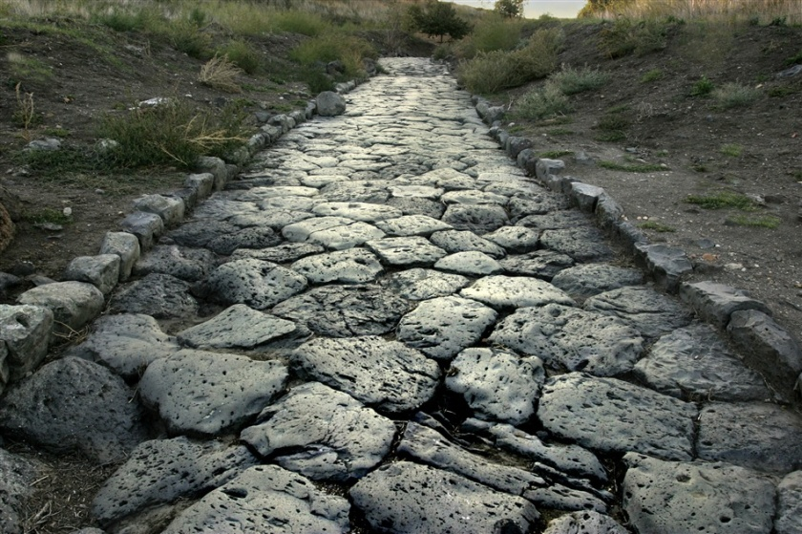
Roman Contributions
Twelve Tables of Roman Law
Aqueducts
Colosseum
Roads → “all roads lead to Rome”

Slide 5
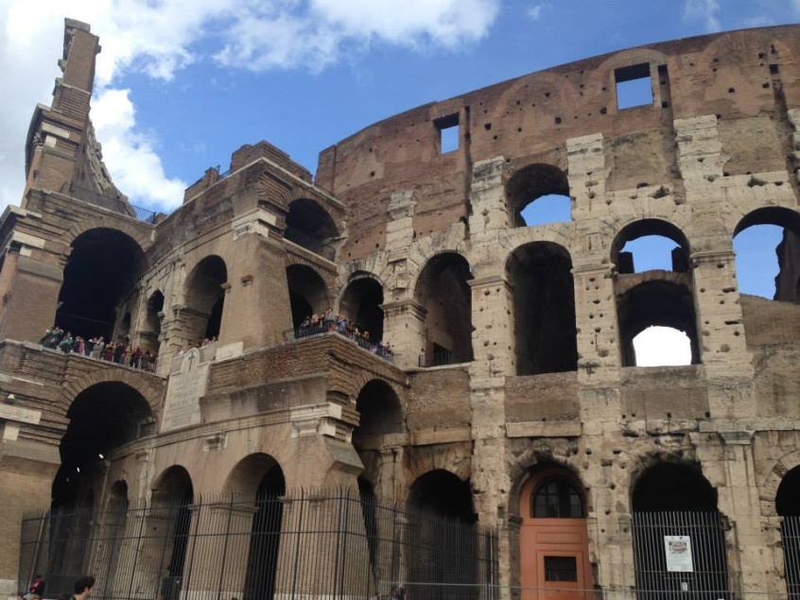
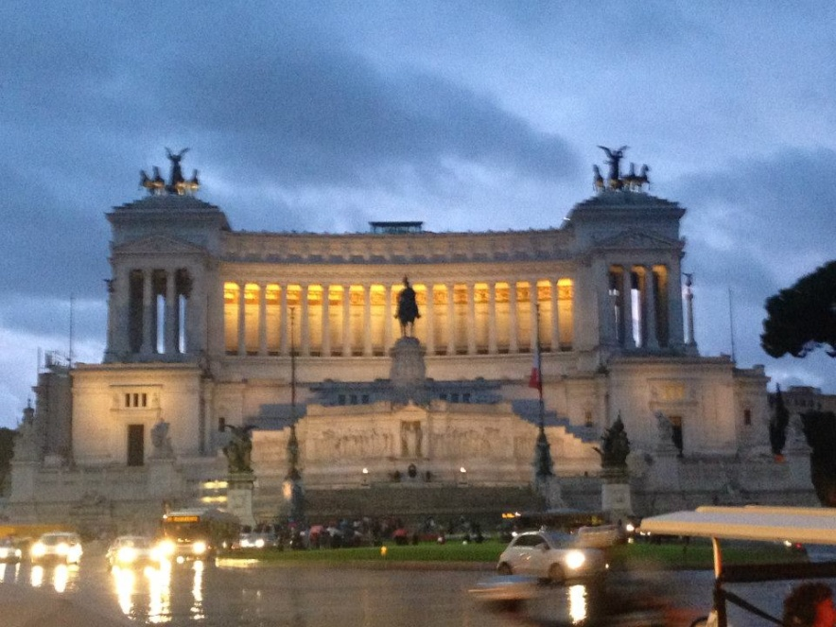
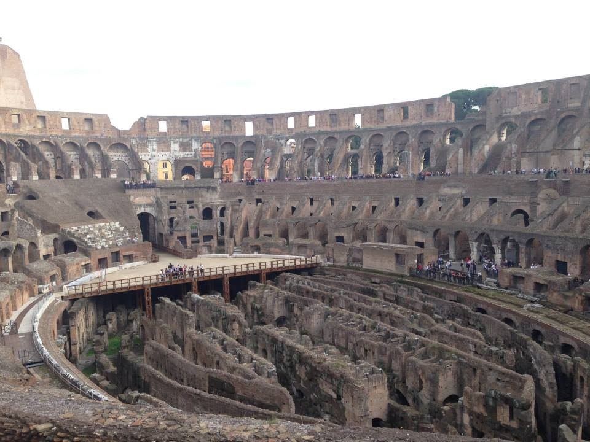
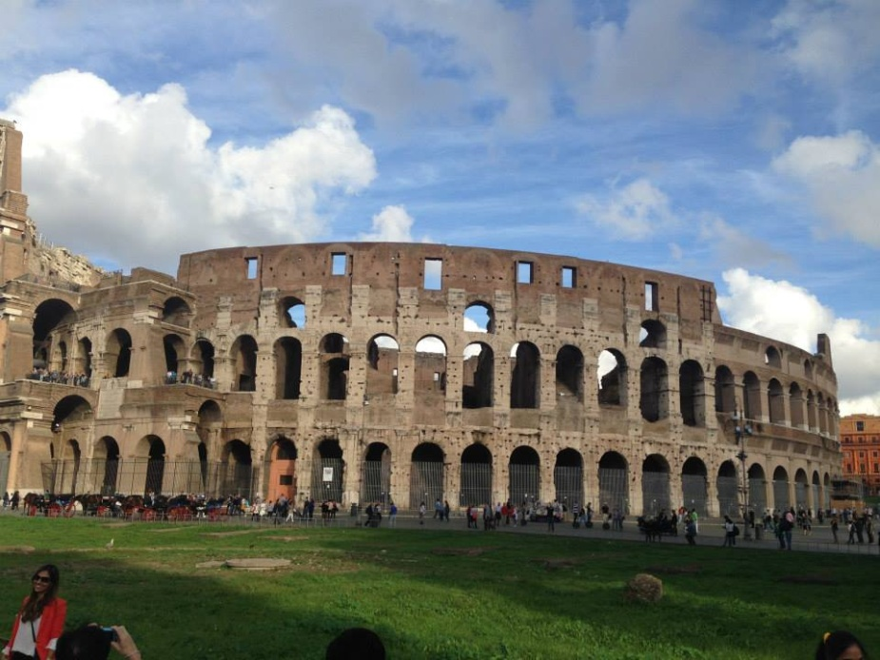
Cont.
Architecture
Government
The Arch

Slide 6
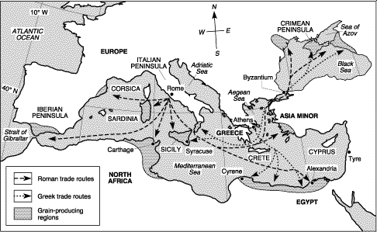
How did the location of Greece and Rome allow them to be successful in trading as well as the spread of their culture?

Slide 7
The Fall of the Roman Empire
Military Causes | Economic Causes | Political Causes | Social Causes
Visigoths and other Germanic peoples invaded the empire Roman army lacked training and discipline Romans were forced to hire foreign soldiers to defend borders | Heavy taxes were necessary to support the government Farmers left land Middle class disappeared Romans used too much slave labor | Government became too strict People stopped supporting government Many officials were corrupt Divided empire became weak | Population declined because of disease and war People became selfish and lazy

