Slide 1
DO Now
Take out your work from yesterday
We will talk about it in just a moment so make sure it is completed and you’ve gone over it for your quiz

Slide 2
Palestine and the Arab-Israeli Conflict

Slide 3
Middle East after World War II
Middle Eastern nations achieved independence
The superpowers tried to secure allies
Why?
Strategic importance in the Cold War
Vital petroleum (oil) fields

Slide 5
Israel
With the end of WWII, the Arab-Israeli conflict became the major political and military problem in the Middle East.
After the Holocaust, many of the survivors had no place to go.
Many Jews (Zionists) believed that they should have a homeland of their own.
They concentrated on the biblical area of Israel

Slide 6
Israel
After WWI, the area had become the British mandate of Palestine.
When Jewish immigration accelerated, friction was created between Jews and Palestinian Arabs
After 1945, Zionists and Palestinian Arabs wanted individual nations and both felt they had claim to Palestine.
Britain withdrew in 1947 and the U.N. proposed that the country be partitioned (“divided”) 50/50

Slide 7
Israel
A war broke out when the Jews, certain of U.S. and Soviet support, declared their independence and the creation of a new state of Israel on May 14, 1948.
When fighting ended in 1949, the Israelis had conquered more territory than had been envisioned in the U.N. plan, and the rest of the territory fell to Egypt and Jordan, rather than forming an independent Palestinian state.
Palestinian Arab refugees fled to Lebanon, the West Bank, and the Gaza strip.

Slide 8
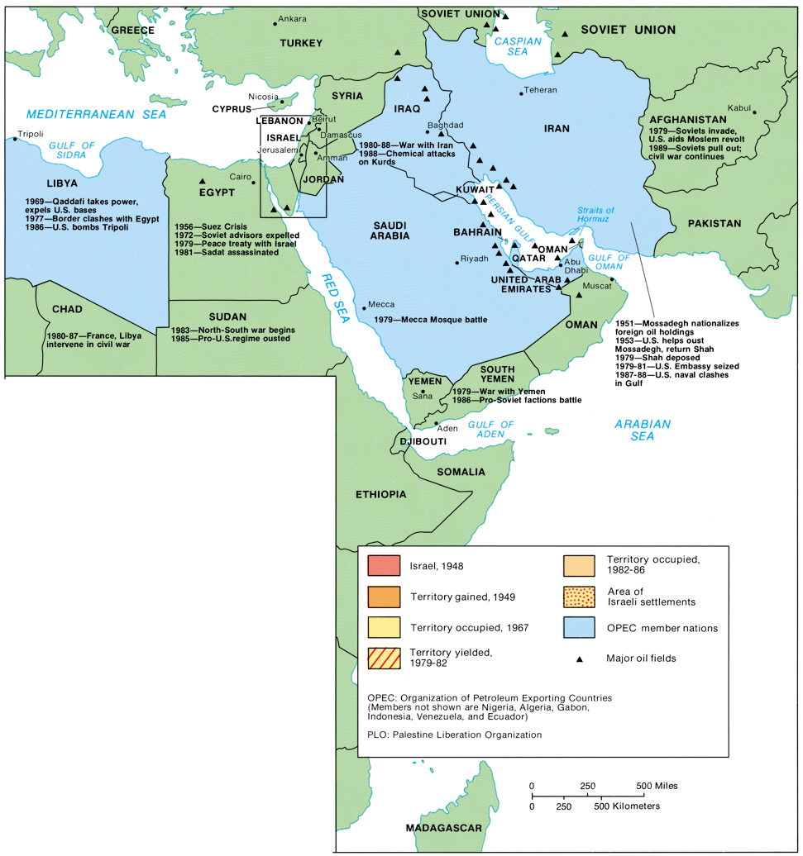
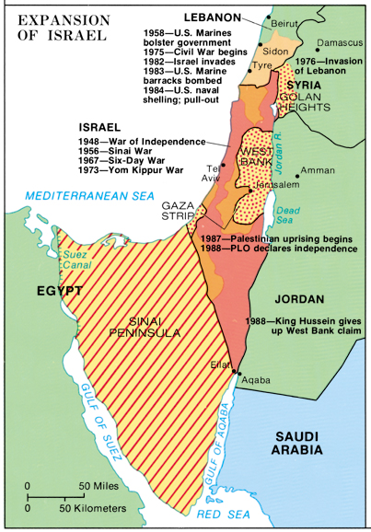

Slide 9
Israel
Israel would fight victorious wars in 1956 against Egypt, and 1967 against Egypt, Syria, and Jordan, securing much of the territory around Israel
Yom Kippur War (1973)
Syria and Egypt launched a surprise attack against Israel
Soviet Union supplied the Arabs and the U.S. supplied the Israeli allies
The seven Arab members of the Organization of Petroleum Exporting Countries (OPEC) imposed a boycott of oil sales to countries seen as friendly to Israel. (October 1973 to March 1974)

Slide 10
Camp David Accords
Israel and Egypt would sign a peace treaty in 1979 with U.S. Pres. Jimmy Carter mediating the Camp David Accords
Israel would return the Sinai to Egypt in exchange for recognition.
Israel had to negotiate a resolution of the Palestinian refugee dilemma. (Never happened)
Made an all-out war between Israel and the Arab world less likely.

Slide 12
Palestine
After 1967, the refugees would form the Palestinian Liberation Organization, (PLO) under the leadership of Yasir Arafat
In 1988, the PLO declared the independence of Palestine (the West Bank and Gaza)
Conflict still continues today

