Slide 1
Warm Up
1. Quick Write: Tell me everything you know about the early peoples who lived on the Earth.
Think about what they ate, where they lived, how they got their food, transportation, technology they had, how they communicated, etc.

Slide 2
Early Peoples
Paleolithic Era
Neolithic Era
Neolithic Revolution

Slide 3
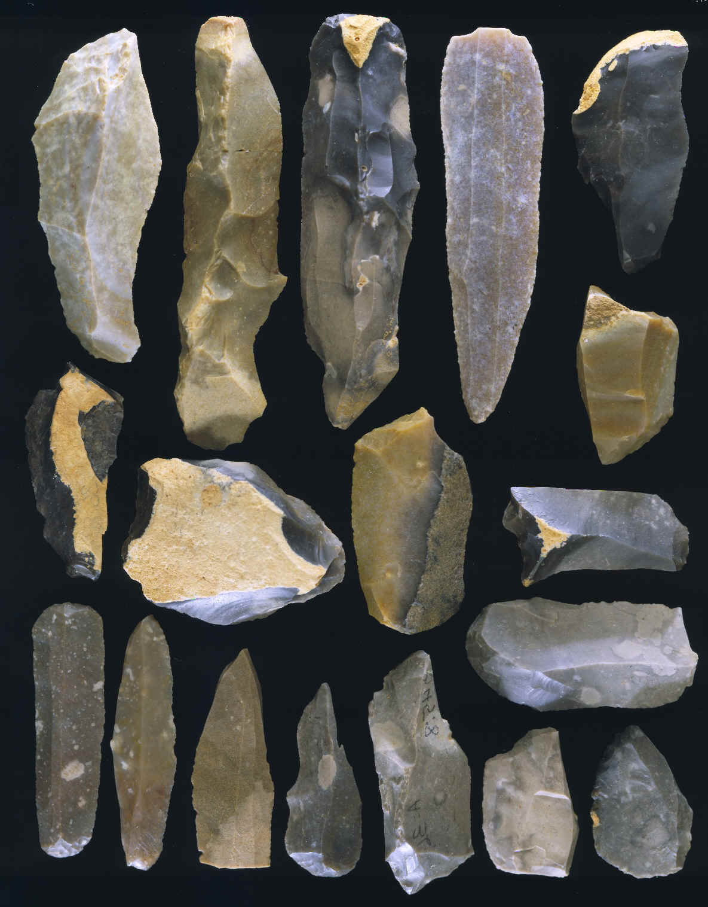
Paleolithic Era
“Old Stone Age”
Began 2.6 million years ago
Characterized by the creation of stone tools

Slide 4
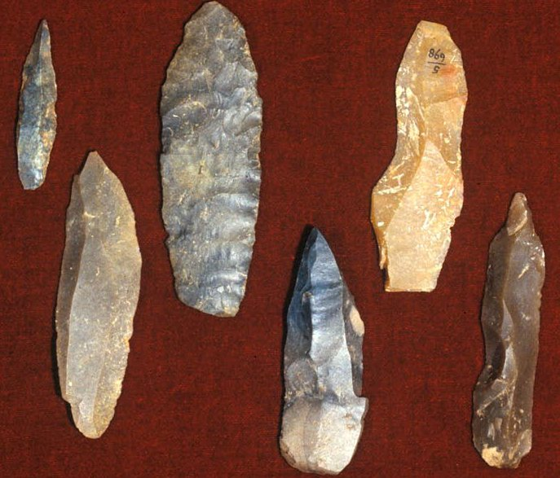
Paleolithic Era
Nomads → people who move from place to place
Hunter-Gatherers → hunted animals and collected plant foods
Made spears
Digging sticks
Stone, bone, wood for tools

Slide 5
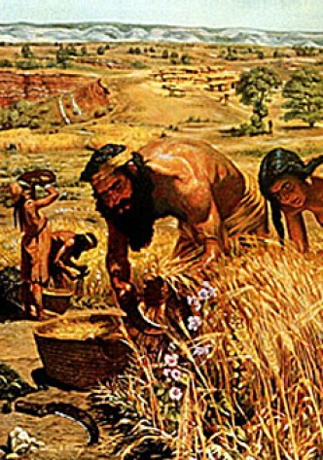
Beginnings of Agriculture
Neolithic Era → “New Stone Age”
Neolithic Revolution→ the discovery of agriculture and domestication of animals
Shift from food gathering to food production
Farming leads to the rise of villages and end of nomads

Slide 6
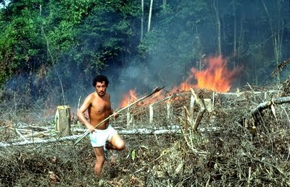
Beginnings of Agriculture
Slash-and-Burn Farming→ cut down trees and burn them to clear fields
Ashes fertilize the fields
Plant crops for one or two years
Move to different field
Trees and grass grow
Repeat

Slide 7
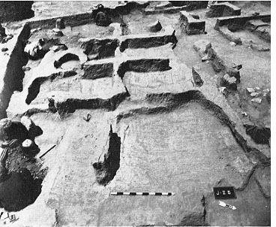
Domestication of Animals
Domestication→ taming of animals
Horses, dogs, goats, pigs

Slide 8
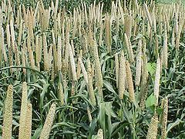
Villages Grow and Prosper
Africa
Nile river
Grow wheat, barley
China
Huang River
Millet, wild rice
Mexico and Central America
Corn, beans, squash

