Slide 1
Do Now
Pick up the handout from the front table
This is your Do Now. It covers the causes of the French Revolution, which you should have some idea of from the WebQuest yesterday. However, it’s really important you understand who and why the French people started a revolution.
You can answer the 7 tasks on the back of the sheet. You have 25 minutes and whatever you don’t finish is homework.
*Turn in the WebQuest from yesterday, if you haven’t already*

Slide 2
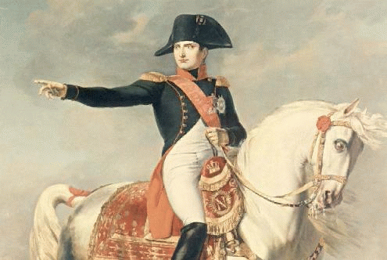
French Absolutism, Enlightenment, & Revolution!
Outcome: Napoleon Bonaparte

Slide 3
Napoleon Bonaparte
Napoleon Bonaparte: Who was he?
Born in 1769 on Mediterranean Island of Corsica
Short guy- only 5 feet 3 inches tall
Considered one of greatest military leaders of all time

Slide 5
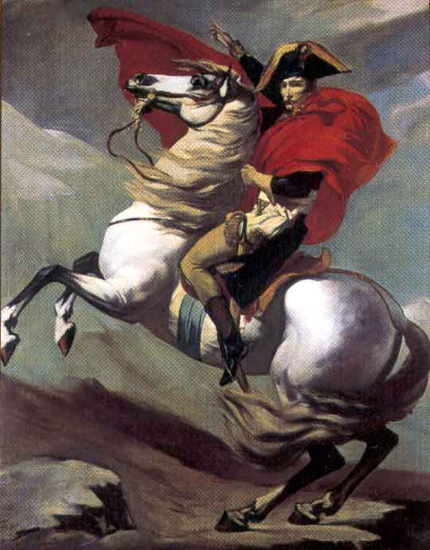

Slide 6
Napoleon Bonaparte
Successes and Coup d’etat
October 1795 rebels marched on National Convention where Napoleon and his gunners successfully forced rebels to panic and flee. Hailed as a hero in France.
1796 Napoleon appointed to lead French army against Austria and Kingdom of Sardinia- swept into Italy and won a series of victories
Tried to repeat success in Egypt but defeated by Horatio Nelson. Napoleon kept this news out of newspapers and was still a hero to France
By 1799, The Directory had lost political confidence of people and after return from Egypt, Napoleon is urged to seize political power
Napoleon becomes first consul and assumes power as a dictator
Coup d’etat- sudden seizure of power or blow to the state

Slide 7
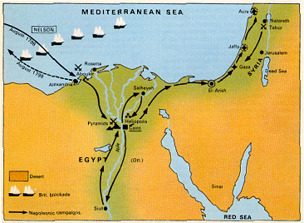
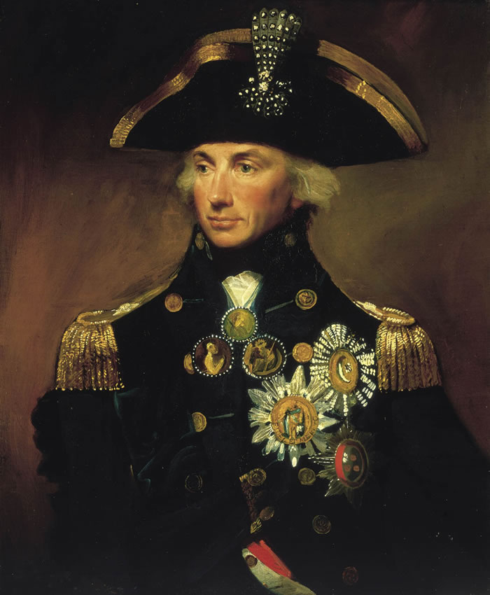
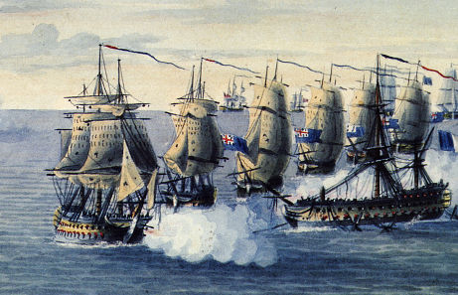
Napoleon’s Rise to Power
Earlier military career → the Egyptian Campaign:
1798 → he was defeated by a British navy under Admiral Horatio Nelson, who destroyed the French fleet at the Battle of the Nile.
Abandoning his troops in Egypt, Napoleon returned to France and received a hero’s welcome!

Slide 8
Napoleon Bonaparte
Napoleon Rules France
1800 plebiscite (vote of the people) approved a new constitution which gave all the real power to Napoleon as first consul; Kept many changes from the Revolution
Righted economy by creating national banking system and efficient tax collection
Signed concordat (agreement) with Pope- government recognized influence of the Church but rejected Church control in national affairs
Created Napoleonic Code- uniform set of laws that eliminated many injustices

Slide 9
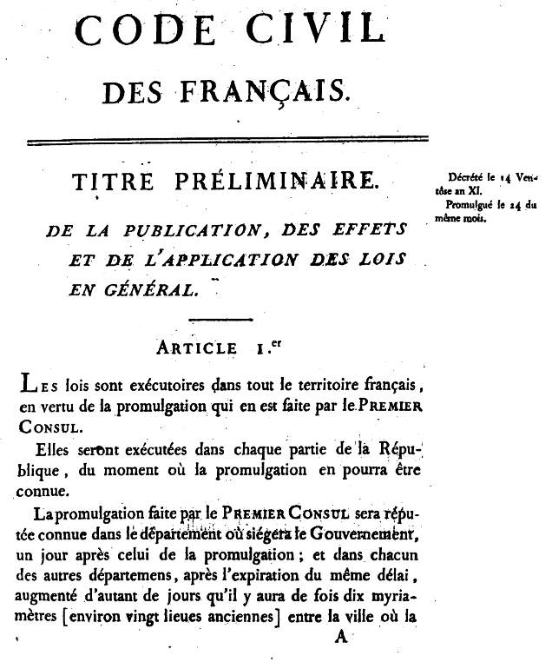
Code Napoleon, 1804
It divides civil law into:
Personal status.
Property.
The acquisition of property.
Its purpose was to reform the French legal code to reflect the principles of the Fr. Revolution.
Create one law code for France.

Slide 10
Napoleon Bonaparte
Napoleon Rules France Continued…
Crowned himself emperor in 1804- took crown from pope and placed on own head
Sold Louisiana Territory to President Jefferson in 1803 for $15 million
Created largest empire in Europe since the Romans
Lost naval Battle of Trafalgar to British and Horatio Nelson which had 2 effects:
Ensured supremacy of British navy for next 100 years
Forced Napoleon to give up plans for Britain
By 1812 Napoleon controlled Spain, Grand Duchy of Warsaw, and German Kingdoms as well as France

Slide 11
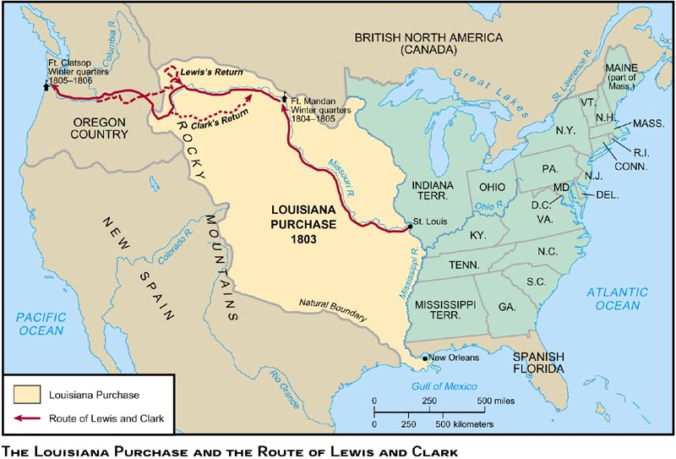
Louisiana Purchase, 1803
$15,000,000

Slide 12
Napoleon Bonaparte
Three Costly Mistakes
Continental System:
To crush Great Britain, Napoleon used a blockade to prevent trade and communication between Great Britain and Europe
Not tight enough, smugglers got through
Great Britain responded with own blockade- more effective
Led to War of 1812 (Great Britain vs. America)

Slide 13
Napoleon Bonaparte
The Peninsular War
Guerrilla fighters in Spain resisted Napoleon’s forces who were trying to enforce Continental System on Spain
Napoleon loses 300,000 men which weakens French Empire

Slide 14
Napoleon Bonaparte
Invasion of Russia
Breakdown on Russian-French alliance caused Napoleon to invade Russia
Napoleon brought 420,000 soldiers
Russians used scorched earth policy- burning supplies to hinder enemy
Czar Alexander destroys Moscow by time Napoleon takes city
Russian army attacks Napoleon’s troops on way back, only 10,000 are left

Slide 15
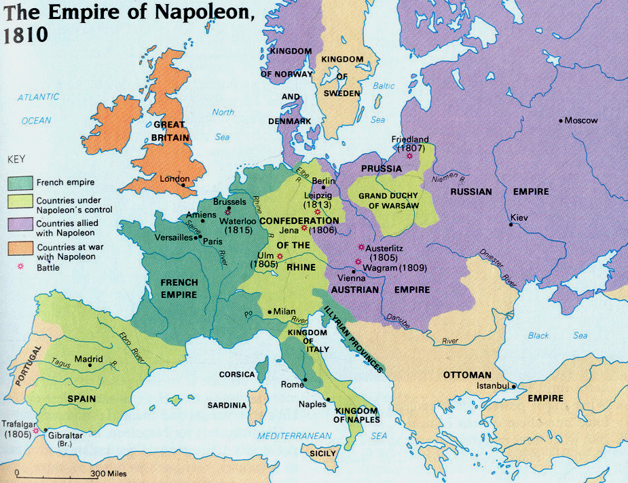
Napoleon’s Empire in 1810

Slide 16
Napoleon Bonaparte
Napoleon’s Downfall
Army defeated allied army of European powers and by early 1814 the leaders of Prussia and Russia marched triumphantly through French capital
April 1814, Napoleon accepted terms of surrender and gave up throne
Banished to tiny Italian island, Elba
Louis XVI’s brother took power but was very unpopular

Slide 17
Napoleon Bonaparte
Napoleon’s Downfall Continued…
Napoleon escapes Elba and in March 1815 lands back in France
Joyous crowds welcome him back and within days was emperor of France again
Europe responded: Britain and Prussia attacked at Battle of Waterloo
Defeat at Waterloo ended 2nd bid for power known as the Hundred Days
Exiled to St. Helena- island in South Pacific
Died of a stomach ailment in 1821

Slide 18
Napoleon Bonaparte
Result: Napoleon was a military genius but millions of lives were lost in his wars. The British would become the dominant force in Europe and European countries were freed to establish a new order.

Slide 19
France
King Louis XVI
3rd estate (common people) are upset with how the 1st and 2nd estate are being treated better than them
French Revolution occurs led by the 3rd estate
Reign of Terror (King Louis XVI is beheaded along with 50,000 other French people who are against the revolution
Napoleon takes over and institutes Napoleonic Code

