Slide 1
The BiG idea
The Mayas, Aztecs, and Incas:
Developed agriculture that could support large populations
Placed great importance on religion
Formed governments that ruled large empires
Had advanced knowledge in areas such as agriculture, engineering, and architecture

Slide 2
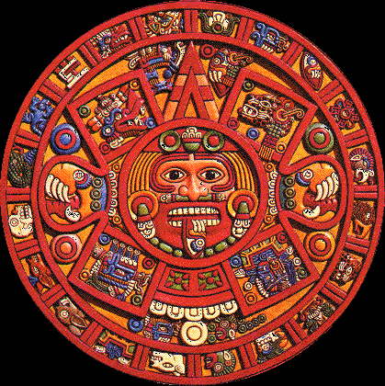
Mesoamerica
Outcome: The Mayas

Slide 3
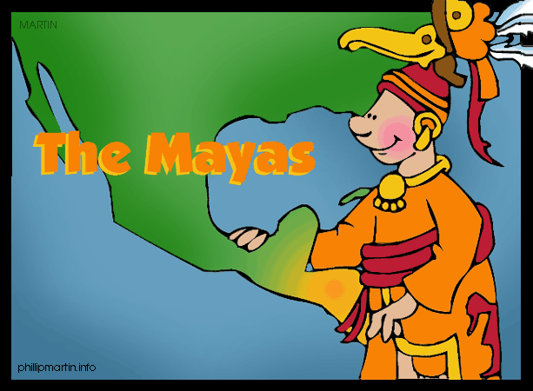
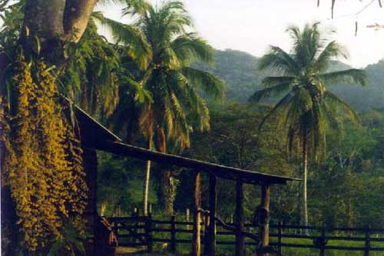
The Mayas
Environment
S. Mexico
Yucatan Peninsula
Steamy jungles
Cool mountains

Slide 4
Yucatan by satellite

Slide 5
Maya Cities

Slide 6
The Mayas
Cities
Tikal
Palenque
Chichen Itza

Slide 7
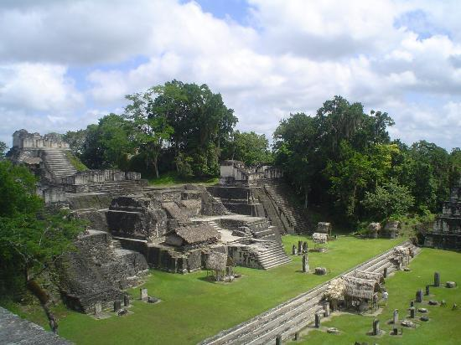
Tikal

Slide 8
Chichen Itza

Slide 9
Palenque

Slide 10
The Mayas
Lang/Writing
Most advanced writing system in Americas
800 glyphs
Codex- records (only 3 exist today)

Slide 11
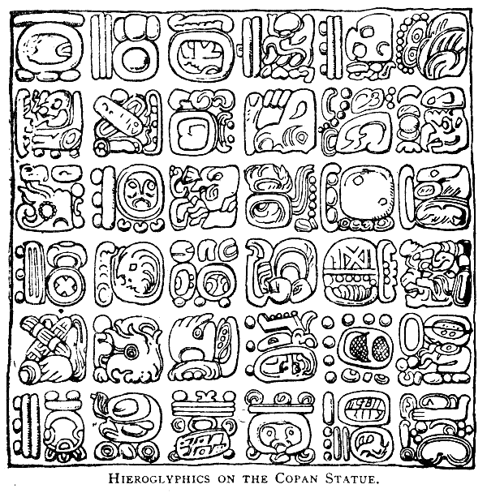
Mayan Glyphs

Slide 12
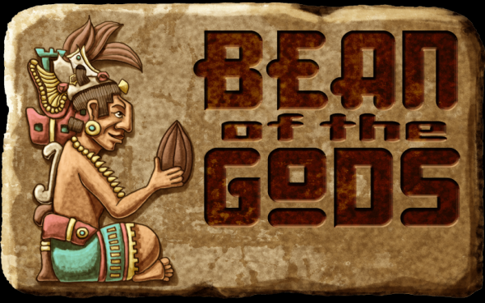
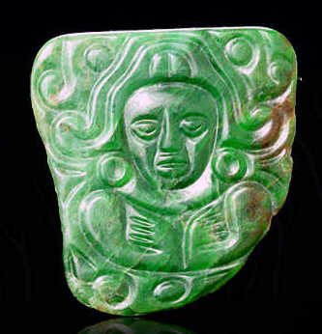
The Mayas
Economy
Cities were linked by trade:
Salt, flint, feathers, shells, & honey
Jade ornaments
Cacao beans used as currency

Slide 13
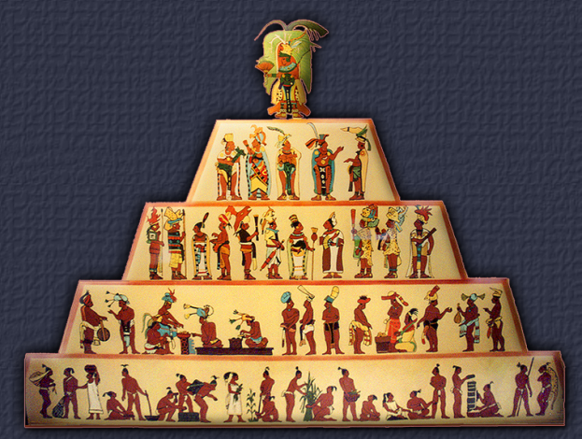
The Mayas
Gov’t
Rule by god-kings (theocracy)
Had city-states
Dynasties were important
Noble class near the top

Slide 14
The Mayas
Religion
Polytheistic
Blood offerings
Human sacrifice

Slide 15
Human Sacrifice

Slide 16
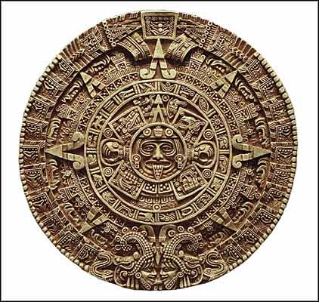
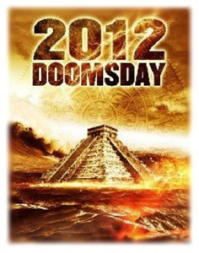
The Mayas
Achievements
Calendar System
.002% short of our calendar
2012??
Temple IV
212 feet high
No iron tools or wheels

Slide 17
The Mayas

