Slide 1
Islamic civilization

Slide 2
Lasted for three empires:
Ottoman
Safavid
Mughal

Slide 3
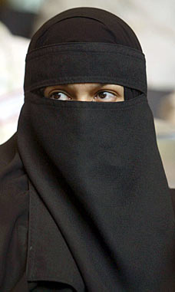
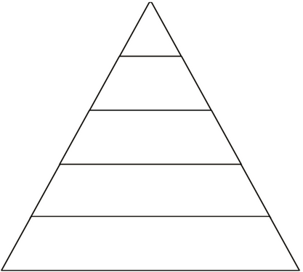
Muslim society
Divided into four social classes:
Muslim at birth
People who convert to islam
Protected people (jews and Christians)
Slaves
Islam required that slaves were treated equally and most slaves were non-Muslims
Muslim women had more economic rights than European women and access to education, but Muslim women were expected to submit to men
Cultural diversity accepted by Islamic leaders because of its’ position between Europe and Asia (crossroads of trade!)

Slide 4
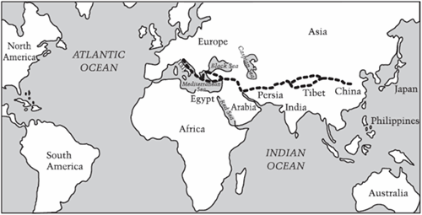
Economy
Built mostly on commerce and trade
The merchants became the middle men between Europe and Asia

Slide 5
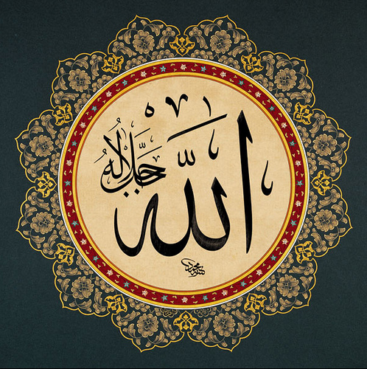
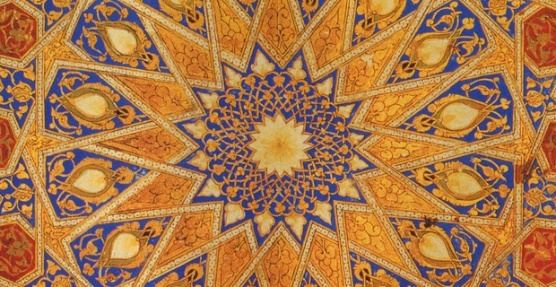
Contributions
Muslim leaders saved much of the Roman literature after the fall of Rome
Extensive Muslim scholarship in medicine, mathematics, astronomy, science, and geography carries over into the Renaissance
Muslim art is known for Calligraphy (beautiful handwriting) and decorative patterns in glass, textiles, ceramics, and architecture

