Slide 1
Do Now
Turn in test corrections if you chose to complete them
I’m going to hand back your World War I quizzes shortly and we will go over them

Slide 2
Interwar Period (1918-1939)

Slide 3
Treaty of Versailles
Ended World War I
Punished Germany severely
Germany was forced to accept guilt for the war
Germany had to pay $30 billion in war reparations
Germany had to decrease its military
Germany gave up all colonies and a lot of land
*The Treaty was so harsh that it eventually helped bring Hitler (and the Nazis) to power and helped cause World War II*

Slide 4
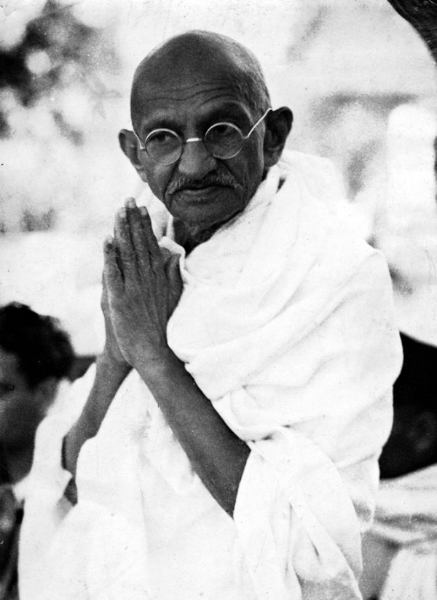
Mohandas Gandhi
India was a colony of Great Britain (imperialism!)
Gandhi is the nationalist leader of India who fought for independence from Britain using non-violent methods (civil disobedience, passive resistance)

Slide 5
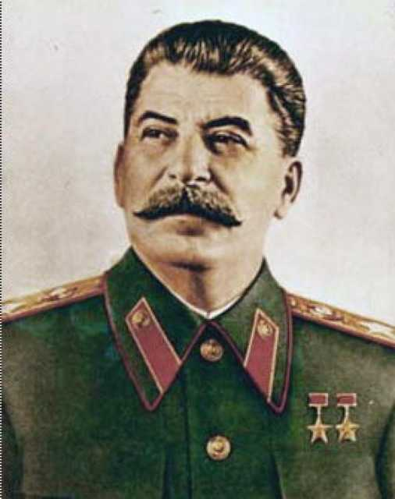
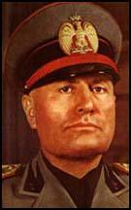
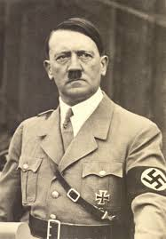
Totalitarian Dictatorships
Governments where one ruler has complete control over ALL aspects of life within a country
After World War I, totalitarian dictatorships were established in 3 countries under 3 men:
Soviet Union under Joseph Stalin
Italy under Benito Mussolini
Germany under Adolf Hitler

Slide 6
Totalitarian Dictatorships
All totalitarian dictatorships have these common traits:
Censorship: freedom of speech is ended and the government controls all media (TV, newspaper, radio)
One political party: only the political party of the dictators was allowed to exist
Stalin=Communist, Mussolini=Fascism, Hitler=Nazi
People were expected to put the needs of the country before their own needs
Any opposing people are eliminated by using a secret police force
Propaganda is used (messages that are meant to influence they way people thought)

Slide 7
Fascism in Italy

Slide 8
Nazis in Germany
Propaganda Government controlled all sources of information. Schools taught Nazi ideas and children joined the Hitler Youth. Forbidden books were burned. | Lack of Civil Liberties Only the Nazi party was allowed and other political parties were outlawed. The Gestapo (secret police) arrested and executed people without a trial.
Anti-Semitism Jews lost their property and citizenship. Their shops and synagogues were destroyed. They were forced to wear the yellow Star of David on their clothing and were moved to ghettoes and concentration camps. | Economic Controls

Slide 9
Communism in the Soviet Union
Government (instead of individuals) owns businesses, makes business decisions, and sets prices
Five-Year Plans: Stalin modernized the industry (factories) and agriculture of the USSR by setting goals every five years
Collectivization: Stalin took over people’s individual farms and forced people to live on government farms (collective farms)
Stalin took away food from Ukraine when they resisted his collectivization program. Millions of peasants in the Ukraine died of starvation.

