Slide 1
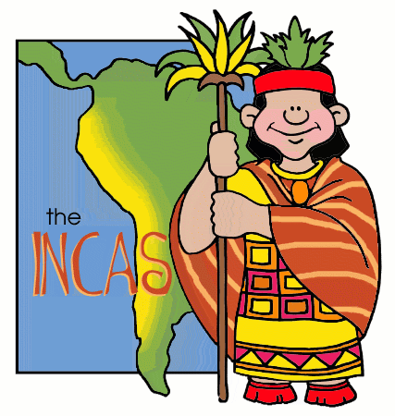
Mesoamerica
Outcome: The Incas

Slide 2
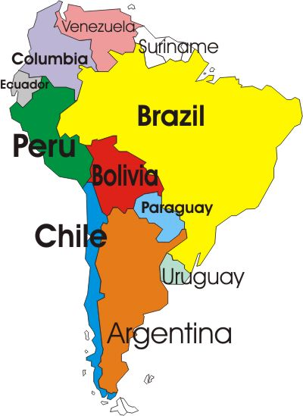
The Incas
Environment
South America
Peru
Andes Valley of Cuzco
Ecuador to Chile

Slide 3
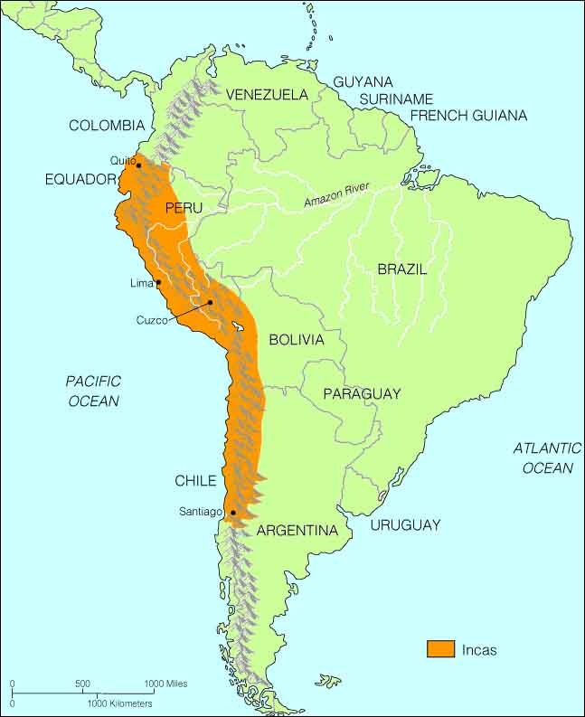

Slide 4
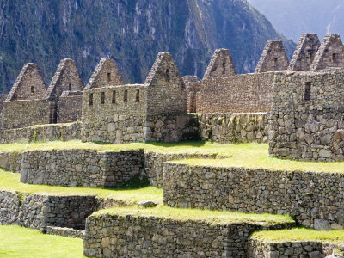
The Incas
Cities
Cuzco
All roads lead to Cuzco
Heart of the Incan Empire
Machu Picchu
Sun temple, central plaza, public buildings

Slide 5
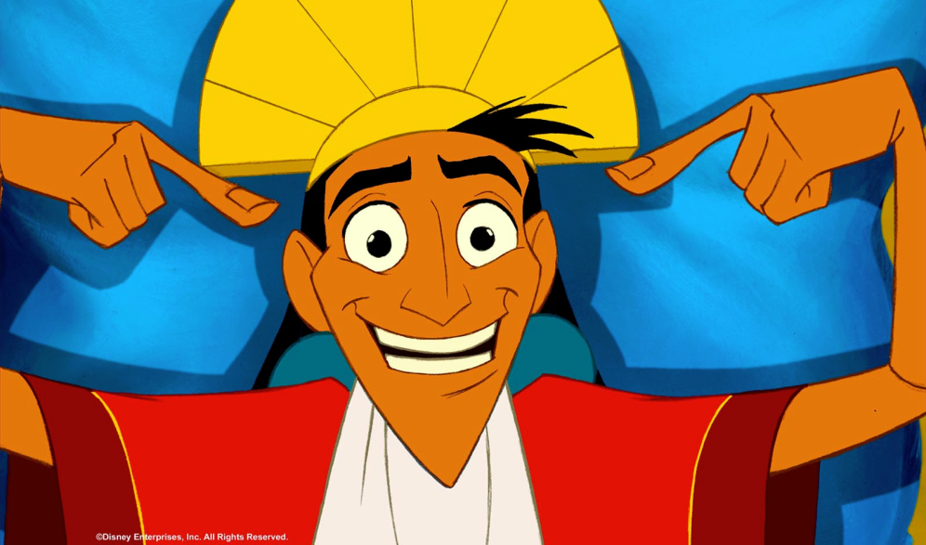
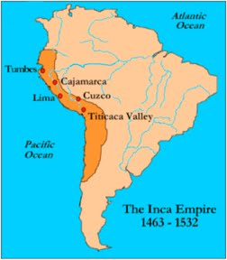
Cuzco

Slide 6
Machu Picchu

Slide 7
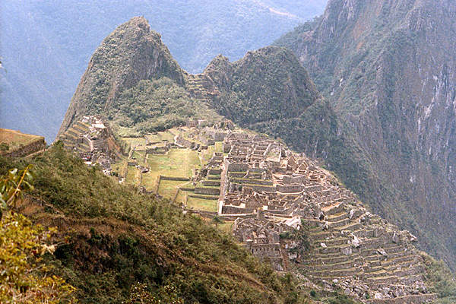
Machu Picchu

Slide 8
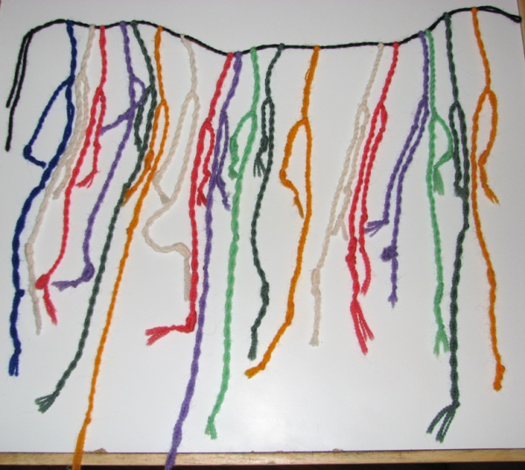
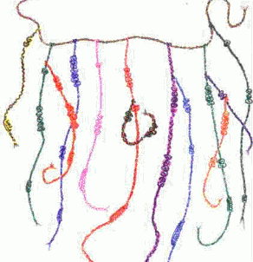
The Incas
Lang/Writing
Quechua: official spoken language
No written language
Quipu were used for gov’t record keeping

Slide 9
The Incas
Economy
Run by the gov’t
Ayllu, or extended family group:
Organized into groups of 10, 100, 1000, & 10,000
Built irrigation canals
Terrace farming
Stored/distributed food

Slide 10
The Incas
Gov’t
Total control over economic & social life
Divided territory into smaller, manageable units
Built cities & schools in conquered areas

Slide 11
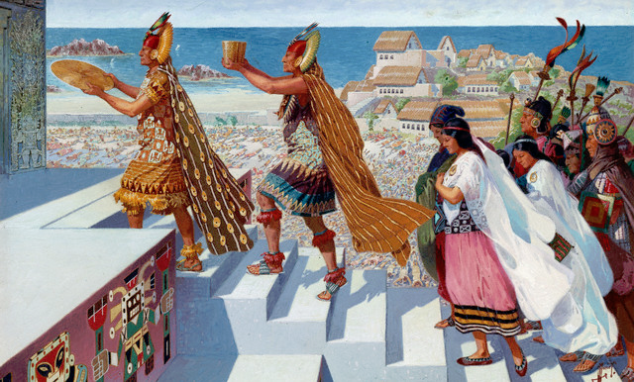
The Incas
Religion
Few key nature spirits
Creator God: Viracocha
Sun God: Inti
Unmarried young men & women sometimes used for lifetime of religious service

Slide 12
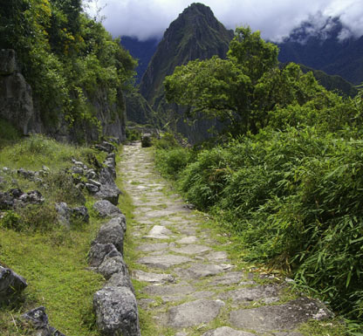
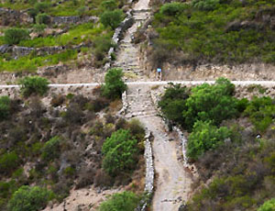
The Incas
Achievements
No iron tools or the wheel
Road system was 14,000 miles long
Runners were used like a postal system

