Slide 1
Do Now (Silent Work)
*Pick up the guided notes and an index card from the front table*
On your index card draw these lines so it looks like the one below:

Slide 2
Imperialism
In the arc, write the word “Imperialism”
In the top left box, write the definition. “When a strong country takes over a weaker country or region and dominates its economic, political, or social life.”
In the top right box, write down “Reasons for Imperialism”
In the bottom right box, draw an image that will help you remember the definition of Imperialism.
In the bottom left box, write “Examples of Imperialism”

Slide 3
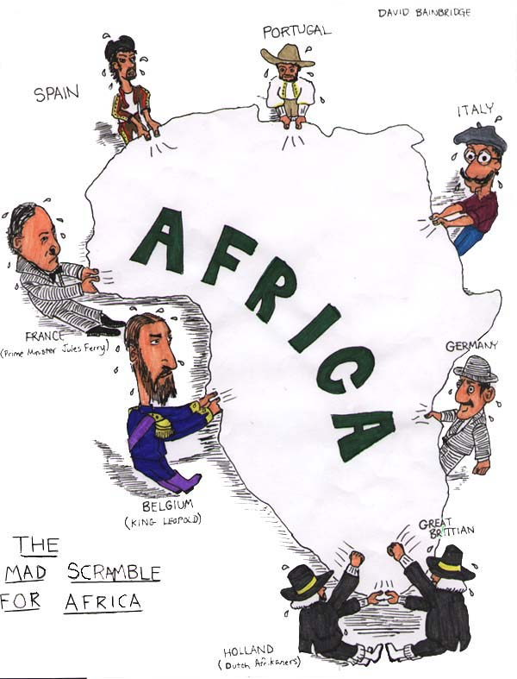
Imperialism to Independence

Slide 4
African Trade [15c-17c]

Slide 5
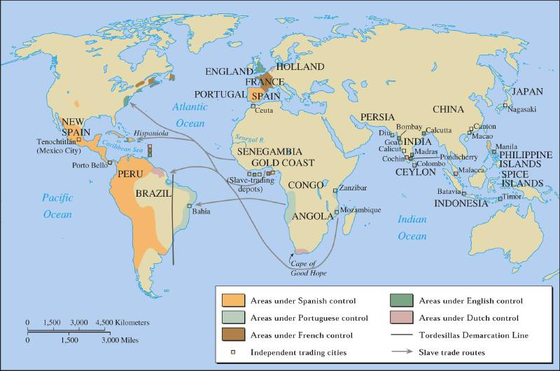
Pre-19c European Trade with Africa

Slide 6
The Age of Imperialism in Africa
Setting the Stage: Layers of History
Ancient Egyptians and Nubians in the north left Africa with impressive ruins
Rule by the Persians and Greeks spread culture
The Ottoman Empire brought Islam
The Roman Empire controlled northern Africa after the defeat of Carthage

Slide 7
European Nationalism
Source for
Raw
Materials
Industrial
Revolution
Missionary Activity
European
Motives
For Colonization
Markets for Finished Goods
Military & Naval Bases
Social Darwinism
European Racism
Places to Dump Unwanted/ Excess Popul.
Humanitarian Reasons
Soc. & Eco. Opportunities
“White Man’s Burden”

Slide 8
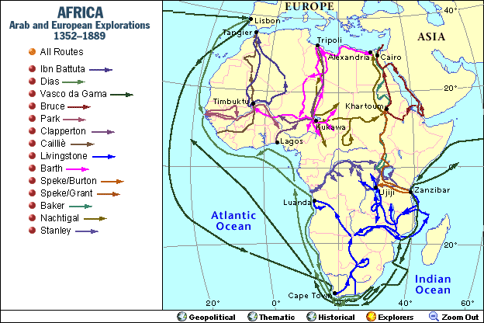
European Explorers in Africa
19c → Europeans Map the Interior of Africa

Slide 9
2. Imperialism
Prior to European domination, African people were divided into hundreds of ethnic and linguistic groups and continued to follow traditional beliefs
Some converted to Islam and Christianity
Due to industrialization, Europeans competed for new markets to buy goods
This led to European imperialism in Africa in the 19th and 20th centuries
Imperialism: the seizure of a country or territory by a stronger country
Disease and African armies had discouraged European exploration in the past
Humanitarians, explorers, and missionaries who were against the Atlantic Slave Trade were allowed to travel to the interior

Slide 10
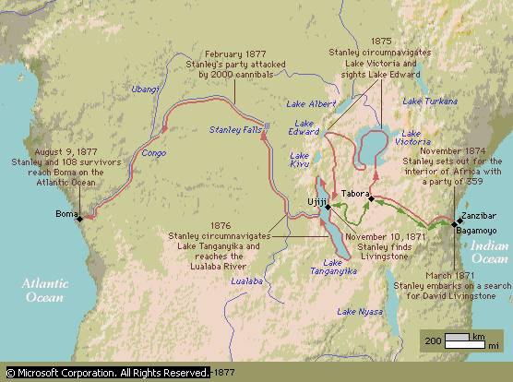
European Explorations in mid-19c: “The Scramble for Africa”

Slide 11
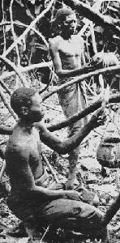
Harvesting Rubber

Slide 12
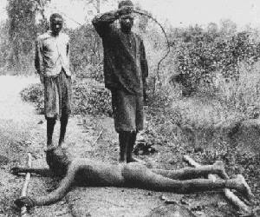
Punishing “Lazy” Workers

Slide 13
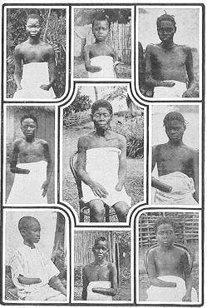
5-8 Million Victims! (50% of Population)
It is blood-curdling to see them (the soldiers) returning with the hands of the slain, and to find the hands of young children amongst the bigger ones evidencing their bravery...The rubber from this district has cost hundreds of lives, and the scenes I have witnessed, while unable to help the oppressed, have been almost enough to make me wish I were dead... This rubber traffic is steeped in blood, and if the natives were to rise and sweep every white person on the Upper Congo into eternity, there would still be left a fearful balance to their credit. -- Belgian Official

Slide 14
The Age of Imperialism in Africa
Social Darwinism
National pride led to the desire for more colonies
Europeans viewed an empire as a measure of national greatness
Simply put: Europeans believed they were better than other peoples; racism
Based on Charles Darwin’s “Survival of the Fittest,” European attitudes were a reflection of a social theory known as Social Darwinism
Essentially they believed those who were the fittest for survival enjoyed wealth and success and were considered superior to others
This colonization push also came from missionaries looking to spread Christianity
Railroads, maxim gun, and quinine for malaria helped Europeans push into Africa

Slide 15
“The White Man’s Burden”
Take up the White Man’s burden—
Send forth the best ye breed—
Go send your sons to exile
To serve your captives' need
To wait in heavy harness
On fluttered folk and wild—
Your new-caught, sullen peoples,
Half devil and half child
Take up the White Man’s burden

Slide 16
The Age of Imperialism in Africa
The Berlin Conference
The discovery of diamonds in 1867 and gold in 1886 in South Africa increased European interest in colonization
To prevent war, 14 European nations met at the Berlin Conference in 1884-85 to lay down rules for the division of Africa
They agreed that any European nation could claim land by notifying other nations and showing they could control that land
Very little thought was given to how the African groups would react
No African ruler was invited
By 1914, only Liberia and Ethiopia remained free of European control

Slide 17
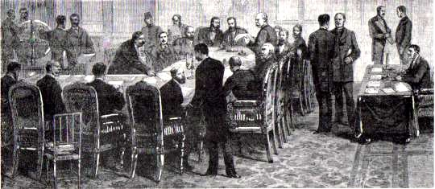
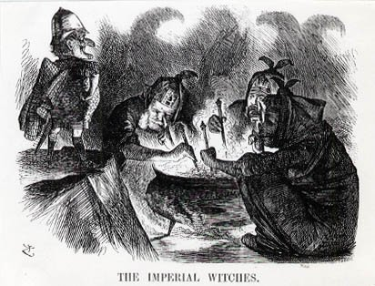
Berlin Conference of 1884-1885
Another point of view? →

Slide 18
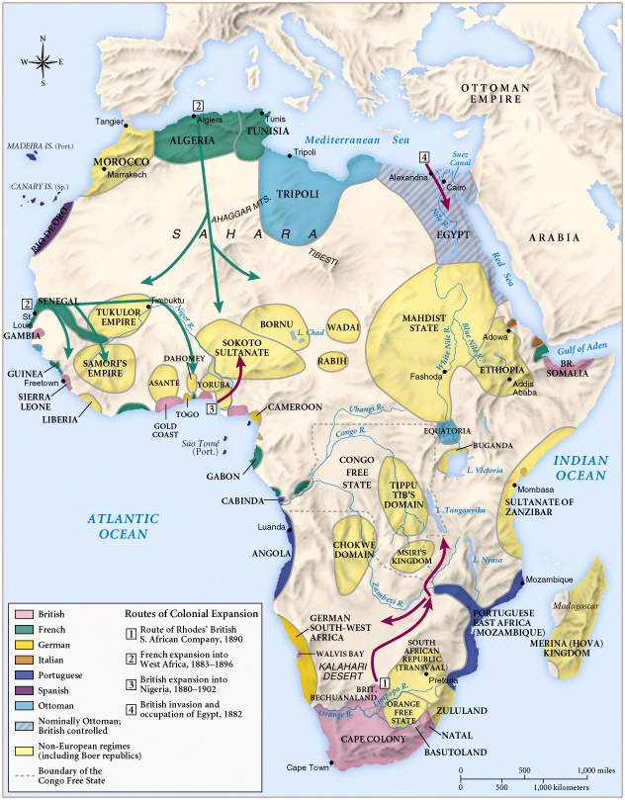
Africa
1890

Slide 19
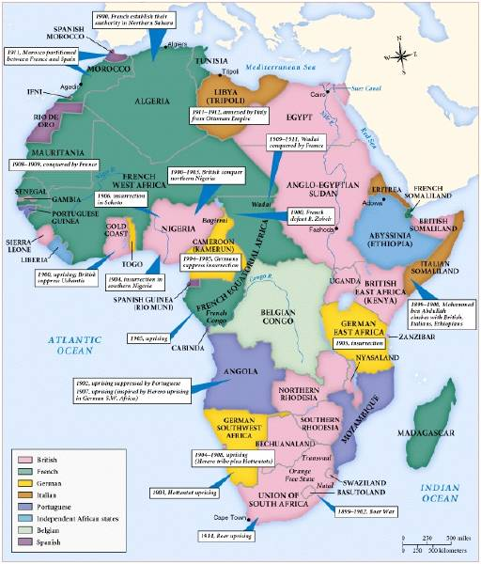
Africa
in
1914

Slide 20
The Age of Imperialism in Africa
Clash over South Africa
The Zulus under leader Shaka fought bravely against the British
Zulus almost win but the Zulu nation fell to Britain in 1887
Dutch settlers known as Boers settled the Cape of Good Hope in 1652
Fought the British when the British took over
Led to the Boer War between the British and the Boers
Britain finally won and created the Union of South Africa in 1910

Slide 21
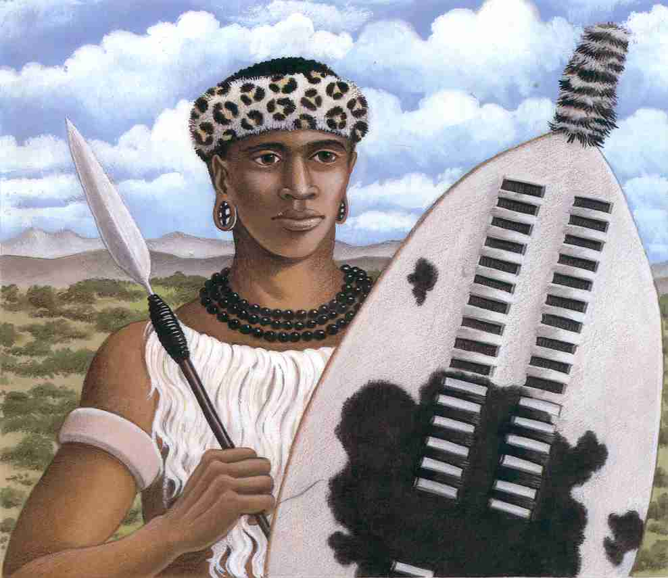
Shaka Zulu (1785 – 1828)

Slide 22
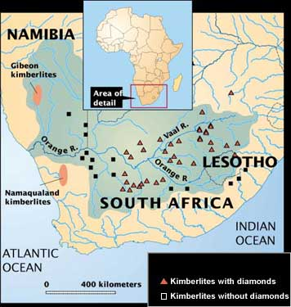
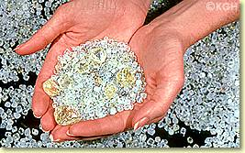
Diamond Mines
Raw Diamonds

Slide 23
The Age of Imperialism in Africa
Legacy of Colonial Rule
Negative Effects
Africans lost control of their lands and their independence
Many died of smallpox
Thousands died resisting European rule
Traditional culture broke-down
Division of Africa combined or unnaturally divided groups
Valuable goods such as gold, salt, and diamonds were taken out of the continent as well as the profit that was made

Slide 24
The Age of Imperialism in Africa
Positive Effects
Reduced local warfare
Sanitation was provided; hospitals & schools built
Life spans and literacy rates increased
Railroads, dams, and telephone/telegraph wires were built; mostly benefitted Europeans

