Slide 1
Human Rights

Slide 2
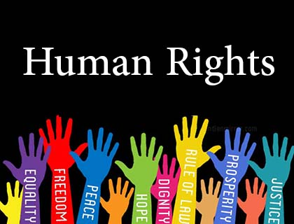
What are Human Rights?
The rights that all people have by being human beings, whatever our nationality, place of residence, sex, national or ethnic origin, color, religion, language, or any other status

Slide 3
UN Declaration of Human Rights
UN Declaration of Human Rights was signed in 1948
This was a reaction to the carnage of World War II and the Holocaust

Slide 4
5 Types of Human Rights
Civil
Political
Economic
Social
Cultural

Slide 5
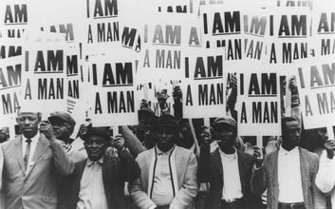
Civil Rights
The right to be treated like anyone else in society
Examples:
-Life
-Opinion
-Free Speech
-Marry
-Non-discrimination based on Race, Religion, Culture, Gender or Sexual Orientation

Slide 6
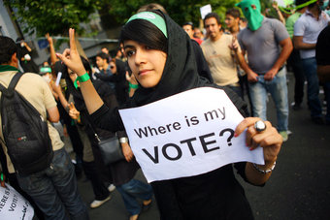
Political Rights
The right to vote, to freedom of speech, and to obtain information
Examples
Voting in elections
Joining political organization or parties freely
Live in an independent country
Freely disagree with government

Slide 7
Economic Rights
The right to participate in an economy that benefits all; and to desirable work
Examples:
Jobs
Fair wage
Create trade unions
Safe working conditions

Slide 8
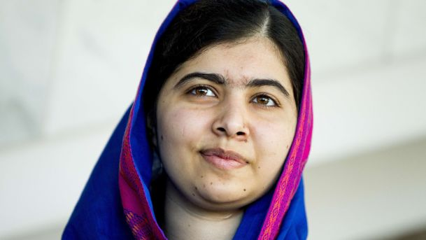
Social Rights
Right to education, healthcare, food, clothing, shelter, and security
Examples
Housing
Education
Clean environment
Health services

Slide 9
Cultural Rights
The right to freedom of religion and to practice the culture of one’s choice
Examples:
Develop own kind of schooling
Develop cultural activities

