Slide 1
Do Now
Today we are finishing Unit 6 by going over the Holocaust
Pick up the reading from the front table and complete this so we can get into it

Slide 2
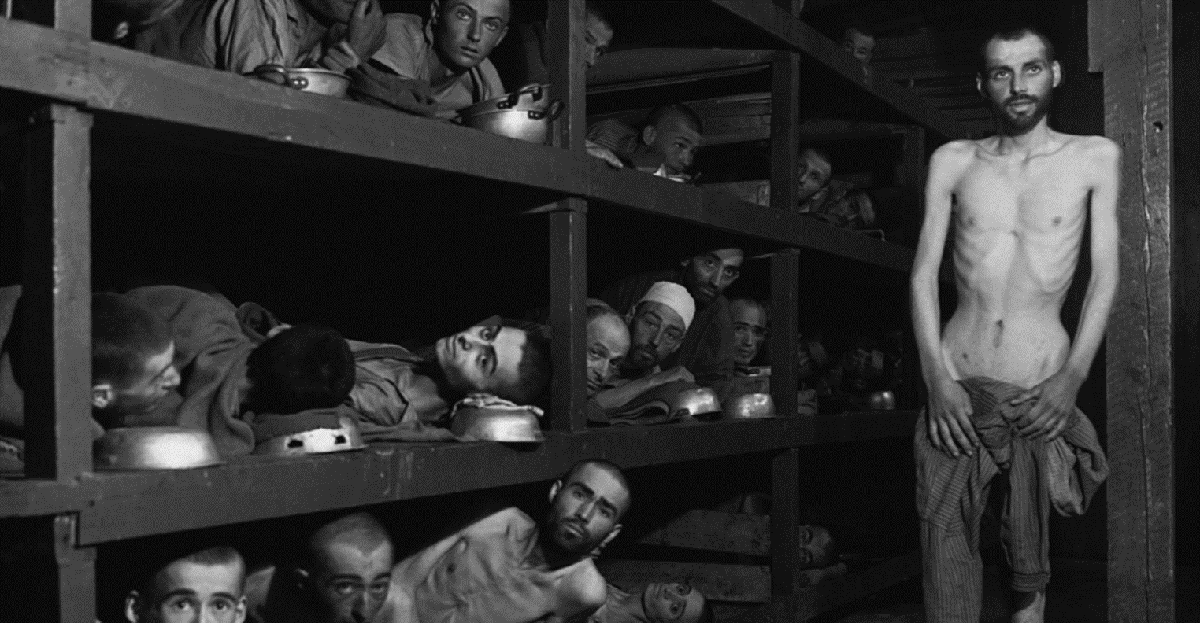
The Holocaust

Slide 3
Hitler’s Speech About Jews
https://www.youtube.com/watch?v=_0V_xf3OQgM

Slide 4
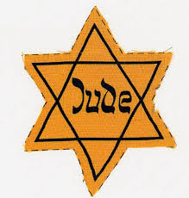
Anti – Semitism
Against / Not
Judaism / Jewish people
prejudice against, hatred of, or discrimination against Jews as a national, ethnic, religious or racial group

Slide 5
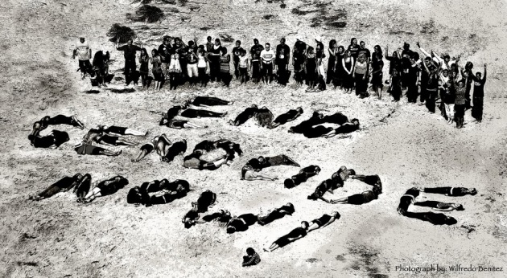
Genocide
the deliberate killing of a large group of people, especially those of a particular ethnic group or nation

Slide 7
“Work will make you free.”

Slide 17
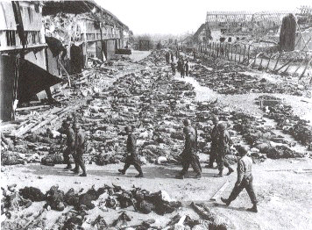

Slide 20
“Never Shall I Forget” – Elie Wiesel
Never shall I forget that night, the first night in camp, that turned my life into one long night seven times sealed.
Never shall I forget that smoke.
Never shall I forget the small faces of the children whose bodies I saw transformed into smoke under a silent sky.
Never shall I forget those flames that consumed my faith for ever.
Never shall I forget the nocturnal silence that deprived me for all eternity of the desire to live.
Never shall I forget those moments that murdered my God and my soul and turned my dreams to ashes.
Never shall I forget those things, even were I condemned to live
as long as God Himself.
Never.

Slide 21
Jewish Deaths
Polish-Soviet area | 4,565,000
Germany | 125,000
Austria | 65.000
Czechoslovakia (in the pre-Munich boundaries | 277,000
Hungary, including northern Transylvania | 402,000
France | 83,000
Belgium | 24,000
Luxembourg | 700
Italy | 7,500
The Netherlands | 106,000
Norway | 760
Romania (Regat, southern Transylvania, southern Bukovina) | 40,000
Yugoslavia | 60,000
Greece | 65,000
Total Loss | 5,820,960

Slide 22
Zanne Farbstein (Auschwitz Survivor)
https://www.youtube.com/watch?v=YWg47sLwlHk&list=PLA5747AFF7EB459EB

Slide 23
Arnold Ropeik (WWII Veteran)
http://www.history.com/topics/world-war-ii/the-holocaust/videos

Slide 24
Nuremberg Trials
Those responsible for the crimes committed during the Holocaust were brought to trial in Nuremberg, Germany
12 prominent Nazis were put to death while many others received short prison sentences or no punishment at all

Slide 25
United Nations Formed
After World War II, the United Nations (UN) was formed to replace the ineffective League of Nations to prevent another such conflict
The UN’s purpose is to maintain international security and peace and to promote human rights
There are currently 193 countries in the UN

