Slide 1
Gupta Empire

Slide 2
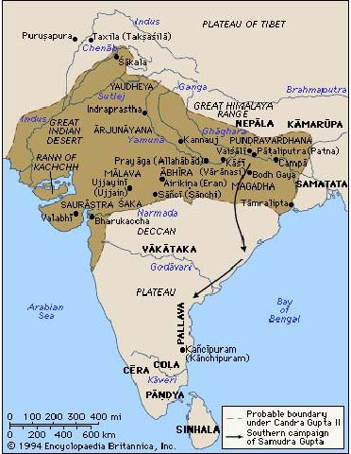
Gupta Empire Overview
Gupta Empire came to power in India in 320 CE.
Ended in 550 C.E.
Facilitated the strengthening of Hinduism as a religion in India.
Known as the “Golden Age” of India.

Slide 3
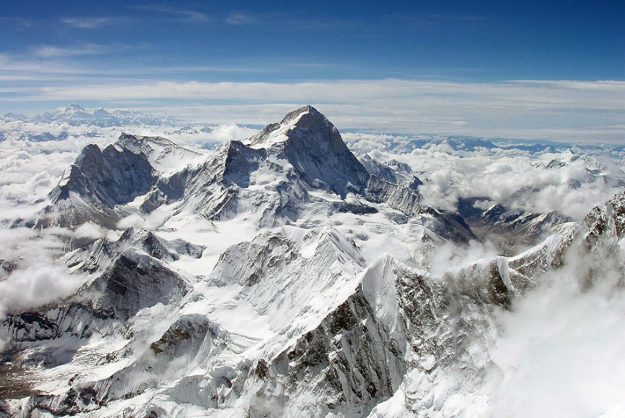
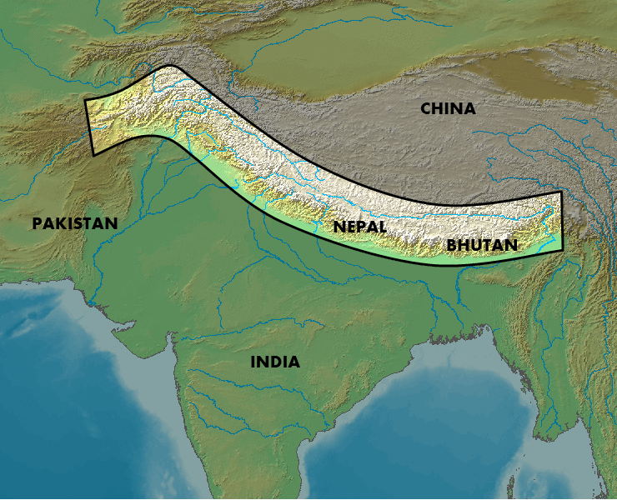
Geography
Gupta Empire rose in the North of India and spread southward.
The Himalayas and Kush mountains helps protect the civilization from invaders.
The Ganges and Indus rivers provided water and fertile soil.
Hot and Humid climate with monsoons.

Slide 4
Government
Gupta emperor ruled over a court in Pataliputra.
Very efficient central government.
Allowed Trade to prosper because of a stable background.
Local leaders had power.
In each village they had a headman and council to make decisions.
At first, women could serve on council ….Then restriction by Hindu law excluded their participation

Slide 5
Caste System
No movement up and down the system in your lifetime

Slide 6
Village and Family Life
Village Life
Family Life
Cluster of homes surround by fields for farming.
Village ran their own affairs with little interference from empire as long as they pay taxes.
Ran by caste system which created stability
Wealthier person lived in joint families where all the family shared a home.
They were Patriarchal, which means the eldest male was the leader.
Arrange marriage of children.
Only marry within their own caste.

Slide 7
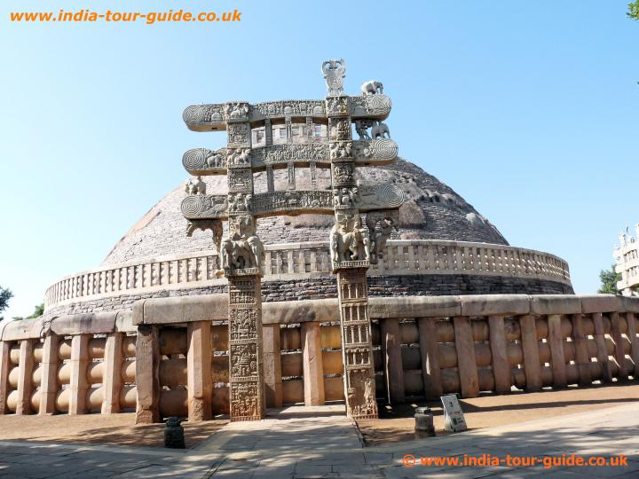
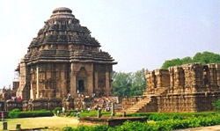
Scientific and Artistic Contributions
Architects built stone temples for worships and Buddhist build stupas.
Science
Artistic
Education took place in Hindu and Buddhist school.
Student learned math, medicine, physics languages.
Indian Mathematics developed the concept of 0 and decimal system.
Surgeons vaccinated people from smallpox .

Slide 8
1. After the fall of Rome, the eastern portion of the Roman empire became known as the
A. Persian empire.
B. Byzantine empire.
C. Mongol empire.
D. Gupta empire.

Slide 9
2. The golden ages of the Tang Dynasty in China, the Gupta Empire in India, and the city-state of Athens in Greece were known as eras of
A. major industrial development.
B. intense nationalism.
C. economic poverty and intellectual upheaval.
D. artistic and intellectual achievement.

Slide 10
4. Which group had the greatest influence on early Russian culture?
A. Franks
B. Ottoman Turks
C. Byzantine empire
D. Roman Catholic Church

Slide 11
5. Hammurabi's Code, the Twelve Tables, and the Justinian Code are examples of early developments in the area of
A. literature.
B. law.
C. engineering.
D. medicine.

Slide 12
6. A study of the Byzantine civilization would show that this civilization
A. collapsed as a result of Germanic invasions of the early Middle Ages.
B. preserved Greek and Roman learning and passed it on to western and eastern Europe.
C. based its economy on subsistence farming and slash-and-burn agriculture.
D. reduced the influence of the Eastern Orthodox Church.

Slide 13
8. Which religion had a strong impact on all areas of Gupta life?
Buddhism
Christianity
Hinduism
Confucianism

Slide 14
9. The Gupta government is best characterized by:
One strong ruler with absolute power
A democracy run by the people
A combination of a strong central government and local power
Confucian thought

