Slide 1
Warm Up
In your warm up books, list at least one achievement or innovation from each of the four ancient river valley civilizations:
Mesopotamia
Egypt
China
Indus River Valley
Use your homework from last night to help you

Slide 2
Classical Civilizations: Greece and Rome

Slide 3
Geography of Greece (1750 B.C. – 133 B.C.)
Greece is a peninsula about the size of Louisiana in the Mediterranean Sea.
Extremely mountainous, many small islands (difficult to unify)
Because of this, Greece developed as a collection of city-states (“polis”)

Slide 4
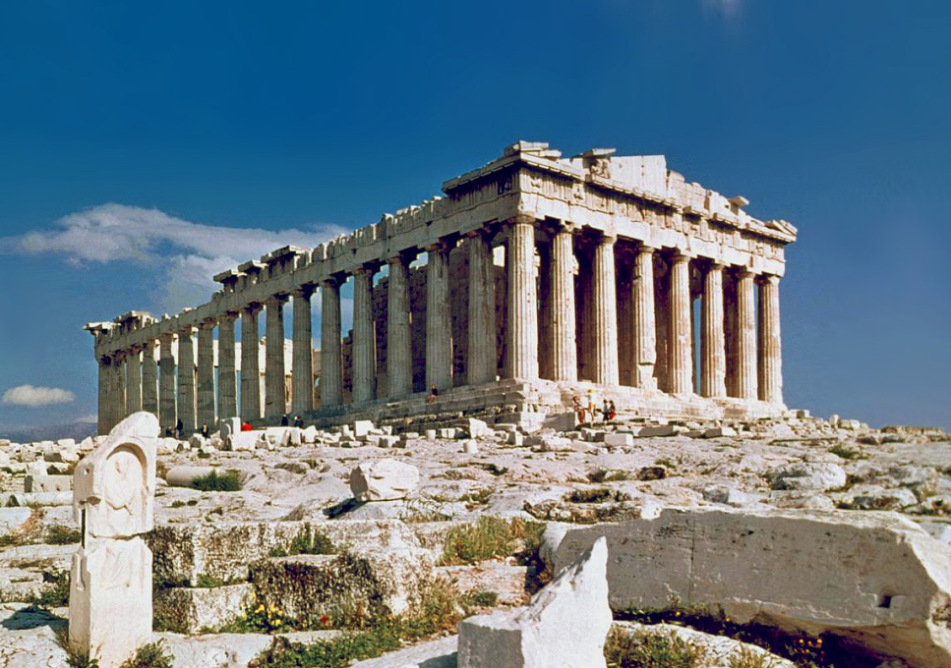
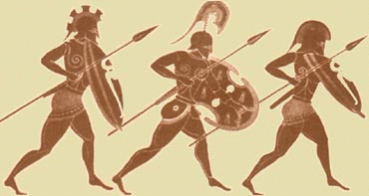
City-States (“polis”)
The two most famous Greek city-states were:
Athens
Sparta

Slide 5
Athens and Sparta

Slide 6
Common Features of Athens and Sparta
Common language
Shared heroes
Olympic games
Same gods and religious beliefs

Slide 7
Athens
Created the first democracy (type of government where people vote); this was known as direct democracy and was a form of limited democracy
The U.S. has a representative democracy, where we vote for people to make decisions for us
Athens valued education, literature, art, mathematics, architecture, science, and philosophy
Traded extensively with other city-states
Excellent education for boys, but not for women

Slide 8
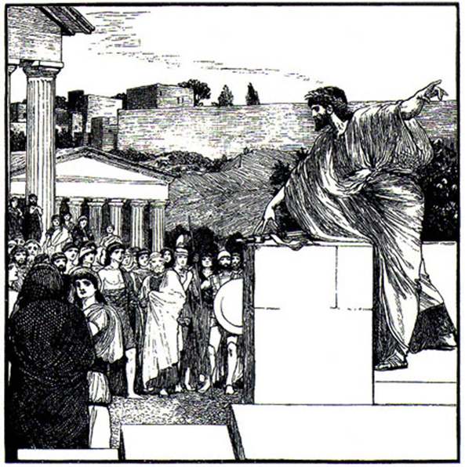
Direct Democracy
“Direct participation was the key to Athenian democracy. In the Assembly, every male citizen was not only entitled to attend as often as he pleased but also had the right to debate, offer amendments, and vote on proposals. Every man had a say in whether to declare war or stay in peace. Basically any thing that required a government decision, all male citizens were allowed to participate in.”

Slide 9
Remember! If you think the U.S. is so much better…
Some southern states did not let African Americans vote until the 1960s (Voting Rights Act 1965)
Women could not vote in the U.S. until 1920 (19th Amendment)
Eighteen year olds could not vote until the late 1970s

Slide 10
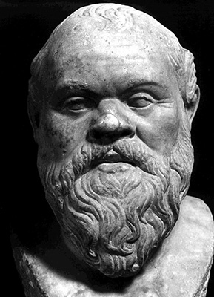
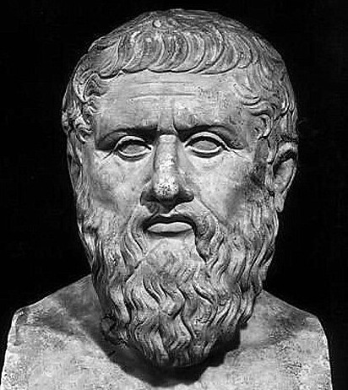
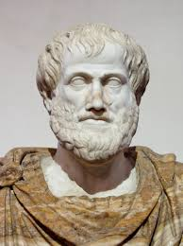
Greek Philosophers
Socrates
Plato
Aristotle
Socratic Method
Learning by asking questions
Government put him to death
Believed government should control people’s lives
3 classes: workers, philosophers, and soldiers
Believed in one strong and good ruler
People learned through reason

Slide 11
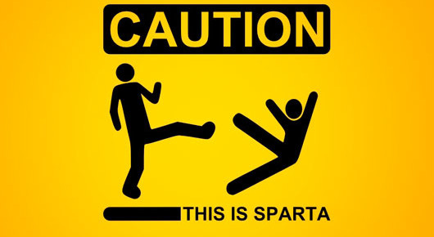
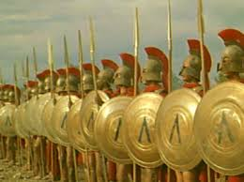
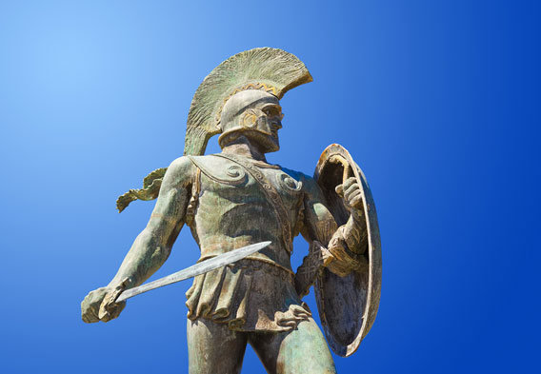
Sparta
Monarchy with two kings
Warrior society
From an early age, boys trained for a lifetime in the military
Trade and travel were not allowed
Women were inferior to men, but were allowed to own property (why do you think this was?)

Slide 12
Greek Achievements and Contributions
First form of democracy (Athens)
Paintings and statues
Plays and poems
Advanced battle tactics
Discovered the Earth rotates around the sun
Advancements in medicine and mathematics

Slide 13
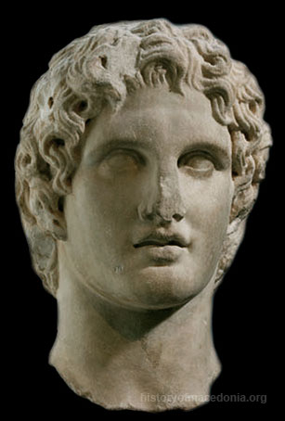
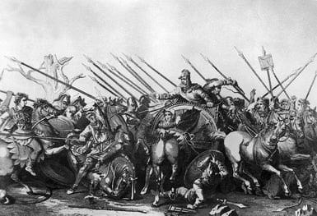
Alexander the Great (Or Not So Great?)
Son of Phillip of Macedonia who conquered Greece
Built an extensive empire that included Egypt, Persia, and part of India
Spread Greek culture

Slide 14
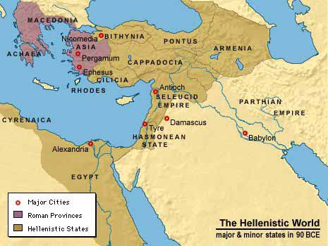
Hellenistic Age
Hellenistic culture arose that blended aspects of Greek, Persian, Egyptian, and Indian life in the areas that Alexander the Great took over
Gave more rights and opportunities to women

Slide 15
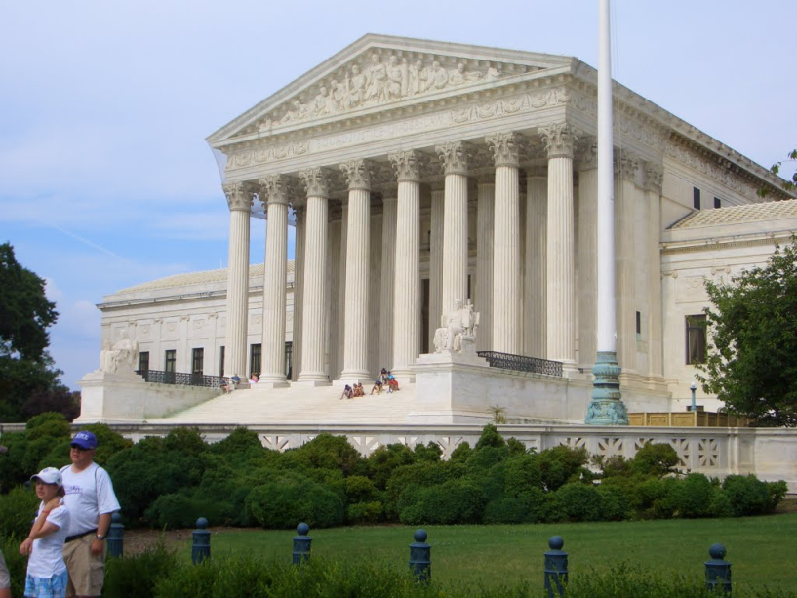
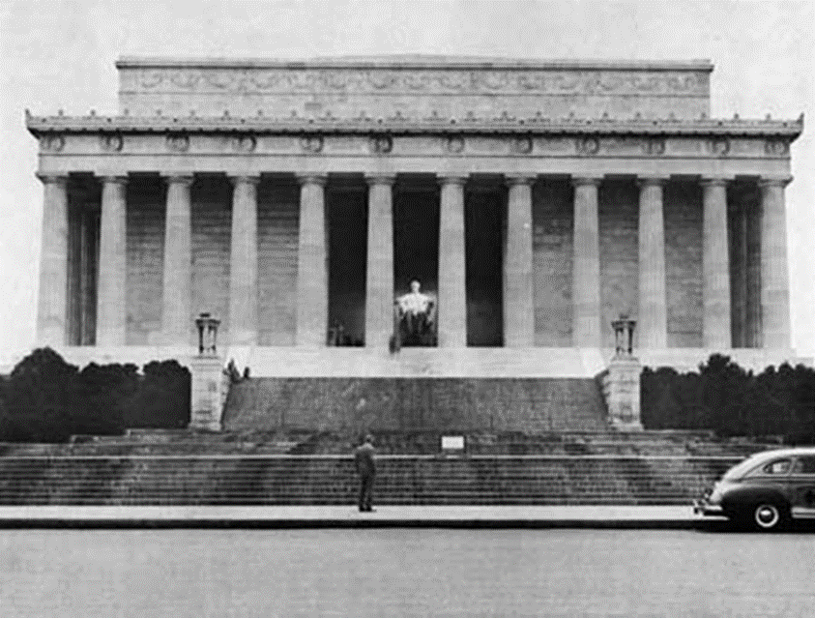
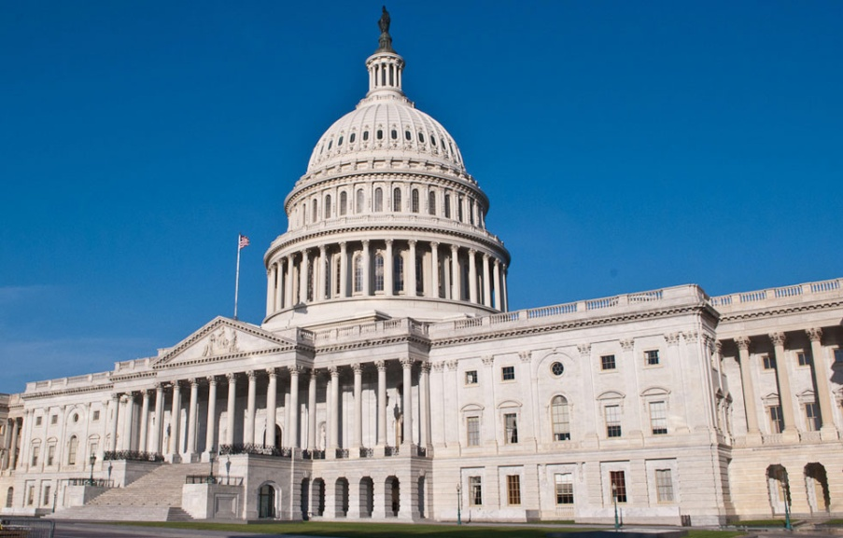
Hellenistic Architectural Influences in the U.S.
Supreme Court
Smithsonian Museum
Lincoln Memorial
Capitol Building

