Slide 1
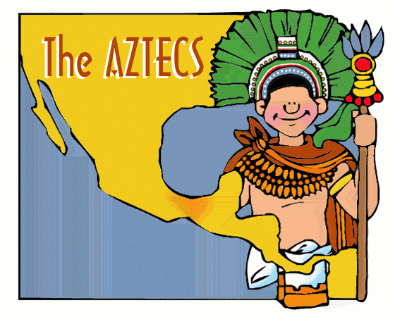
Mesoamerica
Outcome: The Aztecs

Slide 2
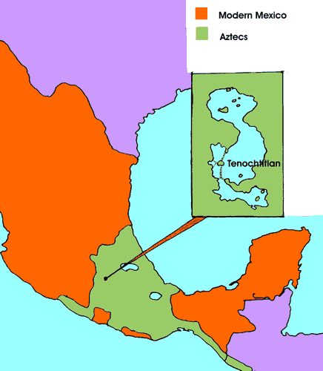
The Aztecs

Slide 3
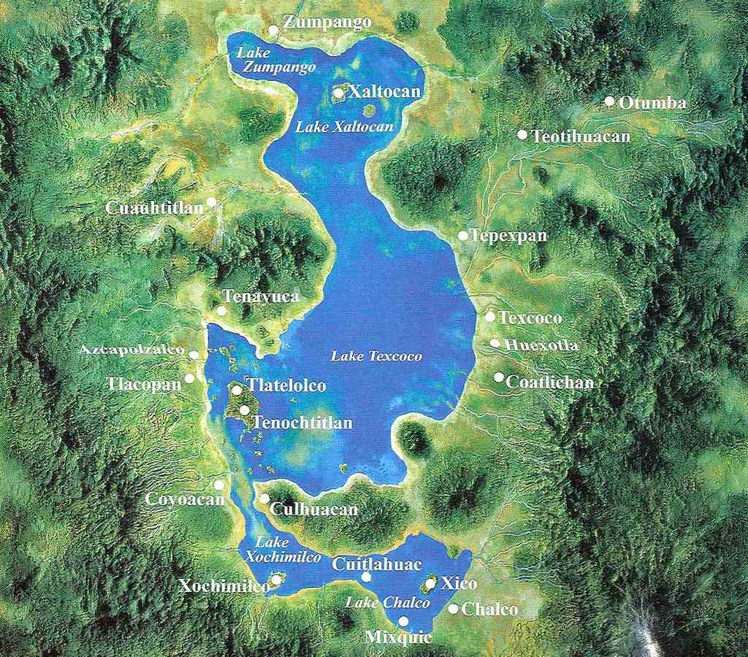
The Aztecs
Environment
Valley of Mexico
7,500 ft above sea level
Fertile soil
Several shallow lakes
Lake Texcoco

Slide 4
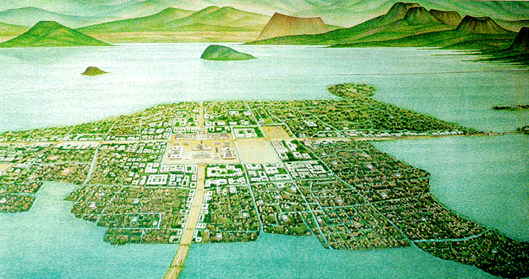
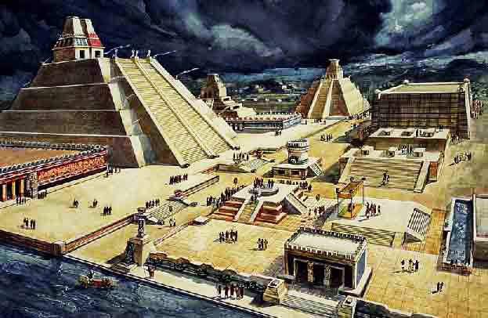
The Aztecs
Cities
Teotihuacan
Tenochtitlan

Slide 5
The Aztecs
Lang/Writing
Pictographs or glyphs
Not a complete writing system that can communicate all things
Most codices were burned by Spanish clergy

Slide 6
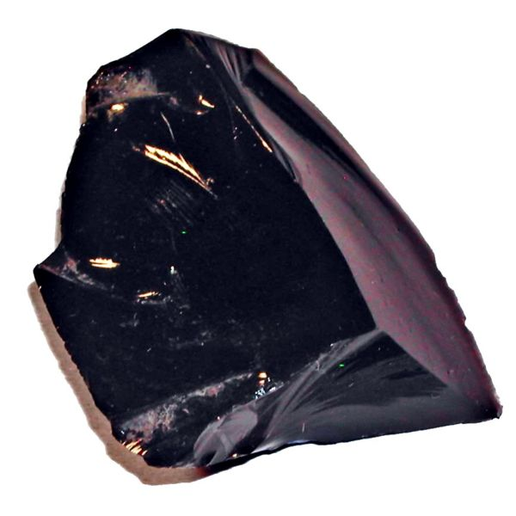
The Aztecs
Economy
Demanded tribute from those they conquered
Traded Obsidian

Slide 7
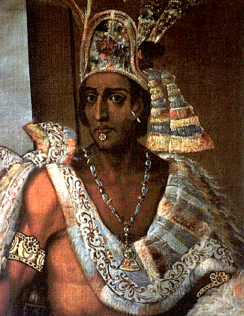
The Aztecs
Gov’t
Created Triple Alliance with:
Texcoco
Tlacopan
Emperor at the top – absolute power
Power weakens under Montezuma

Slide 8
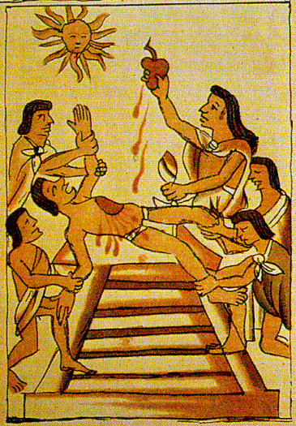
The Aztecs
Religion
Polytheistic – over 1,000 gods
Offerings to the gods:
Dramas
Songs
Dances
Sacrifice to the Sun God- cut out human hearts

Slide 9
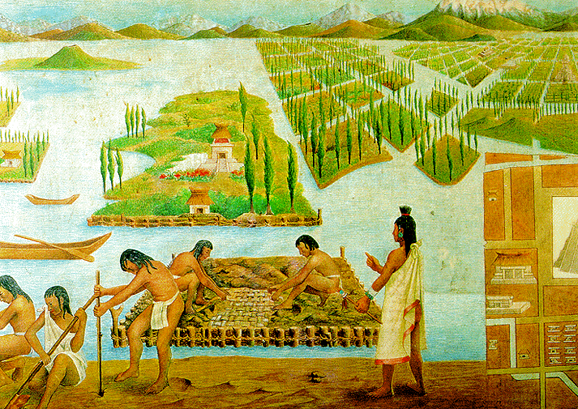
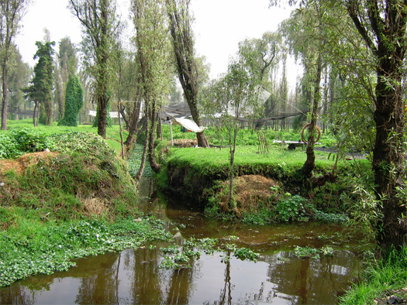
The Aztecs
Achievements
2 main calendars
Planned city of Tenochtitlan
Causeways or bridges to city
Chinampas: floating gardens

