Slide 1
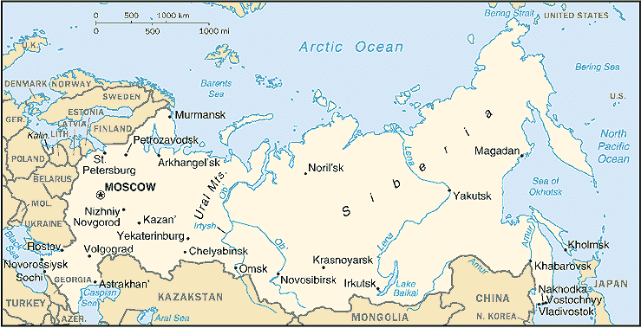
ABSOLUTISM IN RUSSIA
The driving force behind Russia’s rise to power was Ivan III (Ivan the Great). He built the framework for absolute rule in Russia, which would only get worse.

Slide 2
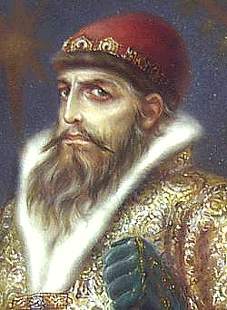
Ivan the Terrible
Country: Russia
Years: 1533 - 1584
Achievements: Introduced extreme absolute power, expanded Russian lands, made Russia more religious.
Downfalls: Set up the first Russian secret police, the Oprichniki, who murdered thousands for him. He killed many nobles and destroyed many towns, and even killed his own son in a fit of rage.

Slide 3
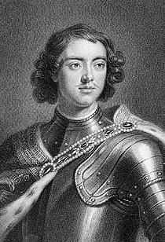
Peter the Great
Country: Russia
Years: 1682 - 1725
Achievements: Westernization, St. Petersburg, modern army, new industries, education, warm water port (Baltic Sea), extended borders, unified the nation, reduced power of nobility, gained control of Russian Orthodox Church.
Downfalls: Did not reach Black sea, reforms died with him.

Slide 4
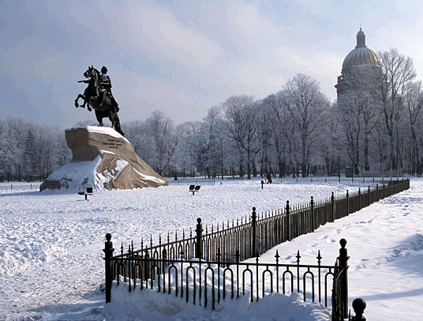

Slide 5
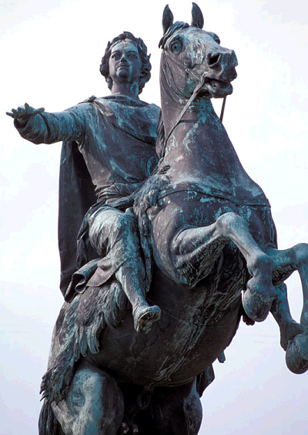

Slide 8
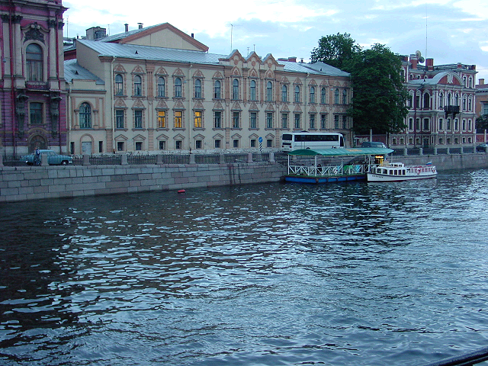

Slide 13
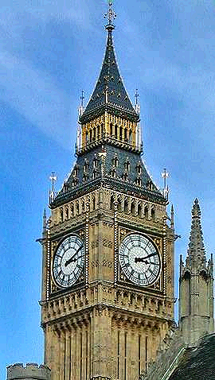
ABSOLUTISM
IN ENGLAND
While other nations turned to absolutism in the 1500s and 1600s, England’s Parliament resisted the throne.

Slide 14
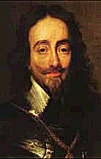
Charles I
Country: England
Years: 1625 -1649
Achievements: Strong army, seized nations.
Downfalls: He put his enemies in prison without trials, high taxes, angered Puritans, he dissolved Parliament and had to call them back because he needed the money. This led to the English Civil War. He was put on trial and beheaded by Parliament in 1649.

Slide 15
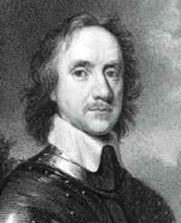
Oliver
Cromwell
Cromwell was the skilled military commander who won the civil war and captured Charles
Charles I was the first king ever to be tried and executed by his own subjects
This event shocked other European monarchies and signified that absolutism would not be tolerated in England

Slide 16
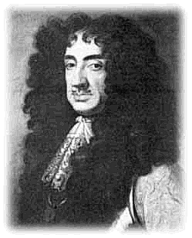
Charles II
Country: England
Years: 1660 - 1685
Achievements: Was asked to take the throne after several years of Puritan rule. He reopened theatres, dancing, and music.
Downfalls: Obeyed Parliament, limited monarchy, limited power.
Limited Monarchy - a government in which a legislative body limits the monarch’s powers.

Slide 17
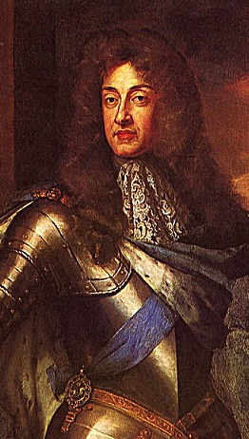
James II
English Bill of Rights – a set of acts passed by Parliament to ensure its superiority over the monarchy. It stated:
King must work with Parliament
House of Commons has financial control
Abolished excessive fines and cruel and unusual punishment
Affirmed habeas corpus – no person could be held in jail without first being charged with a crime.

Slide 18
Summary
Through the 1500s and 1600s absolutism became dominant through much of Europe and parts of Asia. In Spain, France, and Russia, absolutist monarchs claimed that they ruled by divine right and sought to extend their political power. While other nations accepted absolutism, England stood as a contrast to this trend. After the Puritan Revolution and the Glorious Revolution of the mid-1600s, the English Bill of Rights was passed establishing England as a limited monarchy.

