Slide 1
The Age of Absolute Monarchs

Slide 2
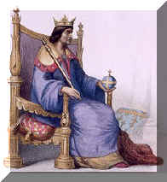
Overview
In the 1500s and 1600s, several rulers in Asia and Europe sough to centralize their political power. Claiming divine right, or authority from God, leaders such as Philip II in Spain and Louis XIV in France gained complete authority over their governments and their subjects.
England resisted the establishment of absolutism. After a civil war, England’s Parliament enacted a Bill of Rights that limited the English monarch’s powers.

Slide 3
Overview
Main Ideas:
Monarchs acted to establish absolute power
Monarchs used the divine right theory and similar ideas to justify their power
Parliament and the Puritans in England resisted absolutism
A limited monarchy was established in England

Slide 4
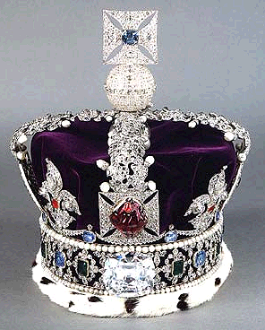
Absolutism
Absolutism: Belief that monarchs hold supreme power, and are responsible only to God.
King has all power
People have no power
Divine Right Theory: Idea that a king gets his authority to rule directly from God.
Kings gain power and centralized governments lose power

Slide 5
ABSOLUTISM IN FRANCE

Slide 6
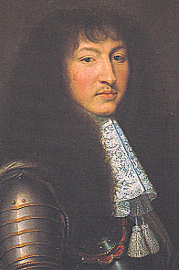
Louis XIV
Country: France
Years: 1643 – 1715 (72 years!)
Achievements: Called himself the “Sun King” and said “I am the state.” Strengthened the monarchy, expanded bureaucracy, built palace of Versailles, strongest army in Europe, made France a wealthy cultural center.
Downfalls: He used the wealth for his own benefit, peasants starved, numerous wars, never called Estates General. The French monarchy would not survive long after Louis’ death.

Slide 7
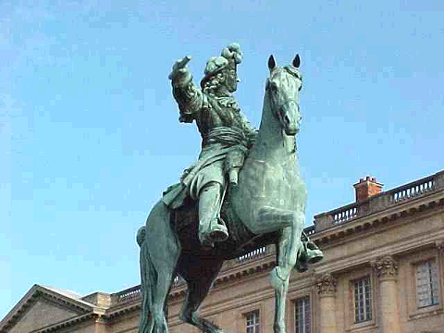

Slide 9
